Slide 1
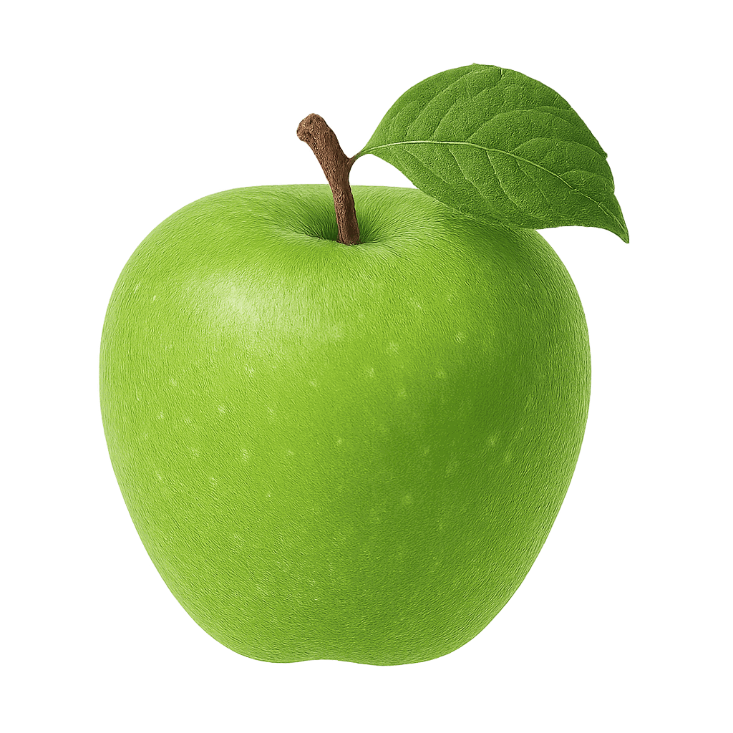
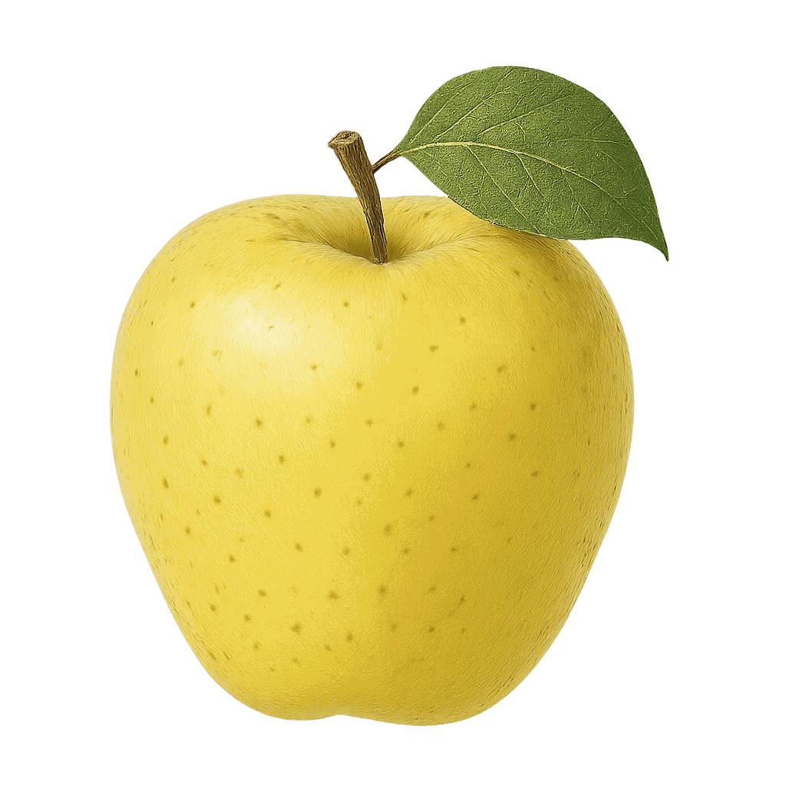
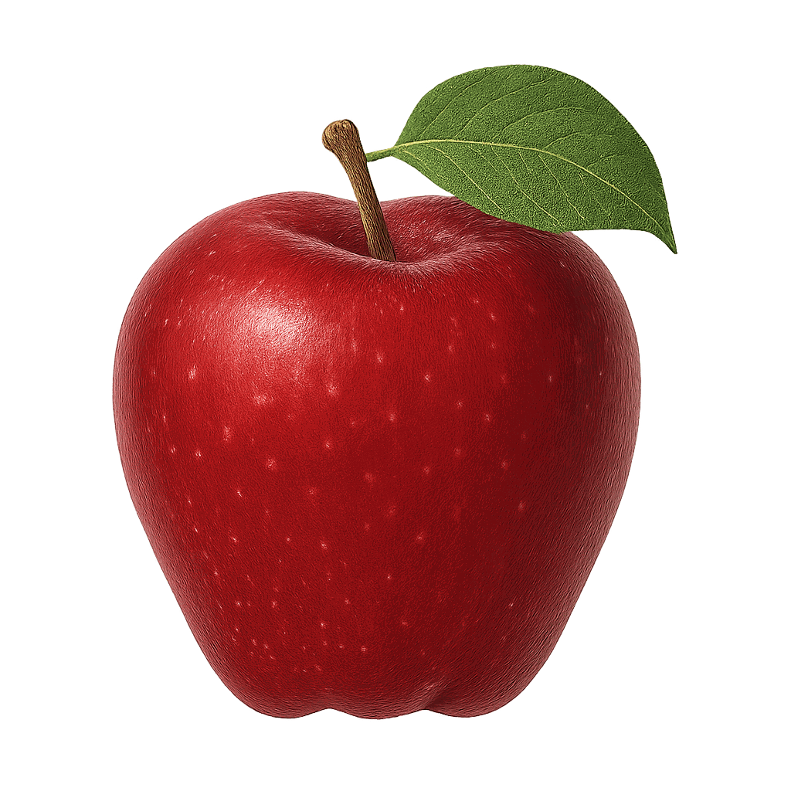
A
A
A
/a/
/a/
/a/
Notes:
🎙️ SCRIPT — read aloud:
Welcome back, everyone. This is the A-to-Z Alphabet Chant. We're going to go through every letter, one at a time, and chant the sound together. Say it out loud with me — three times each. Here's our first one. This letter is A. The sound is /aaa/. (Mouth open wide.) Listen: /aaa/… /aaa/… /aaa/, like the start of apple. Now you — /aaa/, /aaa/, /aaa/! (pause) Beautiful.

Slide 2

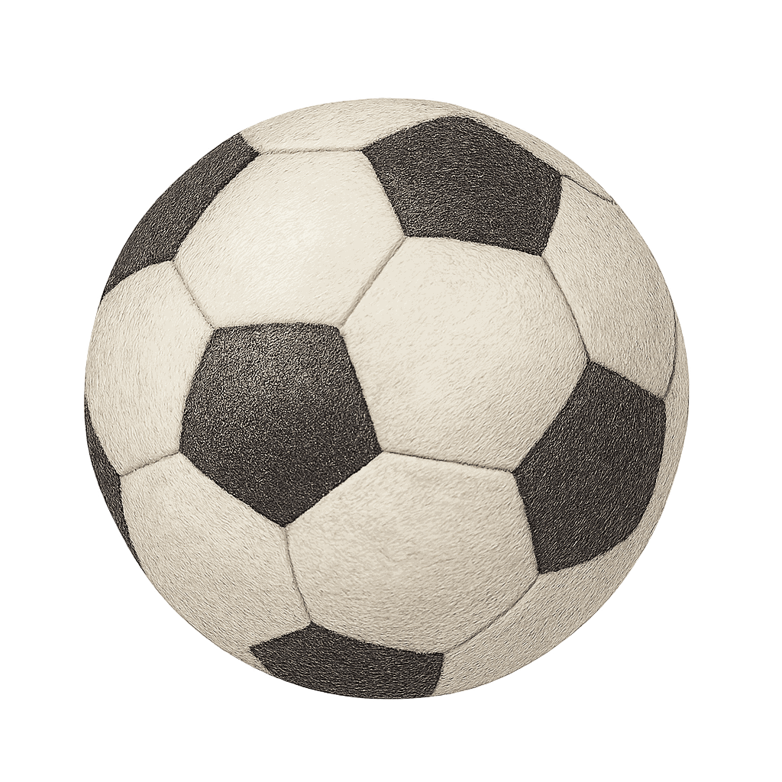
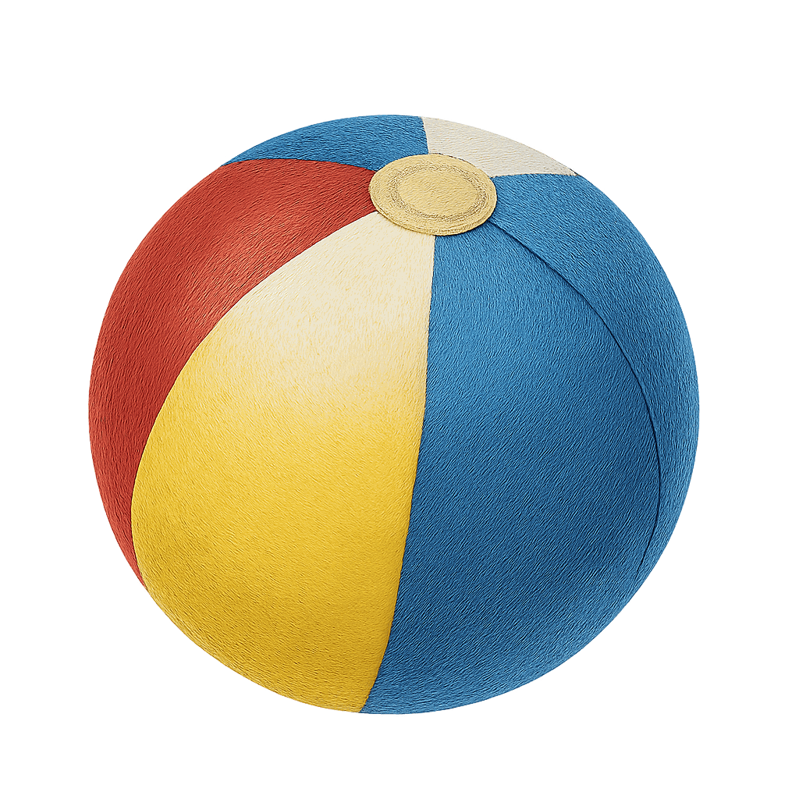
B
B
B
/b/
/b/
/b/
Notes:
🎙️ SCRIPT — read aloud:
This letter is B. The sound is /b/. (lips pop.) Listen: /b/… /b/… /b/ — like the start of ball. ball. Now just you, three times: /b/, /b/, /b/! (pause) Good.

Slide 3
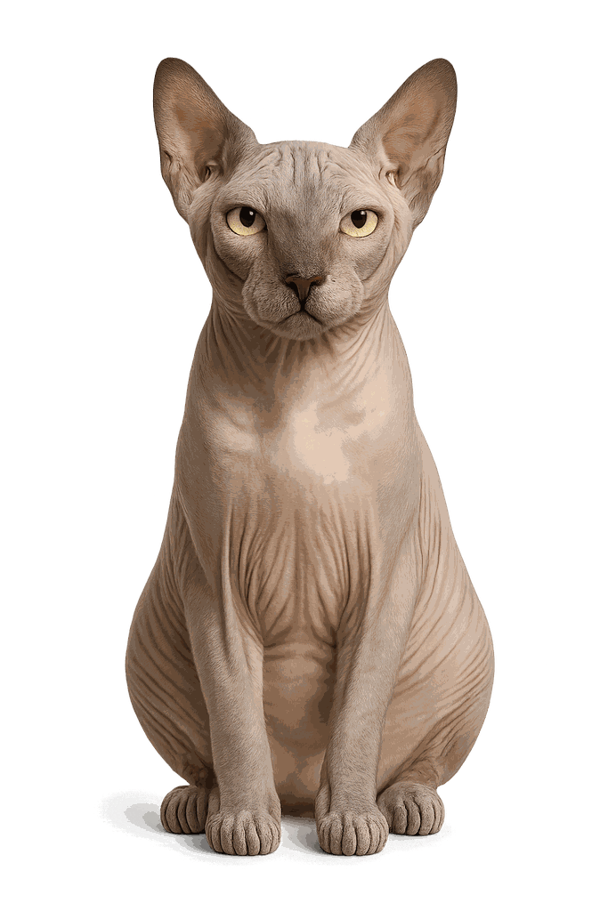
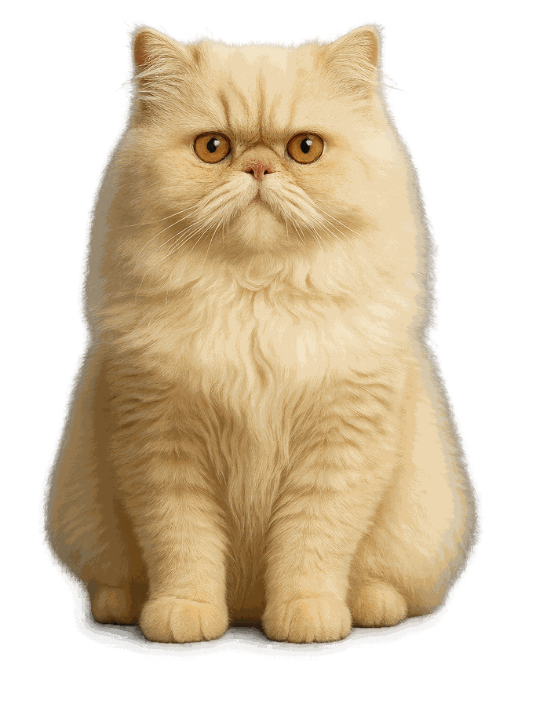
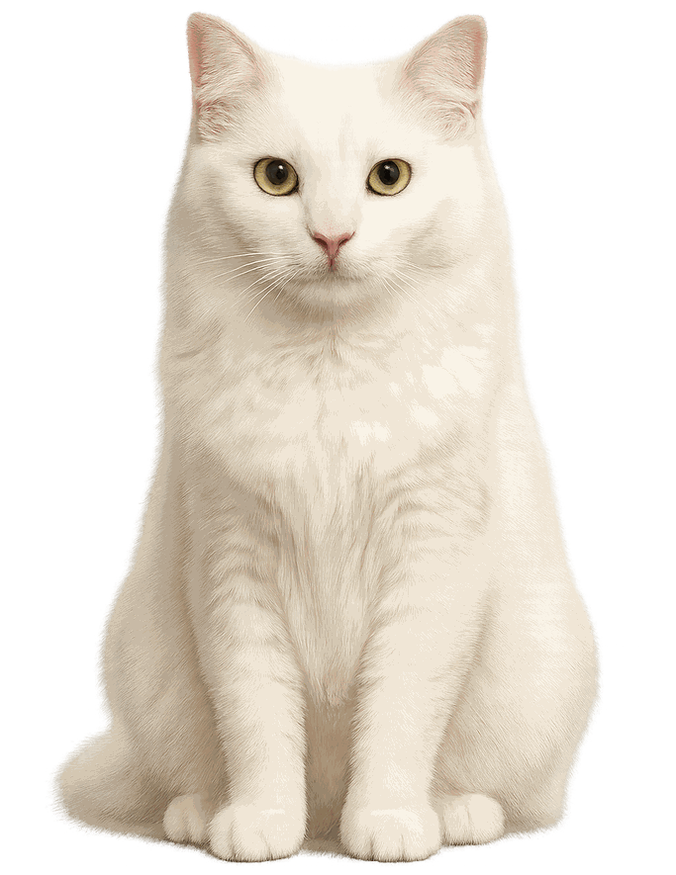
C
C
C
/k/
/k/
/k/
Notes:
🎙️ SCRIPT — read aloud:
This letter is C. The sound is /k/. (back of the throat.) Listen: /k/… /k/… /k/ — like the start of cat. cat. Now just you, three times: /k/, /k/, /k/! (pause) Good.

Slide 4
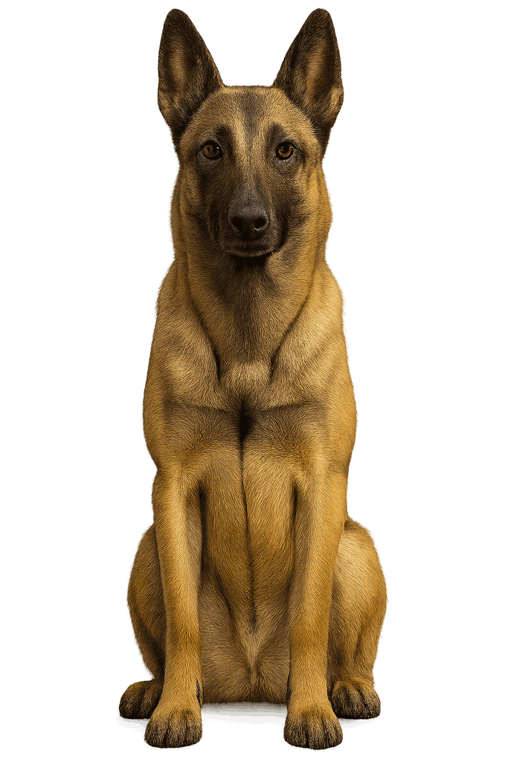
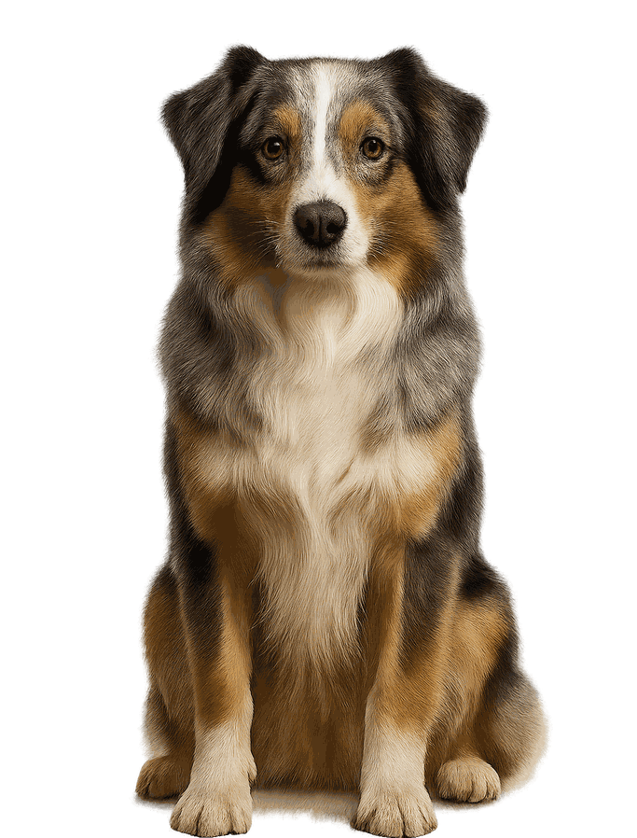
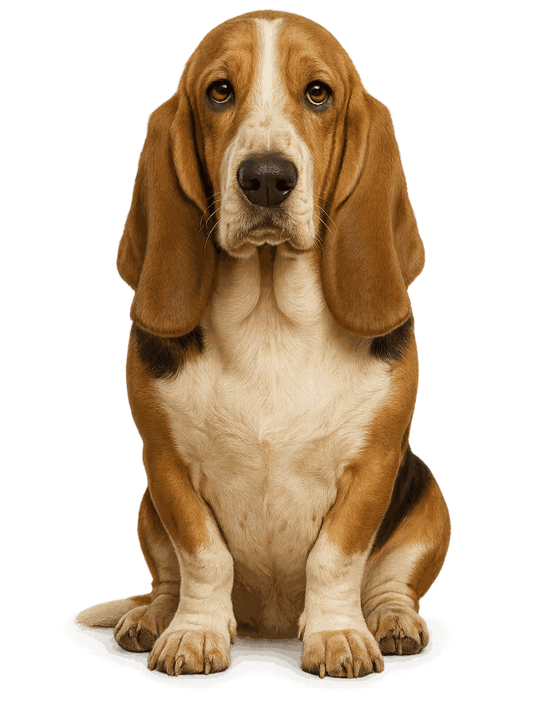
D
D
D
/d/
/d/
/d/
Notes:
🎙️ SCRIPT — read aloud:
This letter is D. The sound is /d/. (tongue taps.) Listen: /d/… /d/… /d/ — like the start of dog. dog. Now just you, three times: /d/, /d/, /d/! (pause) Good.

Slide 5
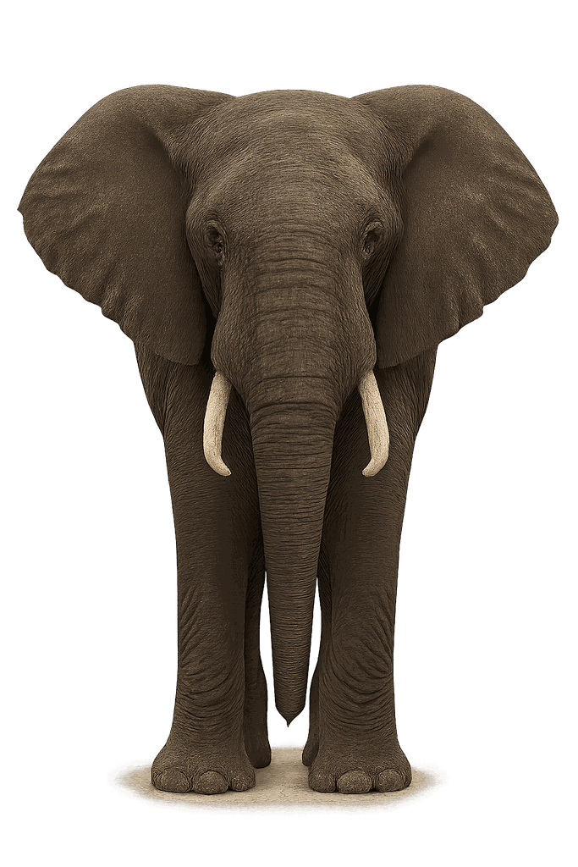
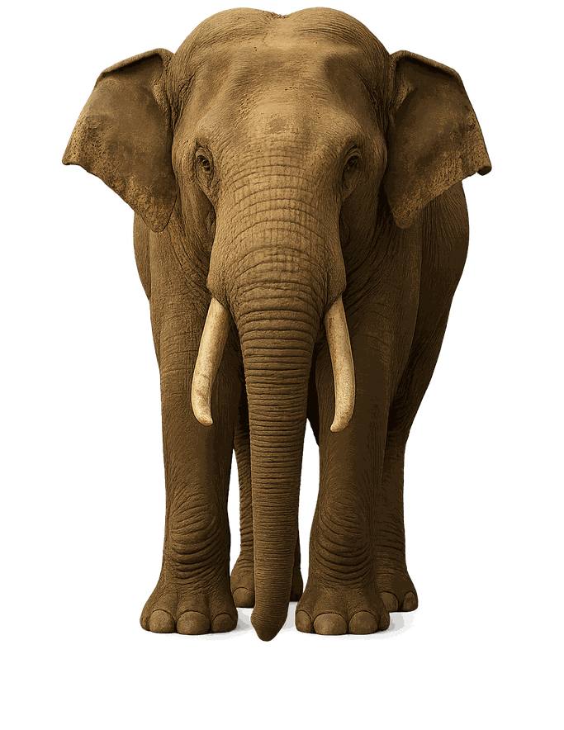
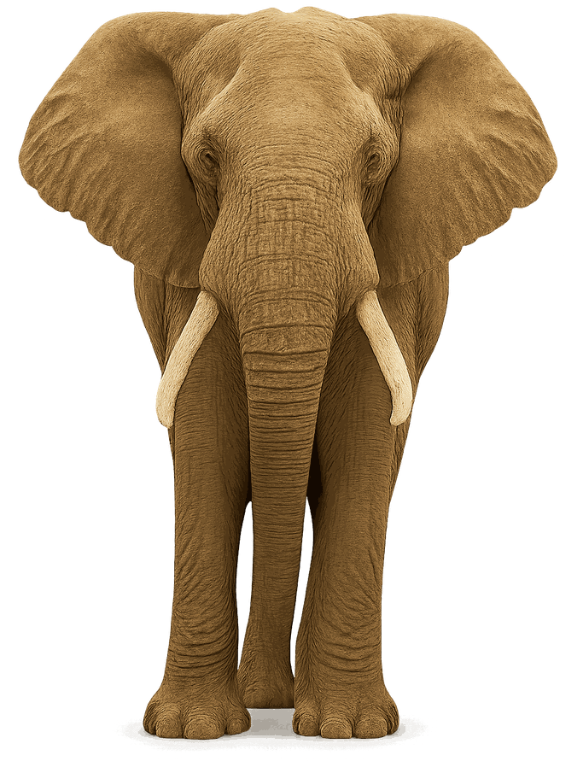
E
E
E
/e/
/e/
/e/
Notes:
🎙️ SCRIPT — read aloud:
This letter is E. The sound is /eh/. (small smile.) Listen: /eh/… /eh/… /eh/ — like the start of egg. egg. Now just you, three times: /eh/, /eh/, /eh/! (pause) Good.

Slide 6
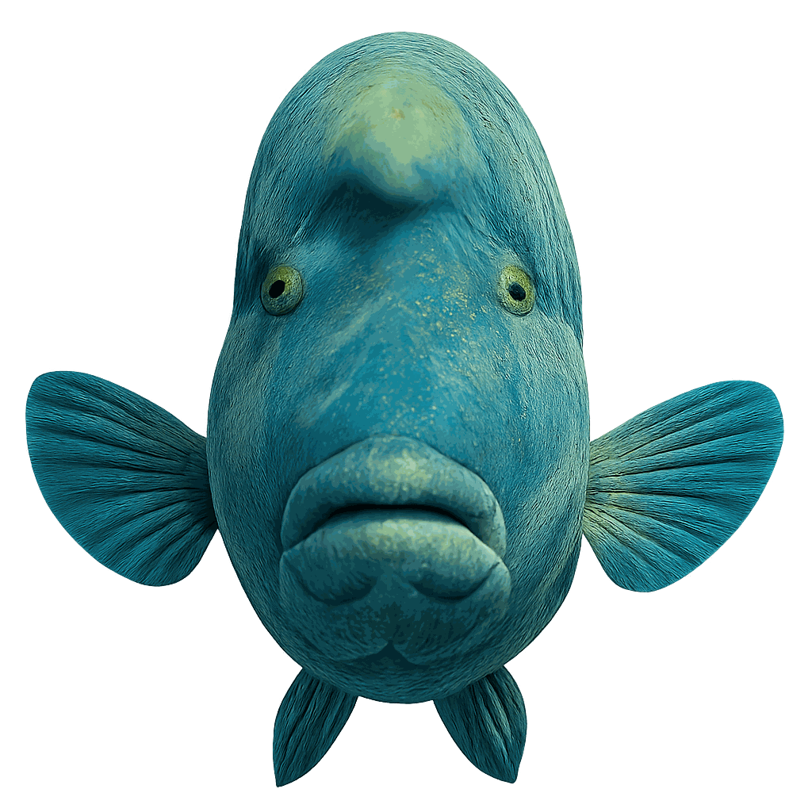
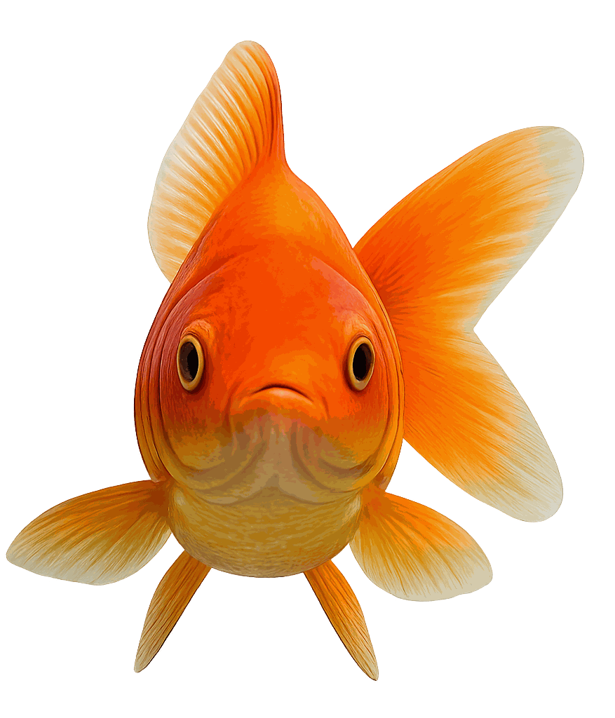
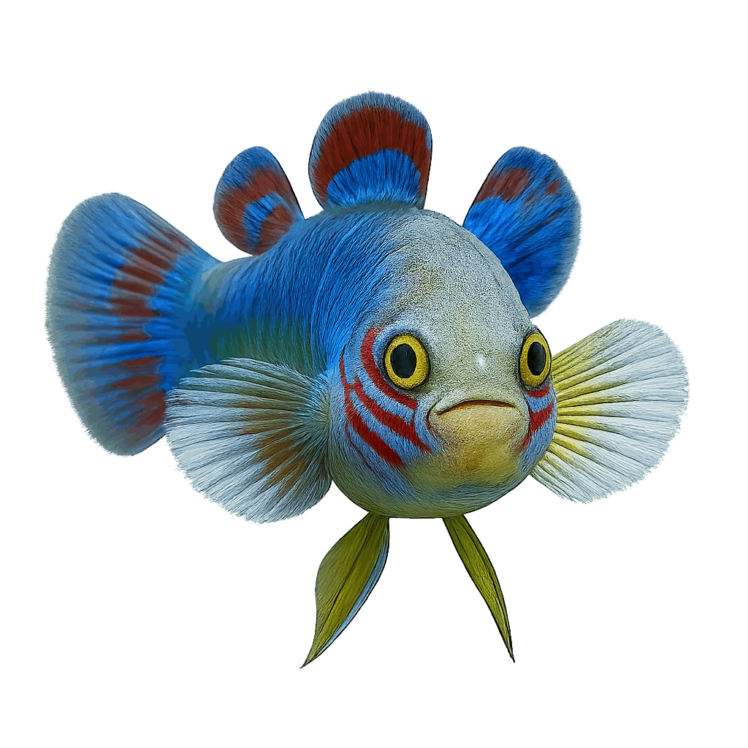
F
F
F
/f/
/f/
/f/
Notes:
🎙️ SCRIPT — read aloud:
This letter is F. The sound is /fffff/. (teeth on lip, blow.) Listen: /fffff/… /fffff/… /fffff/ — like the start of fish. fish. Now just you, three times: /fffff/, /fffff/, /fffff/! (pause) Good.

Slide 7
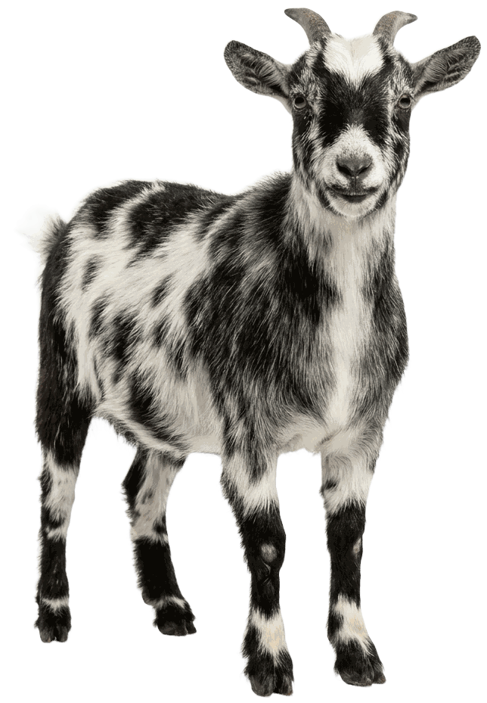
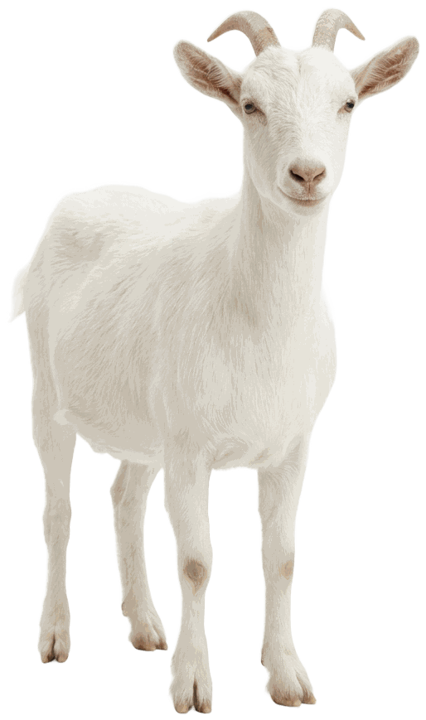
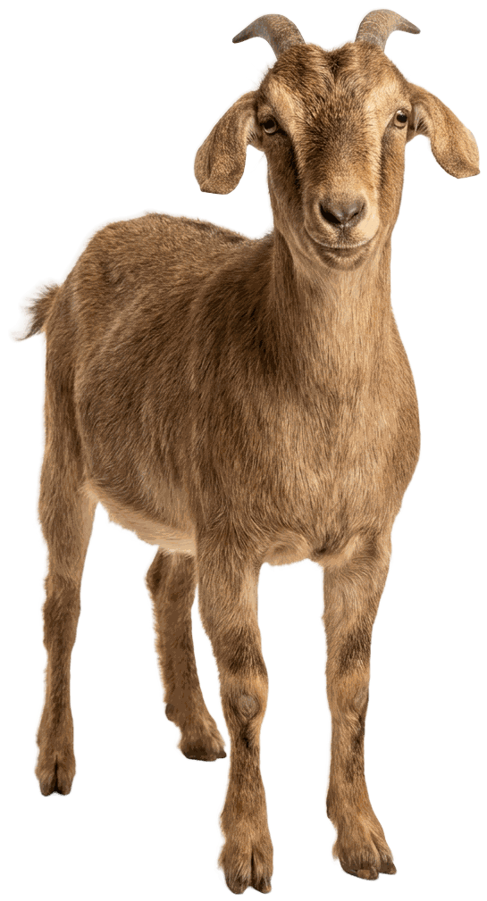
G
G
G
/g/
/g/
/g/
Notes:
🎙️ SCRIPT — read aloud:
This letter is G. The sound is /g/. (back of the throat.) Listen: /g/… /g/… /g/ — like the start of goat. goat. Now just you, three times: /g/, /g/, /g/! (pause) Good.

Slide 8
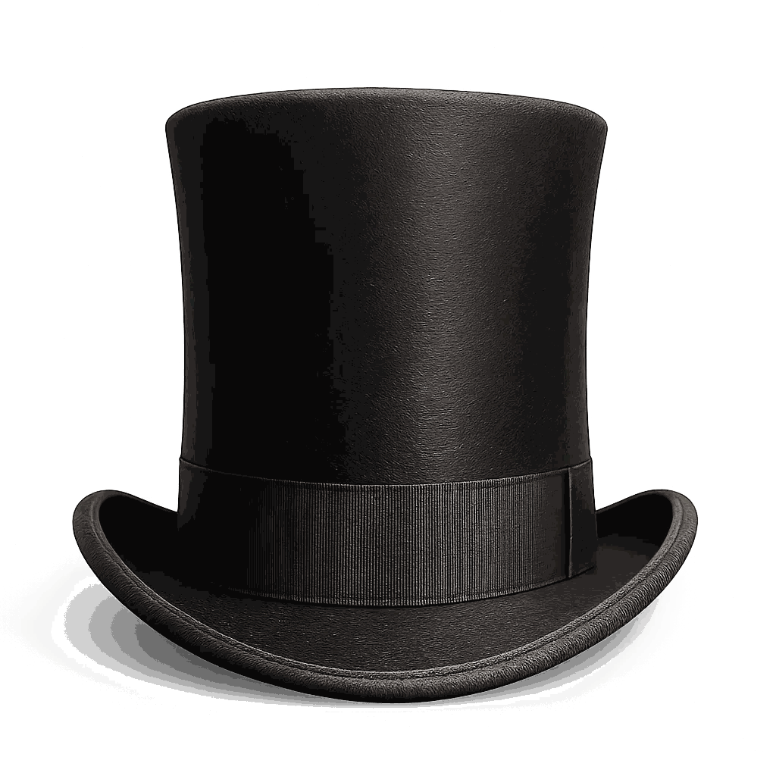
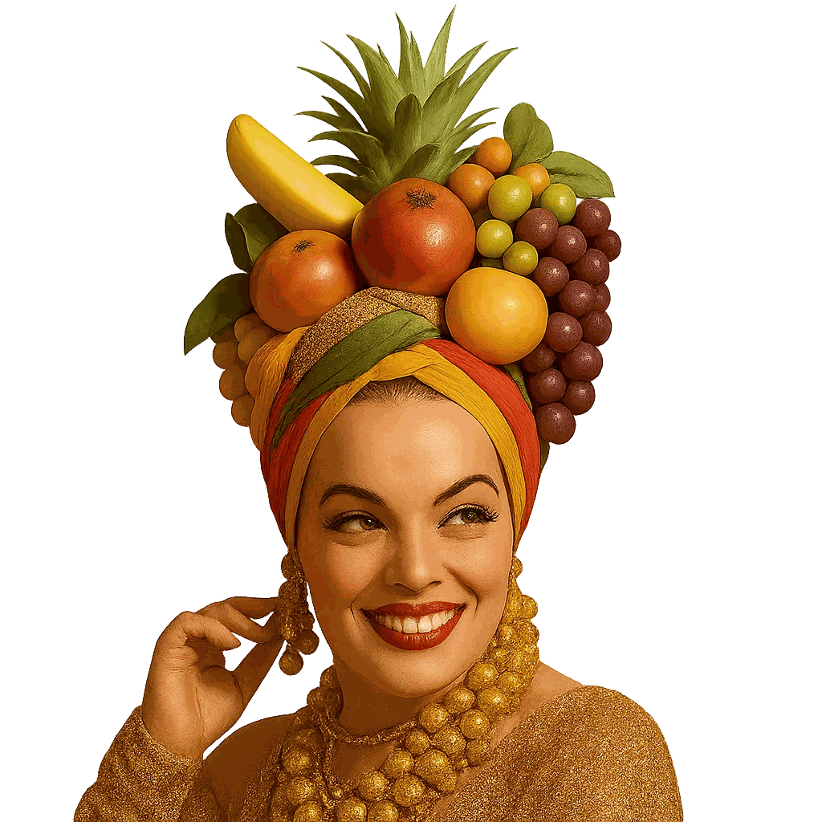

H
H
H
/h/
/h/
/h/
Notes:
🎙️ SCRIPT — read aloud:
This letter is H. The sound is /h/. (just breathe out.) Listen: /h/… /h/… /h/ — like the start of hat. hat. Now just you, three times: /h/, /h/, /h/! (pause) Good.

Slide 9
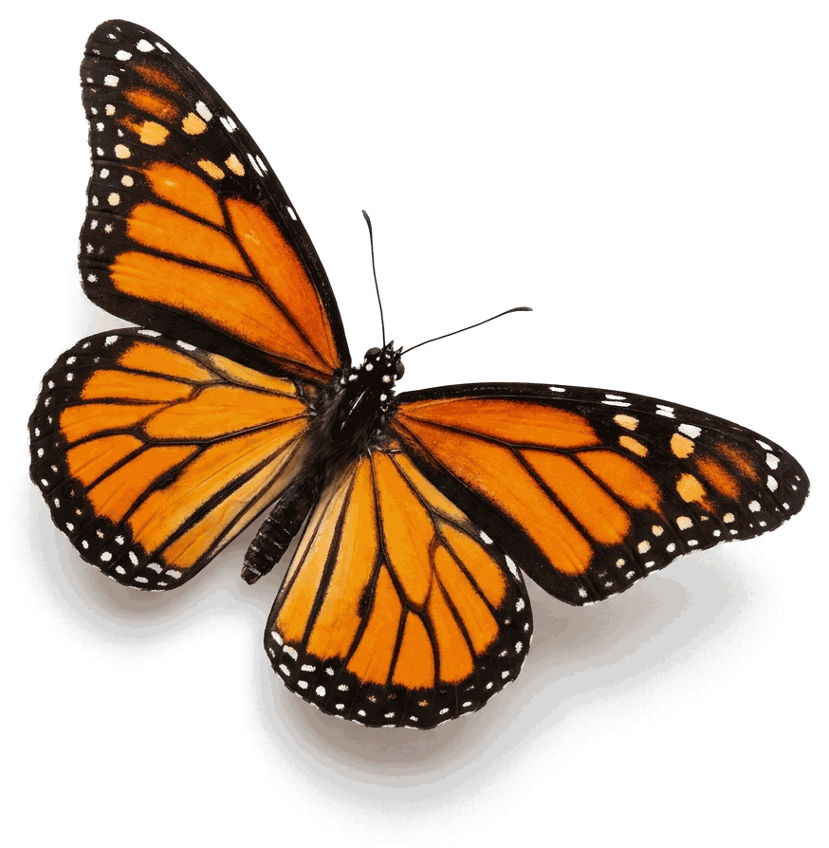
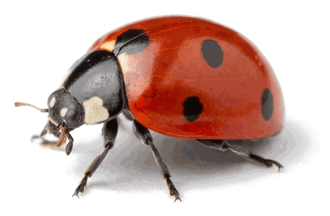
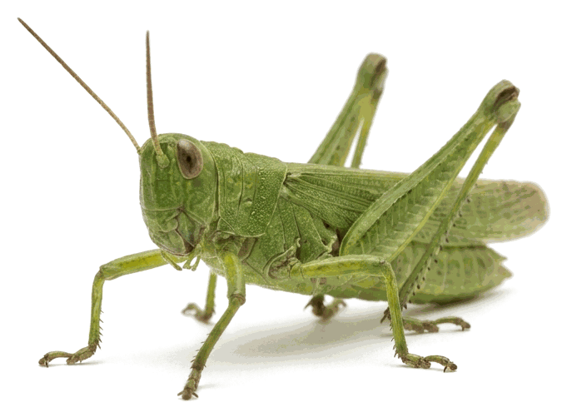
I
I
I
/i/
/i/
/i/
Notes:
🎙️ SCRIPT — read aloud:
This letter is I. The sound is /ih/. (quick and tiny.) Listen: /ih/… /ih/… /ih/ — like the start of insect. insect. Now just you, three times: /ih/, /ih/, /ih/! (pause) Good.

Slide 10
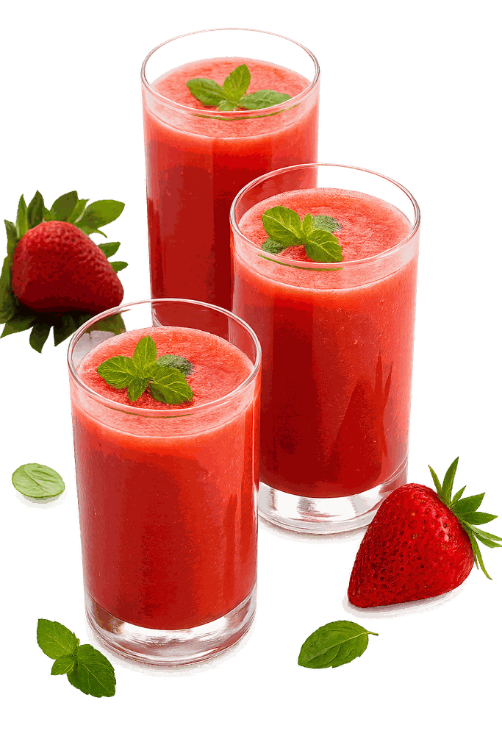
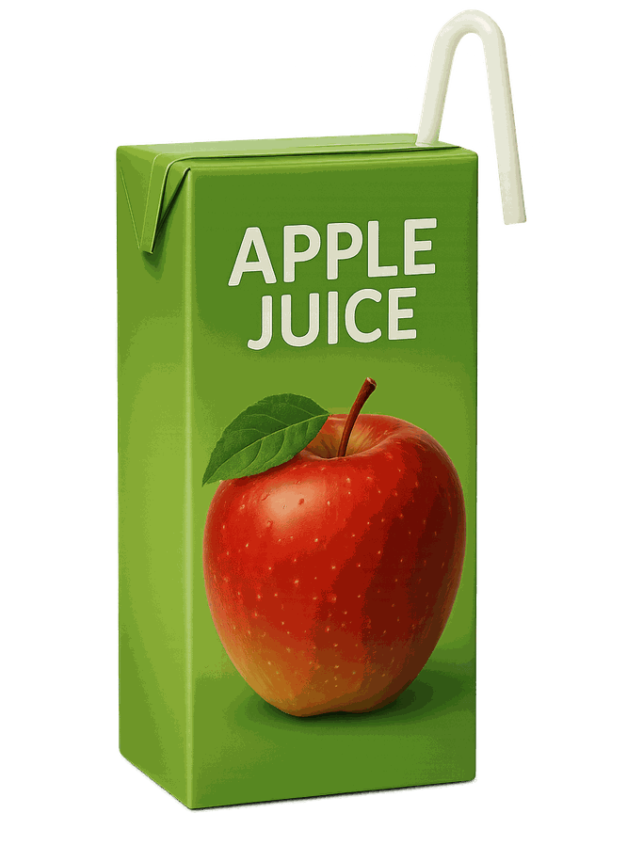
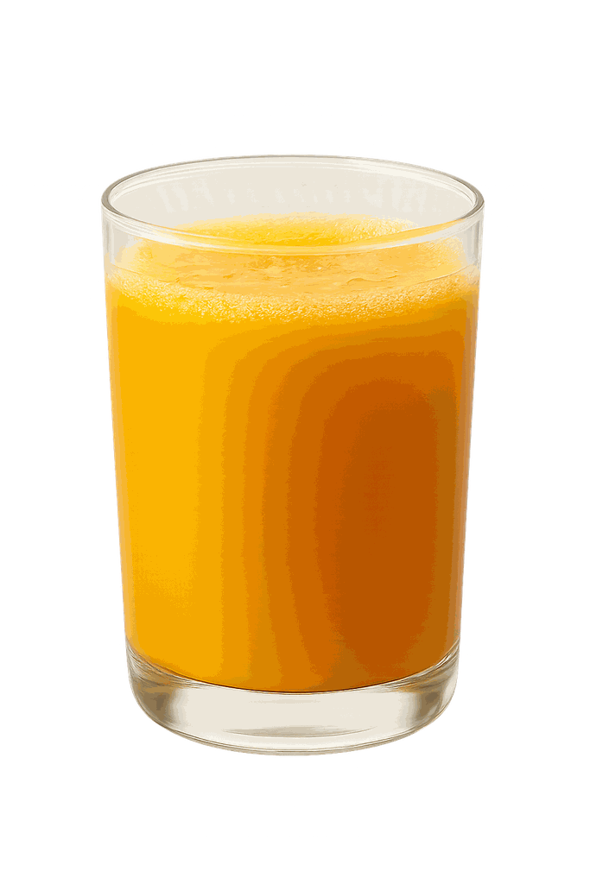
J
J
J
/juh/
/juh/
/juh/
Notes:
🎙️ SCRIPT — read aloud:
This letter is J. The sound is /j/. (tongue to the roof.) Listen: /j/… /j/… /j/ — like the start of jam. jam. Now just you, three times: /j/, /j/, /j/! (pause) Good.

Slide 11
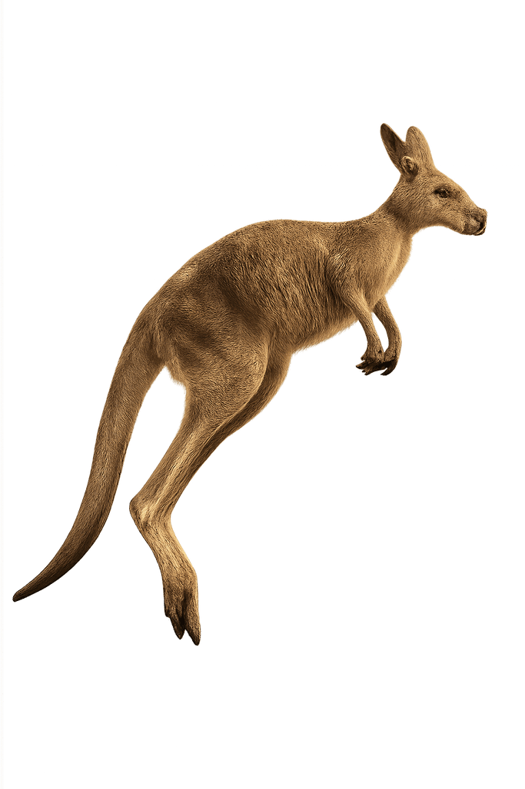
K
K
K
/k/
/k/
/k/
Notes:
🎙️ SCRIPT — read aloud:
This letter is K. The sound is /k/. (back of the throat.) Listen: /k/… /k/… /k/ — like the start of kite. kite. Now just you, three times: /k/, /k/, /k/! (pause) Good.

Slide 12
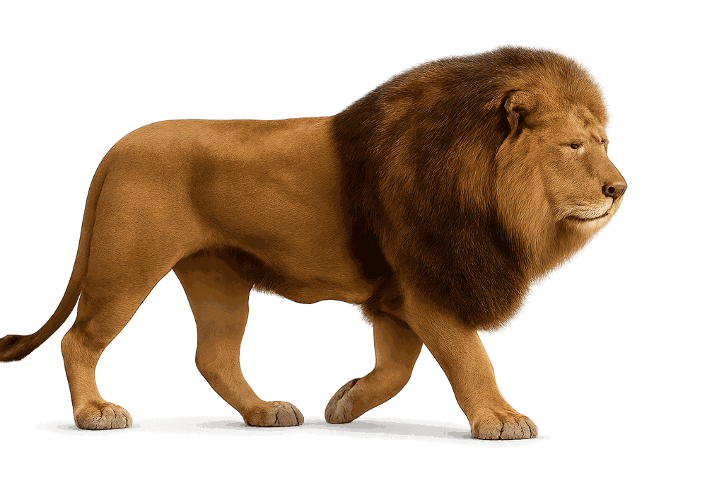
L
L
L
/l/
/l/
/l/
Notes:
🎙️ SCRIPT — read aloud:
This letter is L. The sound is /lllll/. (tongue up behind your teeth.) Listen: /lllll/… /lllll/… /lllll/ — like the start of leaf. leaf. Now just you, three times: /lllll/, /lllll/, /lllll/! (pause) Good.

Slide 13
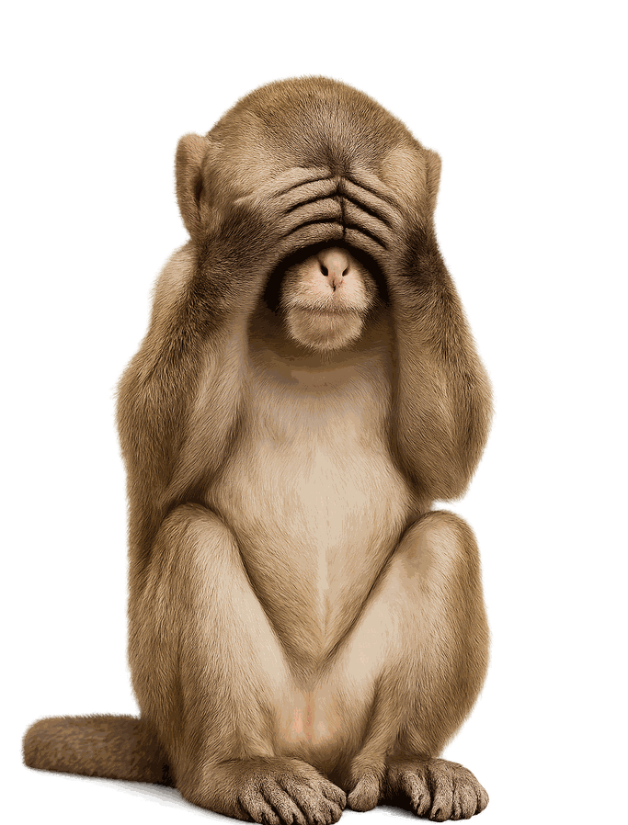
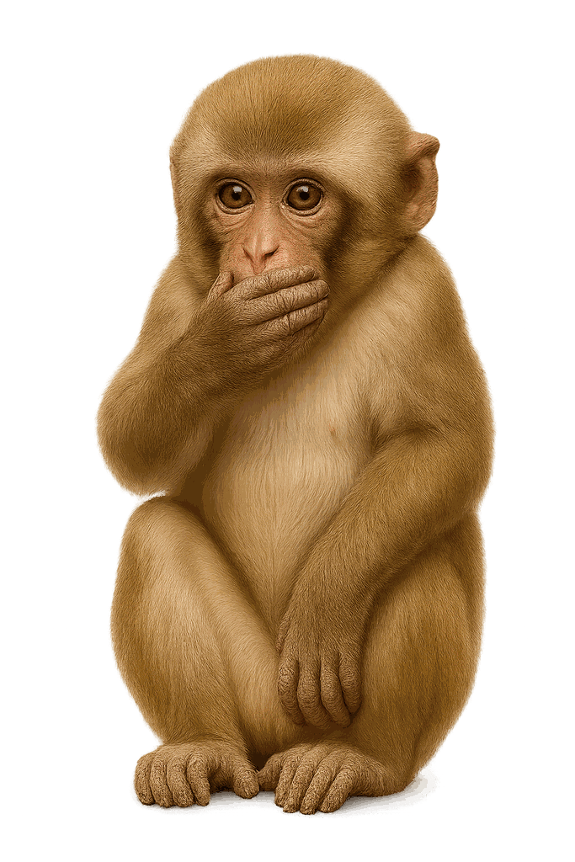
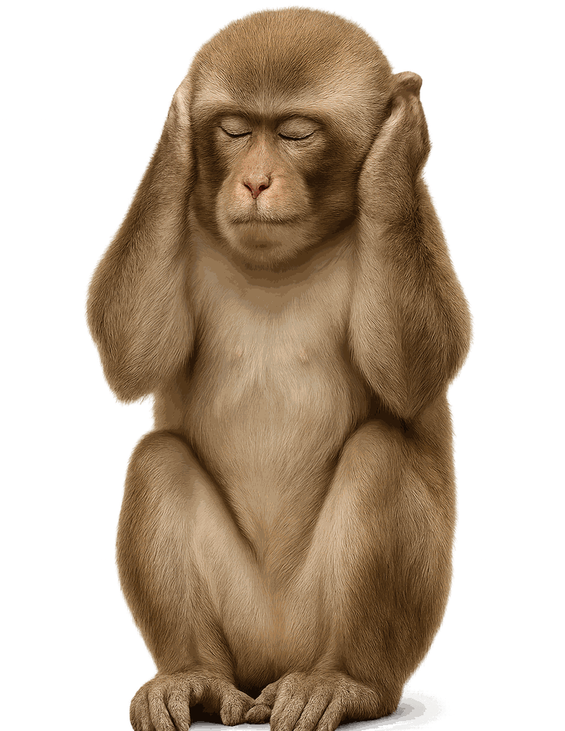
M
M
M
/m/
/m/
/m/
Notes:
🎙️ SCRIPT — read aloud:
This letter is M. The sound is /mmmmm/. (lips together, hum it.) Listen: /mmmmm/… /mmmmm/… /mmmmm/ — like the start of moon. moon. Now just you, three times: /mmmmm/, /mmmmm/, /mmmmm/! (pause) Good.

Slide 14


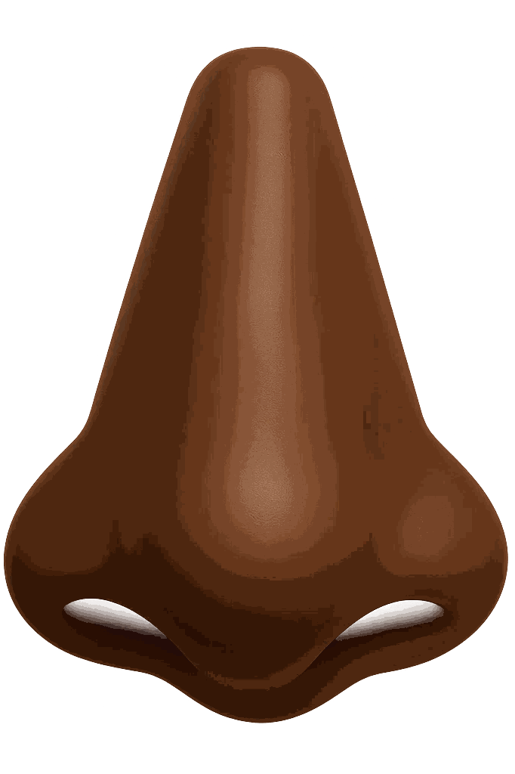
N
N
N
/n/
/n/
/n/
Notes:
🎙️ SCRIPT — read aloud:
This letter is N. The sound is /nnnnn/. (tongue up, hum through your nose.) Listen: /nnnnn/… /nnnnn/… /nnnnn/ — like the start of nest. nest. Now just you, three times: /nnnnn/, /nnnnn/, /nnnnn/! (pause) Good.

Slide 15
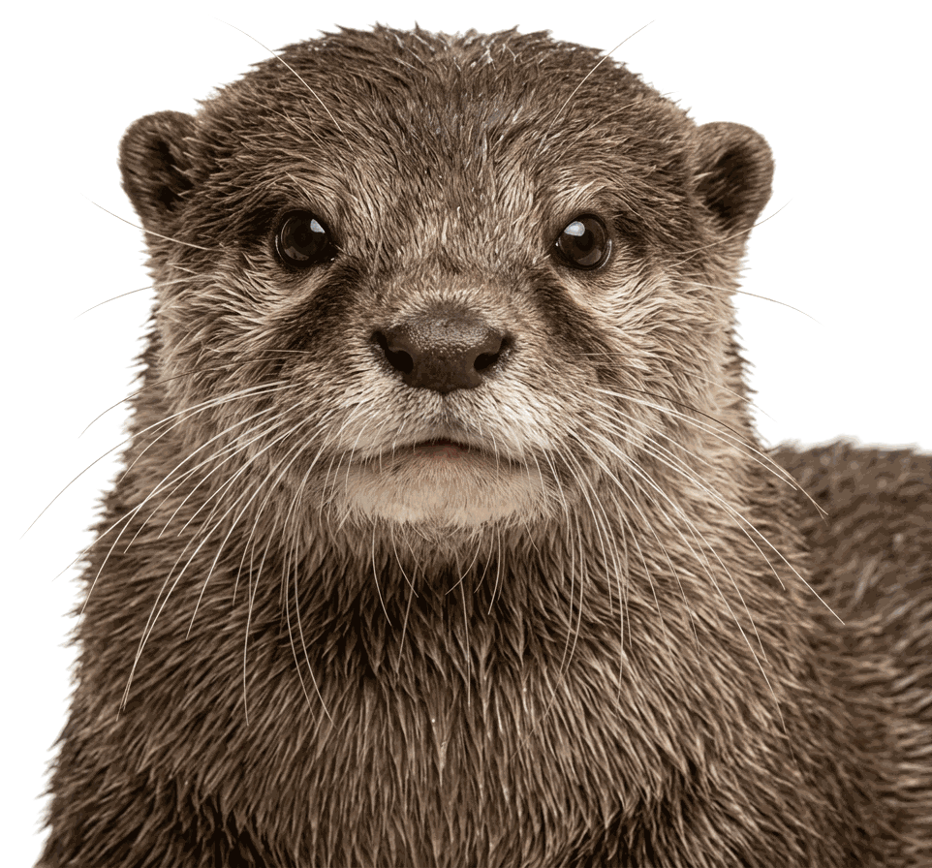
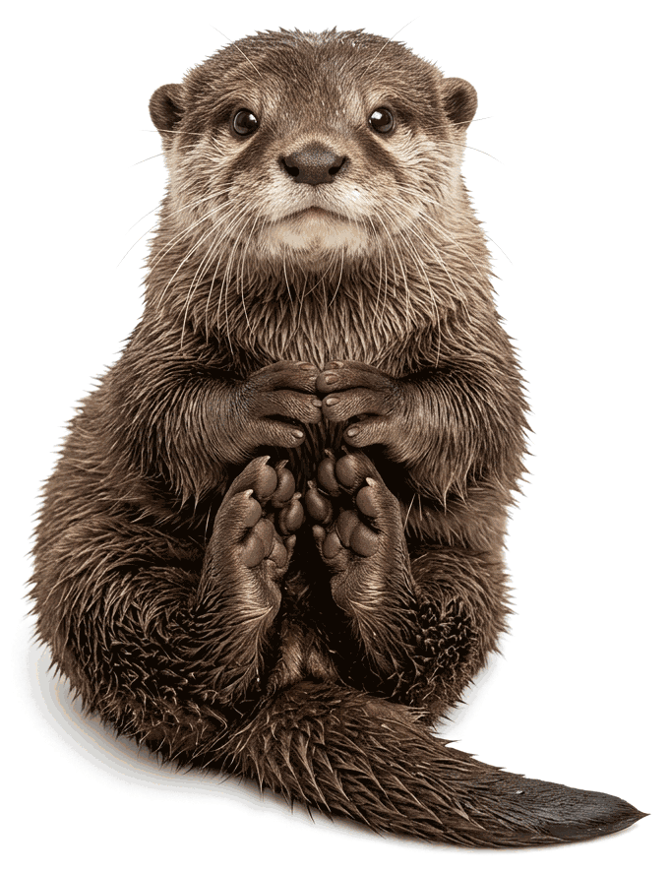
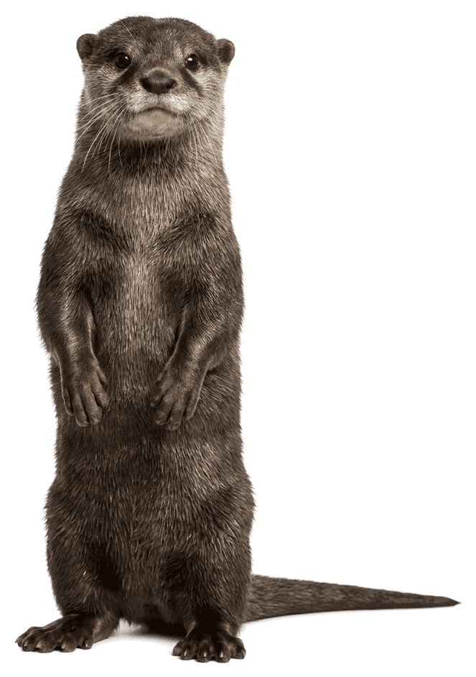
O
O
O
/ah/
/ah/
/ah/
Notes:
🎙️ SCRIPT — read aloud:
This letter is O. The sound is /ahh/. (mouth round and open.) Listen: /ahh/… /ahh/… /ahh/ — like the start of octopus. octopus. Now just you, three times: /ahh/, /ahh/, /ahh/! (pause) Good.

Slide 16
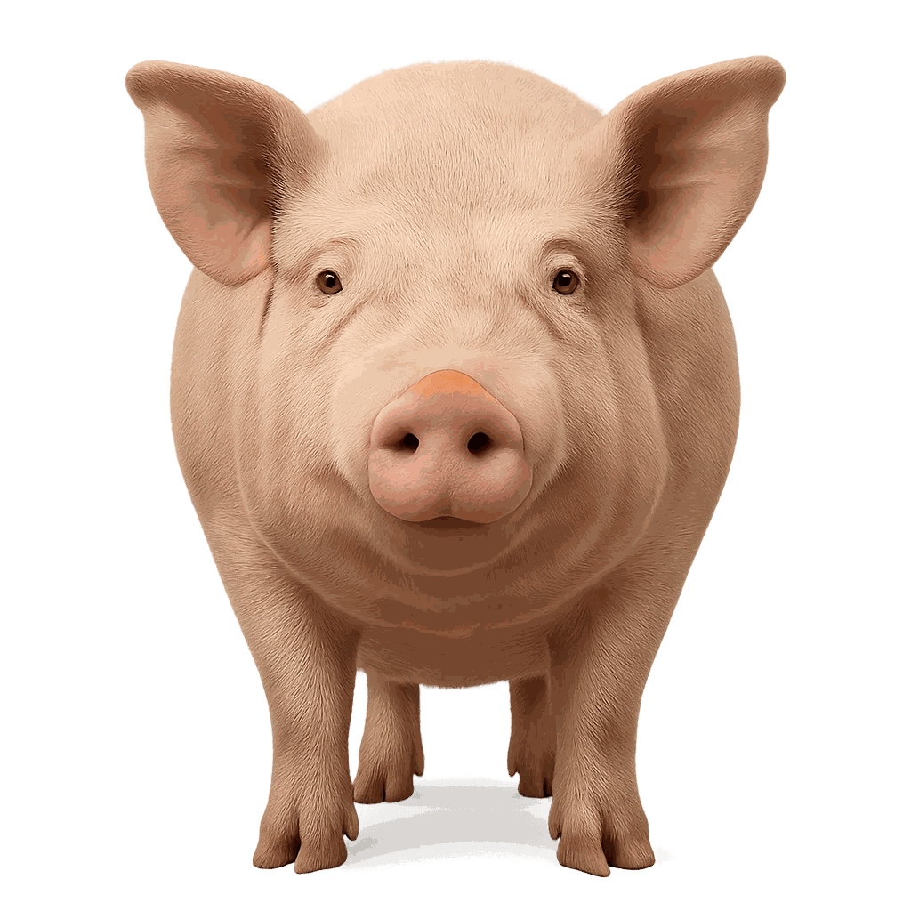
P
P
P
/p/
/p/
/p/
Notes:
🎙️ SCRIPT — read aloud:
This letter is P. The sound is /p/. (lips pop, no voice.) Listen: /p/… /p/… /p/ — like the start of pig. pig. Now just you, three times: /p/, /p/, /p/! (pause) Good.

Slide 17
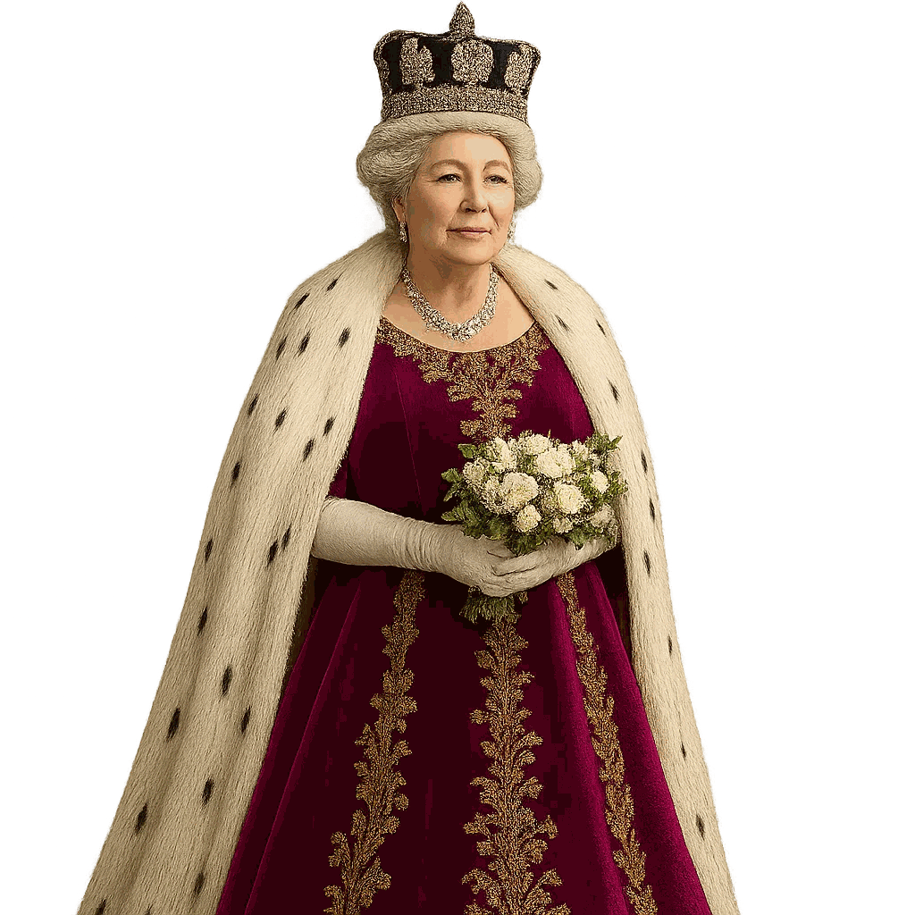
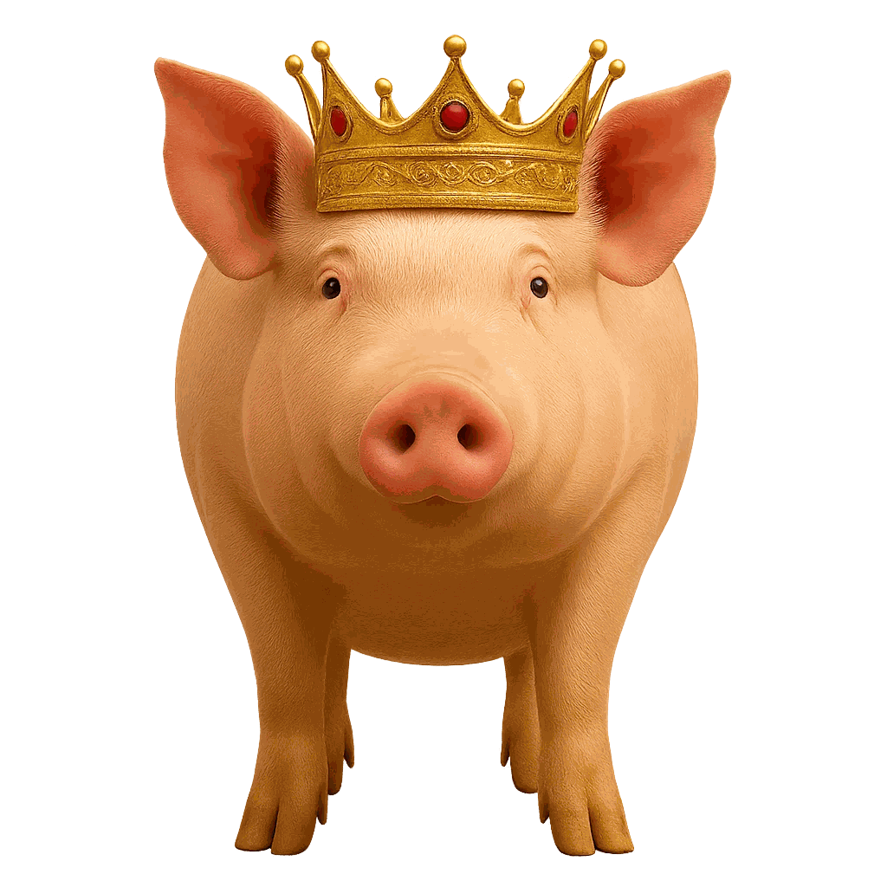
Q
Q
Q
/kw/
/kw/
/kw/
Notes:
🎙️ SCRIPT — read aloud:
This letter is Q. The sound is /kw/. (back of the throat, then round your lips.) Listen: /kw/… /kw/… /kw/ — like the start of queen. queen. Now just you, three times: /kw/, /kw/, /kw/! (pause) Good.

Slide 18
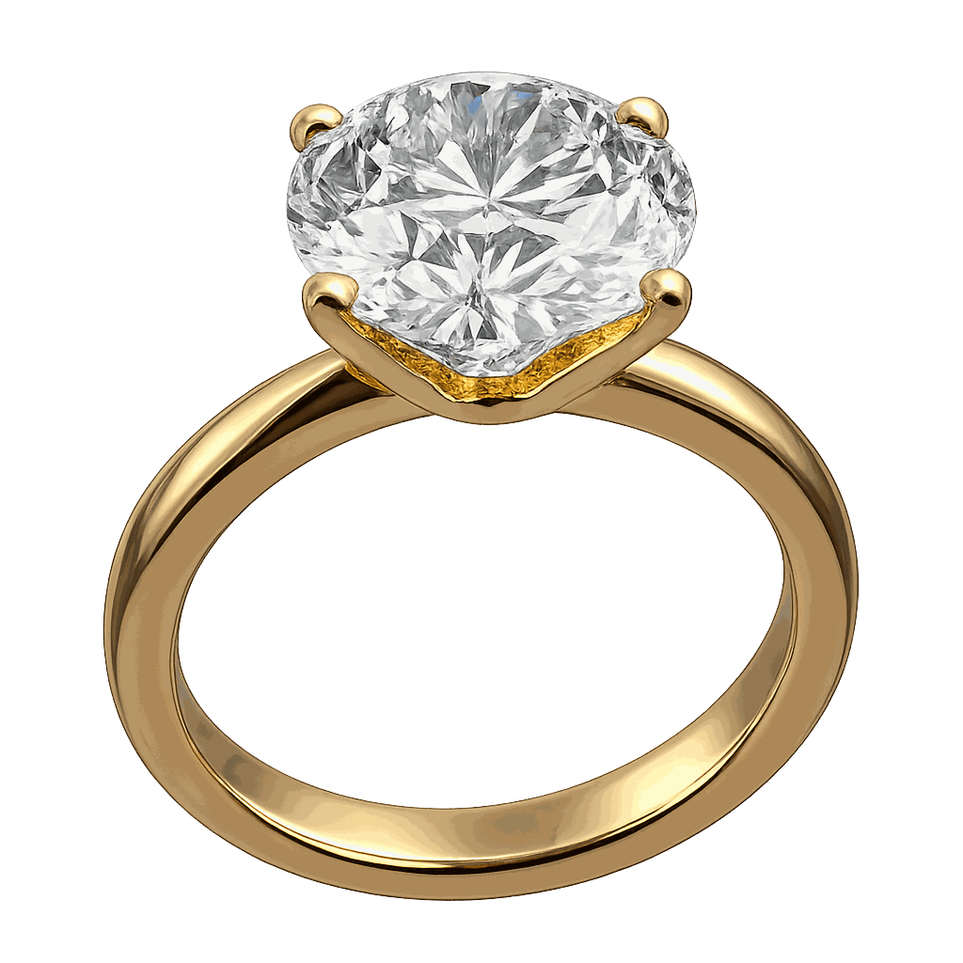
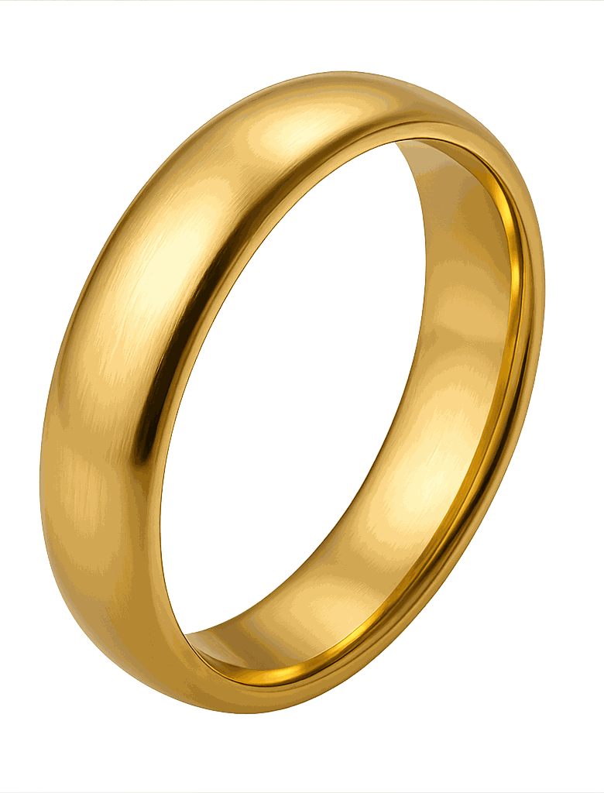
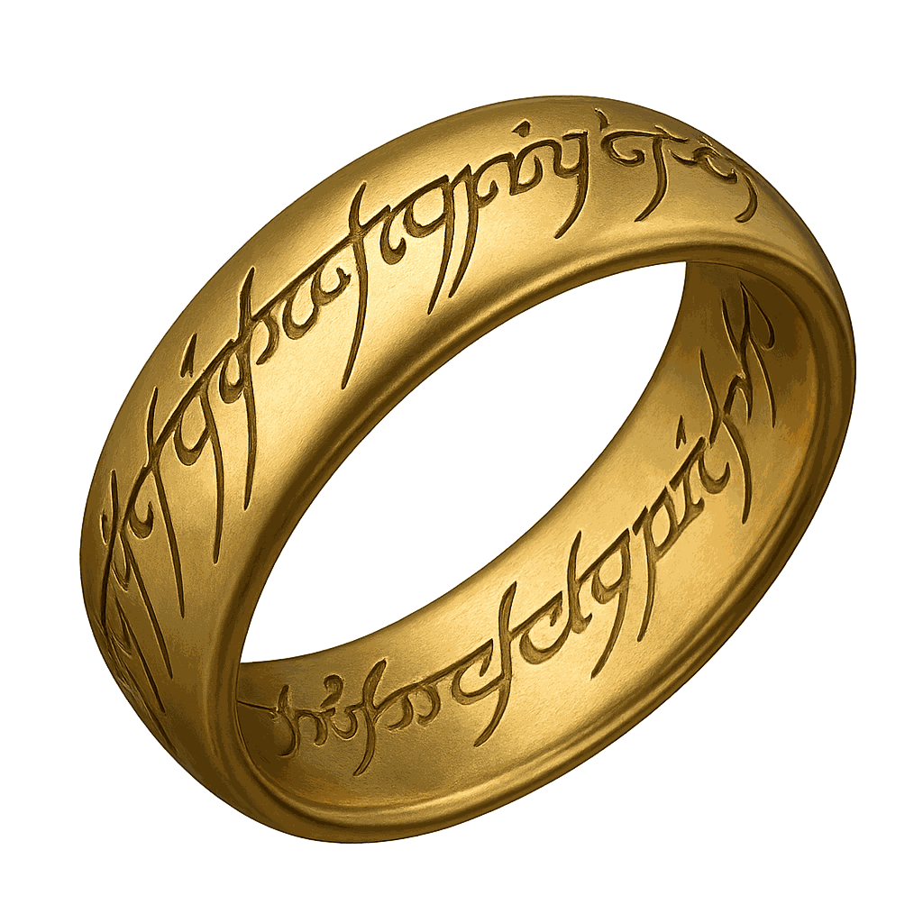
R
R
R
/r/
/r/
/r/
Notes:
🎙️ SCRIPT — read aloud:
This letter is R. The sound is /rrrrr/. (tongue back, lips round, no tap.) Listen: /rrrrr/… /rrrrr/… /rrrrr/ — like the start of rabbit. rabbit. Now just you, three times: /rrrrr/, /rrrrr/, /rrrrr/! (pause) Good.

Slide 19
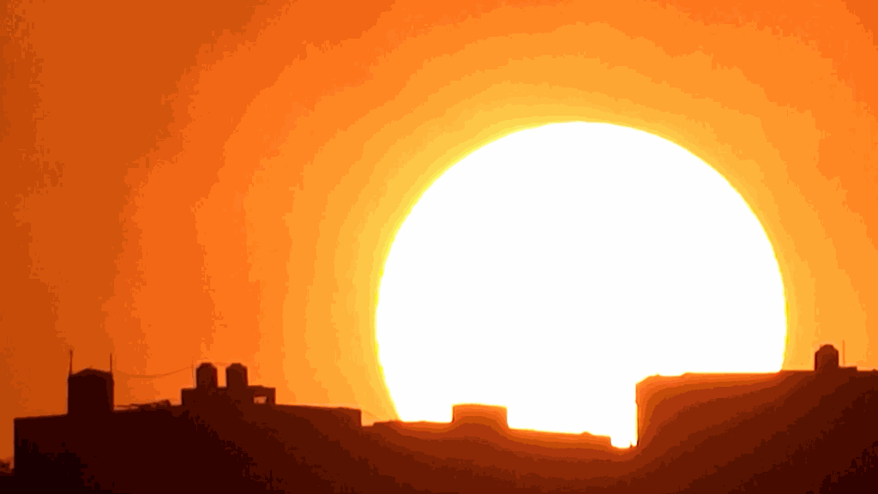
S
S
S
/S/
/S/
/S/
Notes:
🎙️ SCRIPT — read aloud:
This letter is S. The sound is /sssss/. (teeth together, hiss it.) Listen: /sssss/… /sssss/… /sssss/ — like the start of sun. sun. Now just you, three times: /sssss/, /sssss/, /sssss/! (pause) Good.

Slide 20
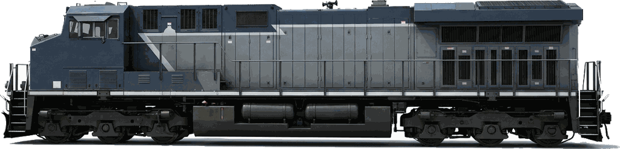
T
T
T
/t/
/t/
/t/
Notes:
🎙️ SCRIPT — read aloud:
This letter is T. The sound is /t/. (tongue taps, quick.) Listen: /t/… /t/… /t/ — like the start of turtle. turtle. Now just you, three times: /t/, /t/, /t/! (pause) Good.

Slide 21



U
U
  U
/uh/
/uh/
/uh/
Notes:
🎙️ SCRIPT — read aloud:
This letter is U. The sound is /uh/. (relaxed and soft.) Listen: /uh/… /uh/… /uh/ — like the start of umbrella. umbrella. Now just you, three times: /uh/, /uh/, /uh/! (pause) Good.

Slide 22
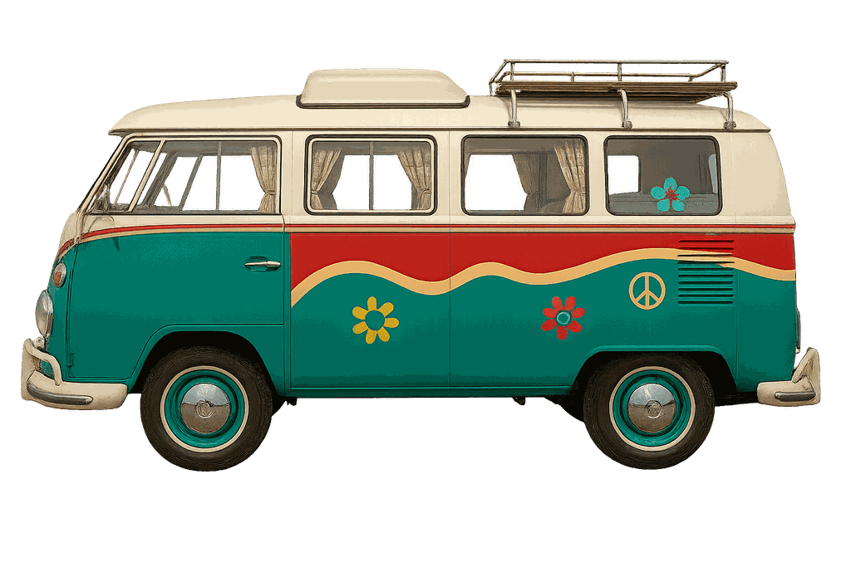
V
V
  V
/v/
/v/
/v/
Notes:
🎙️ SCRIPT — read aloud:
This letter is V. The sound is /vvvvv/. (teeth on lip, with voice.) Listen: /vvvvv/… /vvvvv/… /vvvvv/ — like the start of van. van. Now just you, three times: /vvvvv/, /vvvvv/, /vvvvv/! (pause) Good.

Slide 23
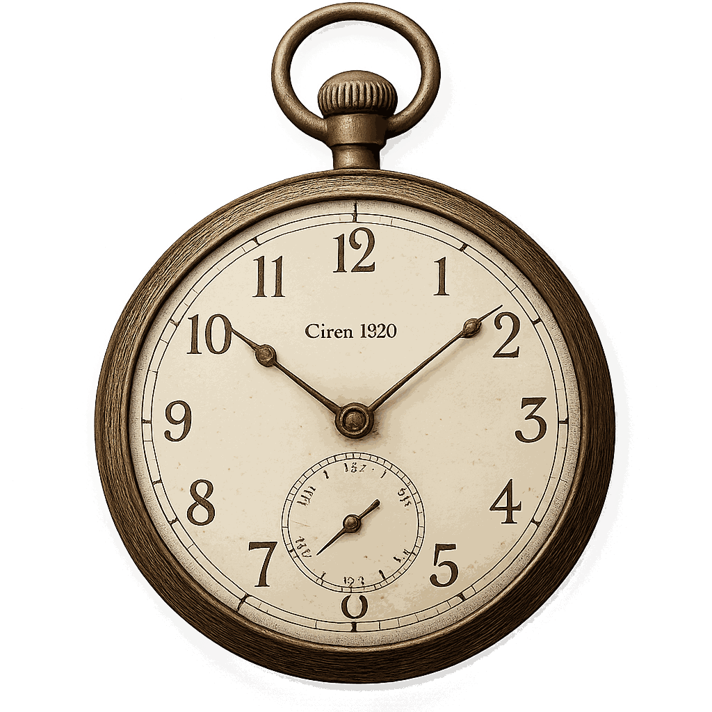
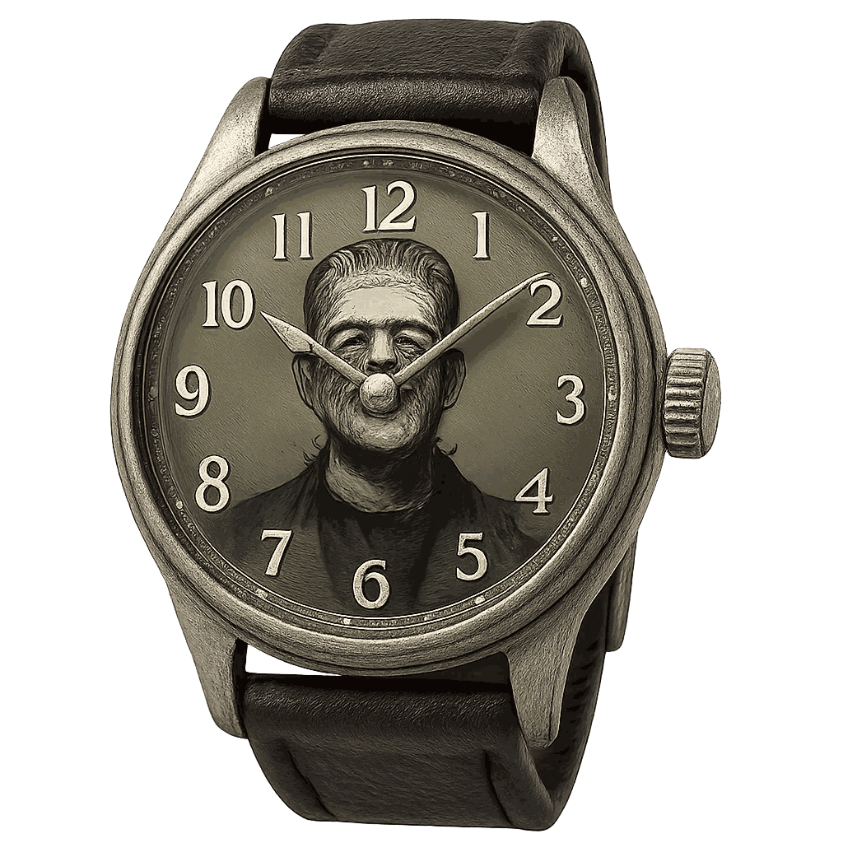
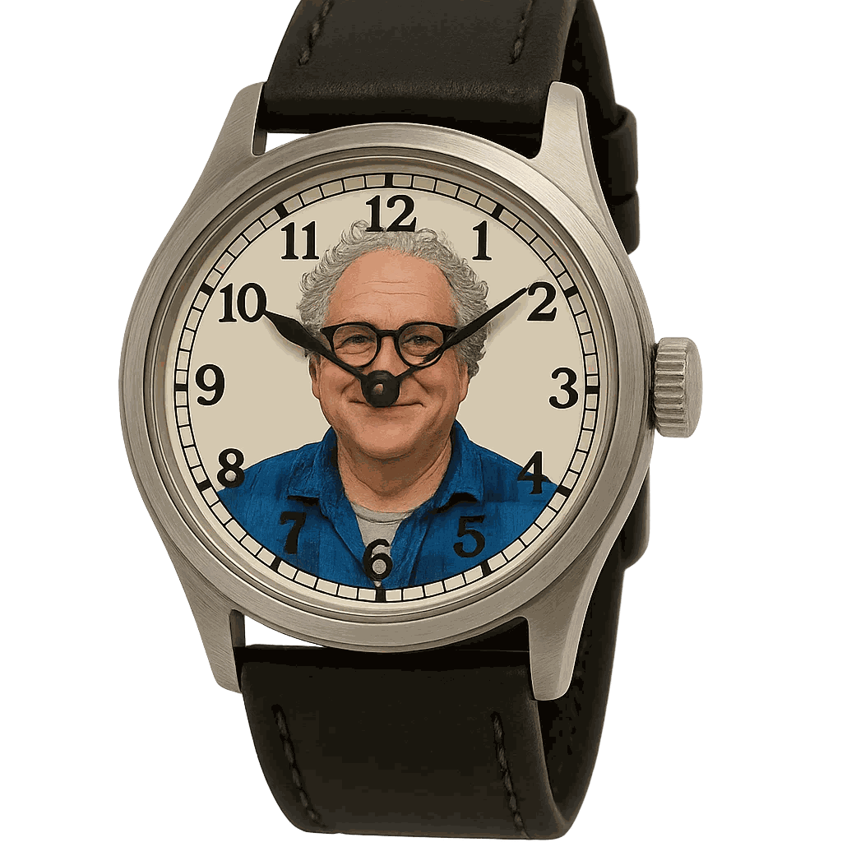
W
W
  W
/w/
/w/
/w/
Notes:
🎙️ SCRIPT — read aloud:
This letter is W. The sound is /w/. (round your lips.) Listen: /w/… /w/… /w/ — like the start of watermelon. watermelon. Now just you, three times: /w/, /w/, /w/! (pause) Good.

Slide 24



X
X
  X
/ks/
/ks/
/ks/
Notes:
🎙️ SCRIPT — read aloud:
This letter is X. The sound is /ks/. (like k and s together.) Listen: /ks/… /ks/… /ks/ — like the start of box. box. Now just you, three times: /ks/, /ks/, /ks/! (pause) Good.

Slide 25
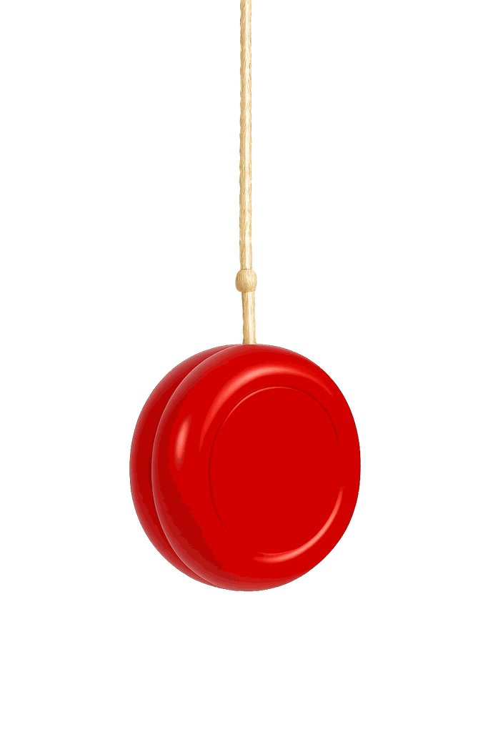
Y
Y
  Y
/ia/
/ia/
/ia/
Notes:
🎙️ SCRIPT — read aloud:
This letter is Y. The sound is /y/. (from the front of your mouth.) Listen: /y/… /y/… /y/ — like the start of yo-yo. yo-yo. Now just you, three times: /y/, /y/, /y/! (pause) Good.

Slide 26

Z
Z
  Z
/z/
/z/
/z/
Notes:
🎙️ SCRIPT — read aloud:
And our last one. This letter is Z. The sound is /zzzzz/. (teeth together, buzz it.) /zzzzz/… /zzzzz/… /zzzzz/, like the start of zebra. Now you. (pause) Wonderful! That's the whole alphabet, A to Z. You chanted every single sound. Come back and do this with me any time — a little each day, and these sounds become yours. Beautiful work.

