Slide 1
M U R R A Y ' S E N G L I S H
Guess the Letter!
Look 👀 · Read 🔤 · Type 💬
DAY 1
murraycohen.com
Notes:
🎙️ SCRIPT — read aloud:
Hi everyone, welcome back. Let's play a game — it's called Guess the Letter. Here's how it works: I'll show you a picture and a word, but one letter is missing. You'll see two choices, number one and number two. Pick the right letter to finish the word. Say your answer out loud where you are — don't be shy. Then I'll show you the answer. Ready? Let's play.

Slide 2
DAY 1
GAME
How to play
👀 Look at the picture
🔤 Read the word — one letter is missing!
💬 Type 1 or 2 in the chat
Notes:
🎙️ SCRIPT — read aloud:
Okay — look at the picture. Read the word with me: … one letter is missing at the front. Which letter finishes it — number one, ?, or number two, ?? Sound it out in your mouth. Say your answer out loud. (pause)

Slide 3
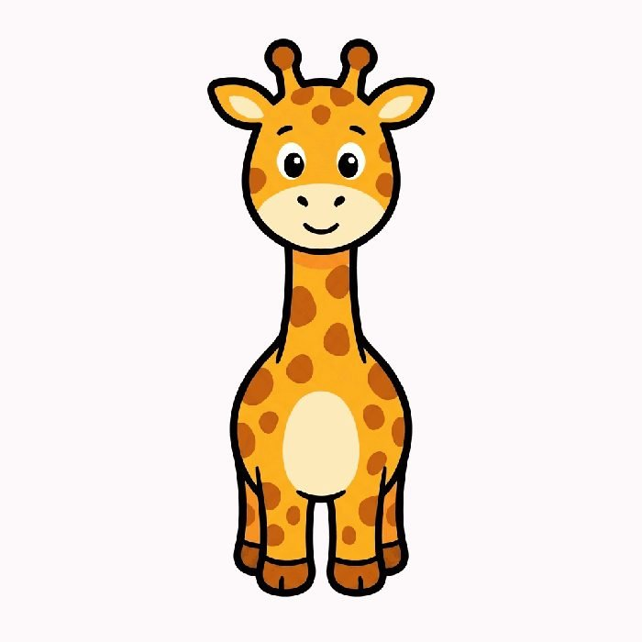
DAY 1
GAME
💬 TYPE 1 or 2 IN THE CHAT
__iraffe
1 g
2 q
Notes:
🎙️ SCRIPT — read aloud:
Okay — look at the picture. Read the word with me: iraffe… one letter is missing at the front. Which letter finishes it — number one, G, or number two, Q? Sound it out in your mouth. Say your answer out loud. (pause)

Slide 4
DAY 1
GAME
✅ Super!
giraffe
Notes:
🎙️ SCRIPT — read aloud:
Super! It's G — the word is giraffe. Say it with me: /g/… giraffe. giraffe. (pause) Good. Let's keep going.

Slide 5

DAY 1
GAME
💬 TYPE 1 or 2 IN THE CHAT
__pple
1 a
2 v
Notes:
🎙️ SCRIPT — read aloud:
Okay — look at the picture. Read the word with me: pple… one letter is missing at the front. Which letter finishes it — number one, A, or number two, V? Sound it out in your mouth. Say your answer out loud. (pause)

Slide 6
DAY 1
GAME
✅ Yes!
apple
Notes:
🎙️ SCRIPT — read aloud:
Yes! It's A — the word is apple. Say it with me: /aaa/… apple. apple. (pause) Good. Let's keep going.

Slide 7

DAY 1
GAME
💬 TYPE 1 or 2 IN THE CHAT
__ake
1 o
2 c
Notes:
🎙️ SCRIPT — read aloud:
Okay — look at the picture. Read the word with me: ake… one letter is missing at the front. Which letter finishes it — number one, O, or number two, C? Sound it out in your mouth. Say your answer out loud. (pause)

Slide 8
DAY 1
GAME
✅ You got it!
cake
Notes:
🎙️ SCRIPT — read aloud:
You got it! It's C — the word is cake. Say it with me: /k/… cake. cake. (pause) Good. Let's keep going.

Slide 9

DAY 1
GAME
💬 TYPE 1 or 2 IN THE CHAT
__an
1 f
2 e
Notes:
🎙️ SCRIPT — read aloud:
Okay — look at the picture. Read the word with me: an… one letter is missing at the front. Which letter finishes it — number one, F, or number two, E? Sound it out in your mouth. Say your answer out loud. (pause)

Slide 10
DAY 1
GAME
✅ Super!
fan
Notes:
🎙️ SCRIPT — read aloud:
Great ears! It's F — the word is fan. Say it with me: /fffff/… fan. fan. (pause) Good. Let's keep going.

Slide 11
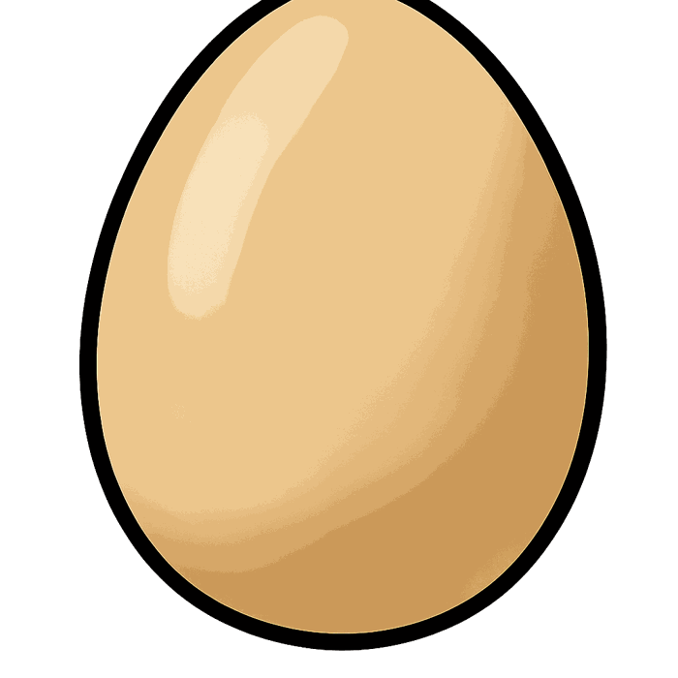
DAY 1
GAME
💬 TYPE 1 or 2 IN THE CHAT
__gg
1 f
2 e
Notes:
🎙️ SCRIPT — read aloud:
Okay — look at the picture. Read the word with me: gg… one letter is missing at the front. Which letter finishes it — number one, F, or number two, E? Sound it out in your mouth. Say your answer out loud. (pause)

Slide 12
DAY 1
GAME
✅ You got it!
egg
Notes:
🎙️ SCRIPT — read aloud:
Nice! It's E — the word is egg. Say it with me: /eh/… egg. egg. (pause) Good. Let's keep going.

Slide 13

DAY 1
GAME
💬 TYPE 1 or 2 IN THE CHAT
__all
1 r
2 b
Notes:
🎙️ SCRIPT — read aloud:
Okay — look at the picture. Read the word with me: all… one letter is missing at the front. Which letter finishes it — number one, R, or number two, B? Sound it out in your mouth. Say your answer out loud. (pause)

Slide 14
DAY 1
GAME
✅ You got it!
ball
Notes:
🎙️ SCRIPT — read aloud:
Beautiful! It's B — the word is ball. Say it with me: /b/… ball. ball. (pause) Good. Let's keep going.

Slide 15

DAY 1
GAME
💬 TYPE 1 or 2 IN THE CHAT
__at
1 n
2 h
Notes:
🎙️ SCRIPT — read aloud:
Okay — look at the picture. Read the word with me: at… one letter is missing at the front. Which letter finishes it — number one, N, or number two, H? Sound it out in your mouth. Say your answer out loud. (pause)

Slide 16
DAY 1
GAME
✅ Yes!
hat
Notes:
🎙️ SCRIPT — read aloud:
Super! It's H — the word is hat. Say it with me: /h/… hat. hat. (pause) Good. Let's keep going.

Slide 17

DAY 1
GAME
💬 TYPE 1 or 2 IN THE CHAT
__gloo
1 i
2 l
Notes:
🎙️ SCRIPT — read aloud:
Okay — look at the picture. Read the word with me: gloo… one letter is missing at the front. Which letter finishes it — number one, I, or number two, L? Sound it out in your mouth. Say your answer out loud. (pause)

Slide 18
DAY 1
GAME
✅ You got it!
igloo
Notes:
🎙️ SCRIPT — read aloud:
Yes! It's I — the word is igloo. Say it with me: /ih/… igloo. igloo. (pause) Good. Let's keep going.

Slide 19
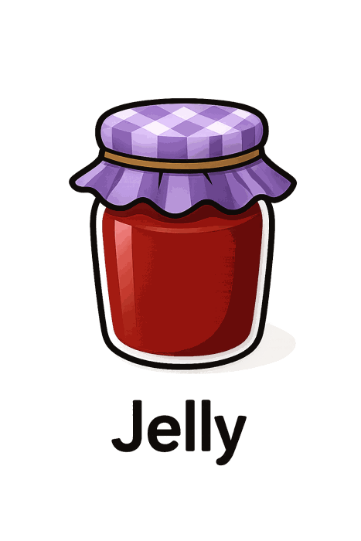
DAY 1
GAME
💬 TYPE 1 or 2 IN THE CHAT
__am
1 i
2 j
Notes:
🎙️ SCRIPT — read aloud:
Okay — look at the picture. Read the word with me: am… one letter is missing at the front. Which letter finishes it — number one, I, or number two, J? Sound it out in your mouth. Say your answer out loud. (pause)

Slide 20
DAY 1
GAME
✅ Yes!
jam
Notes:
🎙️ SCRIPT — read aloud:
You got it! It's J — the word is jam. Say it with me: /j/… jam. jam. (pause) Good. Let's keep going.

Slide 21

DAY 1
GAME
💬 TYPE 1 or 2 IN THE CHAT
__oon
1 w
2 m
Notes:
🎙️ SCRIPT — read aloud:
Okay — look at the picture. Read the word with me: oon… one letter is missing at the front. Which letter finishes it — number one, W, or number two, M? Sound it out in your mouth. Say your answer out loud. (pause)

Slide 22
DAY 1
GAME
✅ Great ears!
moon
Notes:
🎙️ SCRIPT — read aloud:
Great ears! It's M — the word is moon. Say it with me: /mmmmm/… moon. moon. (pause) Good. Let's keep going.

Slide 23

DAY 1
GAME
💬 TYPE 1 or 2 IN THE CHAT
__ite
1 x
2 k
Notes:
🎙️ SCRIPT — read aloud:
Okay — look at the picture. Read the word with me: ite… one letter is missing at the front. Which letter finishes it — number one, X, or number two, K? Sound it out in your mouth. Say your answer out loud. (pause)

Slide 24
DAY 1
GAME
✅ Super!
kite
Notes:
🎙️ SCRIPT — read aloud:
Nice! It's K — the word is kite. Say it with me: /k/… kite. kite. (pause) Good. Let's keep going.

Slide 25

DAY 1
GAME
💬 TYPE 1 or 2 IN THE CHAT
__eaf
1 l
2 t
Notes:
🎙️ SCRIPT — read aloud:
Okay — look at the picture. Read the word with me: eaf… one letter is missing at the front. Which letter finishes it — number one, L, or number two, T? Sound it out in your mouth. Say your answer out loud. (pause)

Slide 26
DAY 1
GAME
✅ You got it!
leaf
Notes:
🎙️ SCRIPT — read aloud:
Beautiful! It's L — the word is leaf. Say it with me: /lllll/… leaf. leaf. (pause) Good. Let's keep going.

Slide 27

DAY 1
GAME
💬 TYPE 1 or 2 IN THE CHAT
__range
1 q
2 o
Notes:
🎙️ SCRIPT — read aloud:
Okay — look at the picture. Read the word with me: range… one letter is missing at the front. Which letter finishes it — number one, Q, or number two, O? Sound it out in your mouth. Say your answer out loud. (pause)

Slide 28
DAY 1
GAME
✅ You got it!
orange
Notes:
🎙️ SCRIPT — read aloud:
Super! It's O — the word is orange. Say it with me: /ahh/… orange. orange. (pause) Good. Let's keep going.

Slide 29
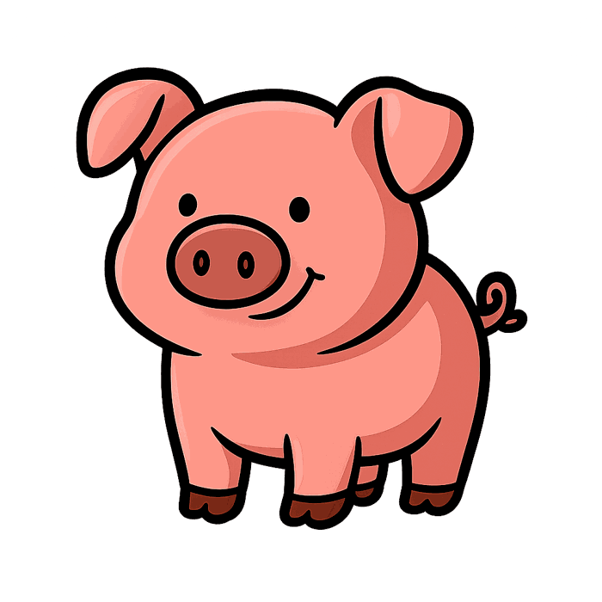
DAY 1
GAME
💬 TYPE 1 or 2 IN THE CHAT
__ig
1 r
2 p
Notes:
🎙️ SCRIPT — read aloud:
Okay — look at the picture. Read the word with me: ig… one letter is missing at the front. Which letter finishes it — number one, R, or number two, P? Sound it out in your mouth. Say your answer out loud. (pause)

Slide 30
DAY 1
GAME
✅ You got it!
pig
Notes:
🎙️ SCRIPT — read aloud:
Yes! It's P — the word is pig. Say it with me: /p/… pig. pig. (pause) Good. Let's keep going.

Slide 31
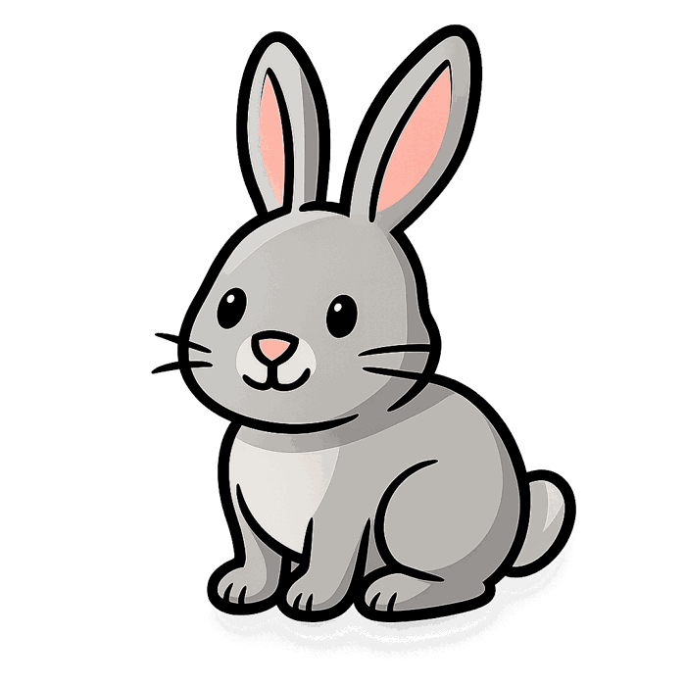
DAY 1
GAME
💬 TYPE 1 or 2 IN THE CHAT
__abbit
1 p
2 r
Notes:
🎙️ SCRIPT — read aloud:
Okay — look at the picture. Read the word with me: abbit… one letter is missing at the front. Which letter finishes it — number one, P, or number two, R? Sound it out in your mouth. Say your answer out loud. (pause)

Slide 32
DAY 1
GAME
✅ Super!
rabbit
Notes:
🎙️ SCRIPT — read aloud:
You got it! It's R — the word is rabbit. Say it with me: /rrrrr/… rabbit. rabbit. (pause) Good. Let's keep going.

Slide 33
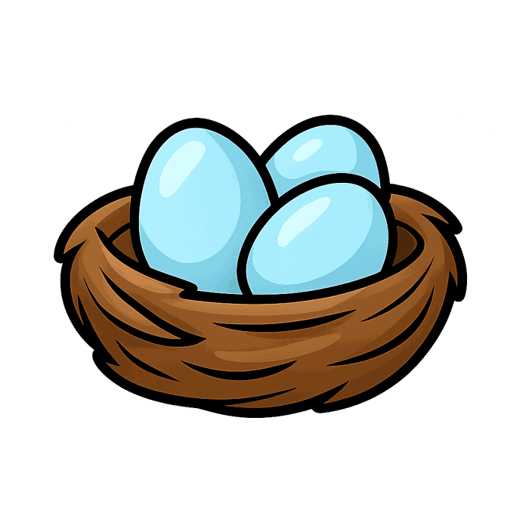
DAY 1
GAME
💬 TYPE 1 or 2 IN THE CHAT
__est
1 n
2 h
Notes:
🎙️ SCRIPT — read aloud:
Okay — look at the picture. Read the word with me: est… one letter is missing at the front. Which letter finishes it — number one, N, or number two, H? Sound it out in your mouth. Say your answer out loud. (pause)

Slide 34
DAY 1
GAME
✅ Great ears!
nest
Notes:
🎙️ SCRIPT — read aloud:
Great ears! It's N — the word is nest. Say it with me: /nnnnn/… nest. nest. (pause) Good. Let's keep going.

Slide 35
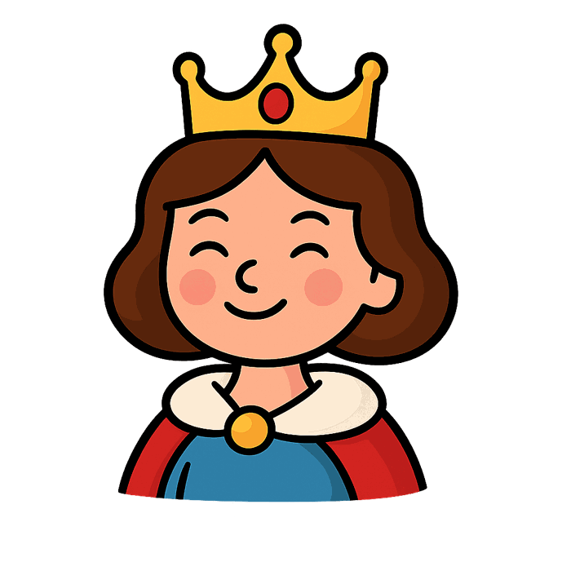
DAY 1
GAME
💬 TYPE 1 or 2 IN THE CHAT
__ueen
1 o
2 q
Notes:
🎙️ SCRIPT — read aloud:
Okay — look at the picture. Read the word with me: ueen… one letter is missing at the front. Which letter finishes it — number one, O, or number two, Q? Sound it out in your mouth. Say your answer out loud. (pause)

Slide 36
DAY 1
GAME
✅ Great ears!
queen
Notes:
🎙️ SCRIPT — read aloud:
Nice! It's Q — the word is queen. Say it with me: /kw/… queen. queen. (pause) Good. Let's keep going.

Slide 37

DAY 1
GAME
💬 TYPE 1 or 2 IN THE CHAT
__un
1 s
2 b
Notes:
🎙️ SCRIPT — read aloud:
Okay — look at the picture. Read the word with me: un… one letter is missing at the front. Which letter finishes it — number one, S, or number two, B? Sound it out in your mouth. Say your answer out loud. (pause)

Slide 38
DAY 1
GAME
✅ Great ears!
sun
Notes:
🎙️ SCRIPT — read aloud:
Beautiful! It's S — the word is sun. Say it with me: /sssss/… sun. sun. (pause) Good. Let's keep going.

Slide 39

DAY 1
GAME
💬 TYPE 1 or 2 IN THE CHAT
__urtle
1 t
2 l
Notes:
🎙️ SCRIPT — read aloud:
Okay — look at the picture. Read the word with me: urtle… one letter is missing at the front. Which letter finishes it — number one, T, or number two, L? Sound it out in your mouth. Say your answer out loud. (pause)

Slide 40
DAY 1
GAME
✅ Great ears!
turtle
Notes:
🎙️ SCRIPT — read aloud:
Super! It's T — the word is turtle. Say it with me: /t/… turtle. turtle. (pause) Good. Let's keep going.

Slide 41

DAY 1
GAME
💬 TYPE 1 or 2 IN THE CHAT
__mbrella
1 n
2 u
Notes:
🎙️ SCRIPT — read aloud:
Okay — look at the picture. Read the word with me: mbrella… one letter is missing at the front. Which letter finishes it — number one, N, or number two, U? Sound it out in your mouth. Say your answer out loud. (pause)

Slide 42
DAY 1
GAME
✅ You got it!
umbrella
Notes:
🎙️ SCRIPT — read aloud:
Yes! It's U — the word is umbrella. Say it with me: /uh/… umbrella. umbrella. (pause) Good. Let's keep going.

Slide 43

DAY 1
GAME
💬 TYPE 1 or 2 IN THE CHAT
__an
1 y
2 v
Notes:
🎙️ SCRIPT — read aloud:
Okay — look at the picture. Read the word with me: an… one letter is missing at the front. Which letter finishes it — number one, Y, or number two, V? Sound it out in your mouth. Say your answer out loud. (pause)

Slide 44
DAY 1
GAME
✅ Super!
van
Notes:
🎙️ SCRIPT — read aloud:
You got it! It's V — the word is van. Say it with me: /vvvvv/… van. van. (pause) Good. Let's keep going.

Slide 45

DAY 1
GAME
💬 TYPE 1 or 2 IN THE CHAT
__o-yo
1 y
2 v
Notes:
🎙️ SCRIPT — read aloud:
Okay — look at the picture. Read the word with me: o-yo… one letter is missing at the front. Which letter finishes it — number one, Y, or number two, V? Sound it out in your mouth. Say your answer out loud. (pause)

Slide 46
DAY 1
GAME
✅ Great ears!
yo-yo
Notes:
🎙️ SCRIPT — read aloud:
Great ears! It's Y — the word is yo-yo. Say it with me: /y/… yo-yo. yo-yo. (pause) Good. Let's keep going.

Slide 47

DAY 1
GAME
💬 TYPE 1 or 2 IN THE CHAT
__atermelon
1 m
2 w
Notes:
🎙️ SCRIPT — read aloud:
Okay — look at the picture. Read the word with me: atermelon… one letter is missing at the front. Which letter finishes it — number one, M, or number two, W? Sound it out in your mouth. Say your answer out loud. (pause)

Slide 48
DAY 1
GAME
✅ You got it!
watermelon
Notes:
🎙️ SCRIPT — read aloud:
Nice! It's W — the word is watermelon. Say it with me: /w/… watermelon. watermelon. (pause) Good. Let's keep going.

Slide 49
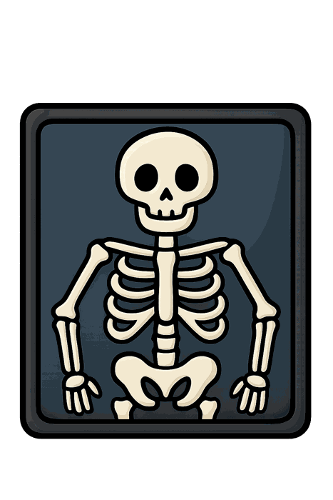
DAY 1
GAME
💬 TYPE 1 or 2 IN THE CHAT
__-ray
1 x
2 k
Notes:
🎙️ SCRIPT — read aloud:
Okay — look at the picture. Read the word with me: -ray… one letter is missing at the front. Which letter finishes it — number one, X, or number two, K? Sound it out in your mouth. Say your answer out loud. (pause)

Slide 50
DAY 1
GAME
✅ Yes!
x-ray
Notes:
🎙️ SCRIPT — read aloud:
Beautiful! It's X — the word is x-ray. Say it with me: /ks/… x-ray. x-ray. (pause) Good. Let's keep going.

Slide 51
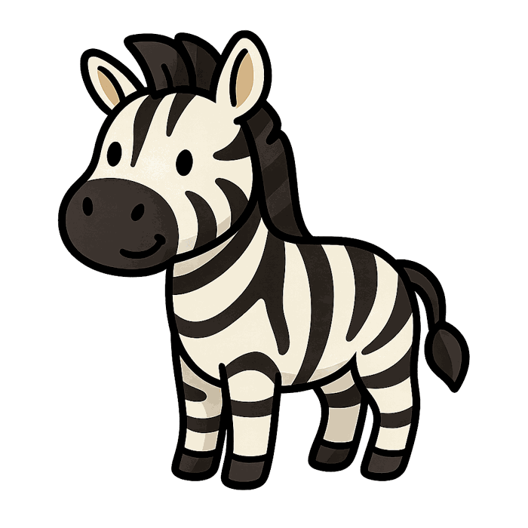
DAY 1
GAME
💬 TYPE 1 or 2 IN THE CHAT
__ebra
1 n
2 z
Notes:
🎙️ SCRIPT — read aloud:
Okay — look at the picture. Read the word with me: ebra… one letter is missing at the front. Which letter finishes it — number one, N, or number two, Z? Sound it out in your mouth. Say your answer out loud. (pause)

Slide 52
DAY 1
GAME
✅ Yes!
zebra
Notes:
🎙️ SCRIPT — read aloud:
Super! It's Z — the word is zebra. Say it with me: /zzzzz/… zebra. zebra. (pause) Good. Let's keep going.

Slide 53

DAY 1
GAME
💬 TYPE 1 or 2 IN THE CHAT
__og
1 d
2 p
Notes:
🎙️ SCRIPT — read aloud:
Okay — look at the picture. Read the word with me: og… one letter is missing at the front. Which letter finishes it — number one, D, or number two, P? Sound it out in your mouth. Say your answer out loud. (pause)

Slide 54
DAY 1
GAME
✅ Great ears!
dog
Notes:
🎙️ SCRIPT — read aloud:
Yes! It's D — the word is dog. Say it with me: /d/… dog. dog. (pause) Good. Let's keep going.

Slide 55
🏆 26 letters — you did it!
Notes:
🎙️ SCRIPT — read aloud:
And that's all twenty-six! You did it — you guessed your way through the whole alphabet. Look how much you can read now. Every one of those was you, using your eyes and your ears together. I'm proud of you. Take a breath — you earned it. See you in the next one.

