Slide 1
DAY 2
M U R R A Y ' S E N G L I S H
☀️ Good morning! Clap the alphabet!
Stand up! Big voice, big claps!
Chant it with me! 👏
murraycohen.com
Notes:
Good morning! Clap every letter with me, A to Z. Ready?

Slide 2
👏 CLAP THE ALPHABET!
A B C D E F G
H I J K L M N O P

Slide 3
👏 CLAP THE ALPHABET!
Q R S · T U V
W X · Y & Z

Slide 4
DAY 2
M U R R A Y ' S E N G L I S H
📍 Where we are
Yesterday: the ALPHABET 🔤 → Today: letters make WORDS
Missed a day? Full replay!
murraycohen.com
Notes:
Yesterday: tricky sounds. Today: the schwa. Missed a day? We'll do all of yesterday again, fast.

Slide 5
DAY 2
M U R R A Y ' S E N G L I S H
yesterday: the alphabet
letter names · letter sounds · A E I O U
let's do it all again!
murraycohen.com
Notes:
Here's everything from yesterday. Let's run through it all, quickly.

Slide 6
DAY 1
TEACH
the 5 vowel letters
A
E
I
O
U
🍎
🥚
🐛
🐙
☂️
Every English word has at least ONE vowel!

Slide 7
DAY 1
REVIEW
⭐ A · E · I · O · U
A
E
I
O
U
🍎
🥚
🐛
🐙
☂️
apple
egg
insect
octopus
umbrella

Slide 8
DAY 1
TEACH
M m
NAME
SOUND
“em”
/mmm/
🌙 moon

Slide 9
DAY 1
REVIEW
⭐ Our six letters!
M 🌙
S ☀️
T 🦷
“em” · /mmm/
“ess” · /sss/
“tee” · /t/
A 🍎
P 🖊️
N 👃
“ay” · /æ/
“pee” · /p/
“en” · /nnn/

Slide 10

DAY 1
GAME
💬 TYPE 1 or 2 IN THE CHAT
__pple
1 a
2 v

Slide 11
DAY 1
GAME
✅ Yes!
apple

Slide 12

DAY 1
GAME
💬 TYPE 1 or 2 IN THE CHAT
__un
1 s
2 b

Slide 13
DAY 1
GAME
✅ Great ears!
sun

Slide 14
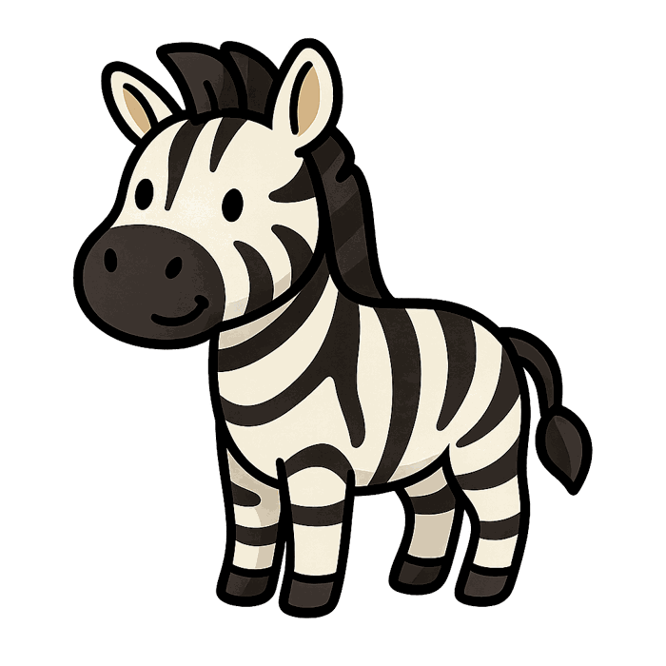
DAY 1
GAME
💬 TYPE 1 or 2 IN THE CHAT
__ebra
1 n
2 z

Slide 15
DAY 1
GAME
✅ Yes!
zebra

Slide 16
DAY 2
M U R R A Y ' S E N G L I S H
You know your letters! 🔤👏
Today: letters make WORDS — mat, map, man!
let's go!
murraycohen.com
Notes:
You did all of yesterday — TH, B/V/W, CH/SH, S/Z, cup/cop. Today: the laziest sound in English, the schwa. Let's go!

