Slide 1
M U R R A Y ' S E N G L I S H
word building game
Read it · Hear it · Type it
DAY 2
murraycohen.com
Notes:
🎙️ SCRIPT — read aloud:
Hi everyone, welcome back. Time for a game — the Word Building Game. I'll show you a picture and a word with one letter missing, and two choices. You pick the right letter, say it out loud, and then we read the whole word together. Later, a few star rounds where you spell the whole word yourself. Say everything out loud where you are. Ready? Let's build some words.

Slide 2
DAY 2
GAME
💬 TYPE 1 or 2 IN THE CHAT
🗺️
__ap
1 m
2 w
Notes:
🎙️ SCRIPT — read aloud:
Look at the picture — it's a map. Read the word: it ends in -ap, and the first letter is missing. Which one — number one, M, or number two, W? Sound it out: /mmmmm/-/aaa/-/p/. Say your answer out loud. (pause)

Slide 3
DAY 2
GAME
✅ map!
🗺️
map
Notes:
🎙️ SCRIPT — read aloud:
Map! Yes — number one, M. Say it with me: /mmmmm/-/aaa/-/p/, map. Map. (pause) Good.

Slide 4
DAY 2
GAME
💬 TYPE 1 or 2 IN THE CHAT
🍳
__an
1 p
2 r
Notes:
🎙️ SCRIPT — read aloud:
Look — a pan, for cooking. The word ends in -an. Which first letter — number one, P, or number two, R? Sound it out: /p/-/aaa/-/nnn/. Say your answer out loud. (pause)

Slide 5
DAY 2
GAME
✅ pan!
🍳
pan
Notes:
🎙️ SCRIPT — read aloud:
Pan! Yes — number one, P. Say it with me: /p/-/aaa/-/nnn/, pan. Pan. (pause) Nice.

Slide 6
DAY 2
GAME
💬 TYPE 1 or 2 IN THE CHAT
🎩
__at
1 h
2 n
Notes:
🎙️ SCRIPT — read aloud:
Look — a hat. The word ends in -at. Which first letter — number one, H, or number two, N? Sound it out: /h/-/aaa/-/t/. Say your answer out loud. (pause)

Slide 7
DAY 2
GAME
✅ hat!
🎩
hat
Notes:
🎙️ SCRIPT — read aloud:
Hat! Yes — number one, H. Say it with me: /h/-/aaa/-/t/, hat. Hat. (pause) Good.

Slide 8
DAY 2
GAME
💬 TYPE 1 or 2 IN THE CHAT
🐕
__og
1 d
2 p
Notes:
🎙️ SCRIPT — read aloud:
Look — a dog. The word ends in -og. Which first letter — number one, D, or number two, P? Sound it out: /d/-/ahh/-/g/. Say your answer out loud. (pause)

Slide 9
DAY 2
GAME
✅ dog!
🐕
dog
Notes:
🎙️ SCRIPT — read aloud:
Dog! Yes — number one, D. Say it with me: /d/-/ahh/-/g/, dog. Dog. (pause) Nice.

Slide 10
DAY 2
GAME
💬 TYPE 1 or 2 IN THE CHAT
⚽
__all
1 r
2 b
Notes:
🎙️ SCRIPT — read aloud:
Look — a ball. The word ends in -all. Which first letter — number one, R, or number two, B? Sound it out: /b/… ball. Say your answer out loud. (pause)

Slide 11
DAY 2
GAME
✅ ball!
⚽
ball
Notes:
🎙️ SCRIPT — read aloud:
Ball! Yes — number two, B. Say it with me: /b/… ball. Ball. (pause) Good.

Slide 12
DAY 2
GAME
💬 TYPE 1 or 2 IN THE CHAT
🍃
__eaf
1 l
2 t
Notes:
🎙️ SCRIPT — read aloud:
Look — a leaf. The word ends in -eaf. Which first letter — number one, L, or number two, T? Sound it out: /lllll/… leaf. Say your answer out loud. (pause)

Slide 13
DAY 2
GAME
✅ leaf!
🍃
leaf
Notes:
🎙️ SCRIPT — read aloud:
Leaf! Yes — number one, L. Say it with me: /lllll/… leaf. Leaf. (pause) Beautiful.

Slide 14
DAY 2
GAME
💬 TYPE 1 or 2 IN THE CHAT
🐟
__ish
1 e
2 f
Notes:
🎙️ SCRIPT — read aloud:
Look — a fish. The word ends in -ish. Which first letter — number one, E, or number two, F? Sound it out: /fffff/… fish. Say your answer out loud. (pause)

Slide 15
DAY 2
GAME
✅ fish!
🐟
fish
Notes:
🎙️ SCRIPT — read aloud:
Fish! Yes — number two, F. Say it with me: /fffff/… fish. Fish. (pause) Nice.

Slide 16
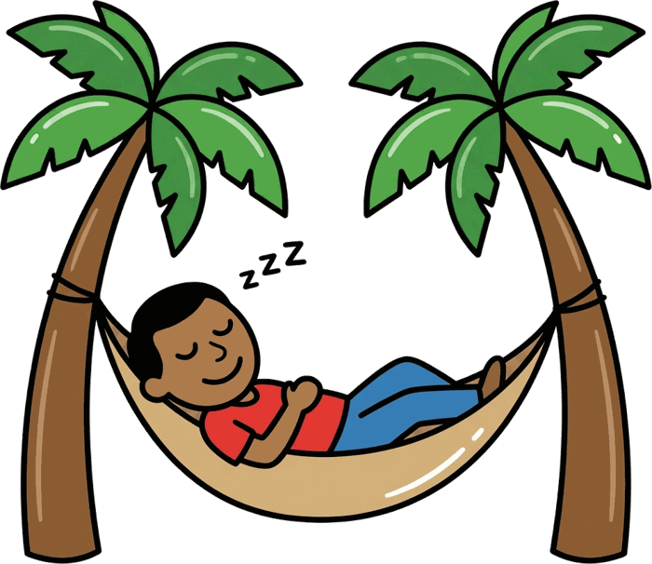
DAY 2
GAME
💬 TYPE 1 or 2 IN THE CHAT
na__
1 p
2 b
Notes:
🎙️ SCRIPT — read aloud:
This time the missing letter is at the END. The word is na-something. Which last letter — number one, P, or number two, B? Sound it out: /nnnnn/-/aaa/-/p/. Say your answer out loud. (pause)

Slide 17
DAY 2
GAME
✅ nap!
nap
Notes:
🎙️ SCRIPT — read aloud:
Nap! Yes — number one, P. Say it with me: /nnnnn/-/aaa/-/p/, nap. Nap. (pause) Good.

Slide 18
DAY 2
WARM-UP
⭐ STAR ROUND: I say it — you type the WHOLE word
💬 TYPE YOUR ANSWER IN THE CHAT
Listen… then type all the letters!
⭐ Stars: I say a word you never saw — sound it out!
Notes:
🎙️ SCRIPT — read aloud:
Now the star round. This time there's no picture and no choices — I say a word, and you spell the WHOLE word out loud, every letter. Ready? Listen: "sat"… /sss/-/aaa/-/t/. Spell it. (pause) S-A-T. Yes! Now "tan"… /t/-/aaa/-/nnn/. (pause) T-A-N. And one more, a word you may never have seen — "bat." Sound it out: /b/-/aaa/-/t/. (pause) B-A-T. Beautiful! If you can do that, your reading is really working.

Slide 19
🏆 You built words today!
Notes:
🎙️ SCRIPT — read aloud:
And that's the game — you built words today! You picked the letters, you sounded them out, you even spelled words on your own. That's real reading, and it's growing every day. I'm proud of you. Keep saying these out loud whenever you can. See you next time.

