Slide 1
DAY 2
PUSH FURTHER
🚀
Push Further!
Change one letter — read a NEW word!
Extra challenge!
Notes:
Big energy. 'You can read words now! Ready for a challenge? We push further!' Point at the rocket. 'Change ONE letter — and you read a NEW word.'

Slide 2

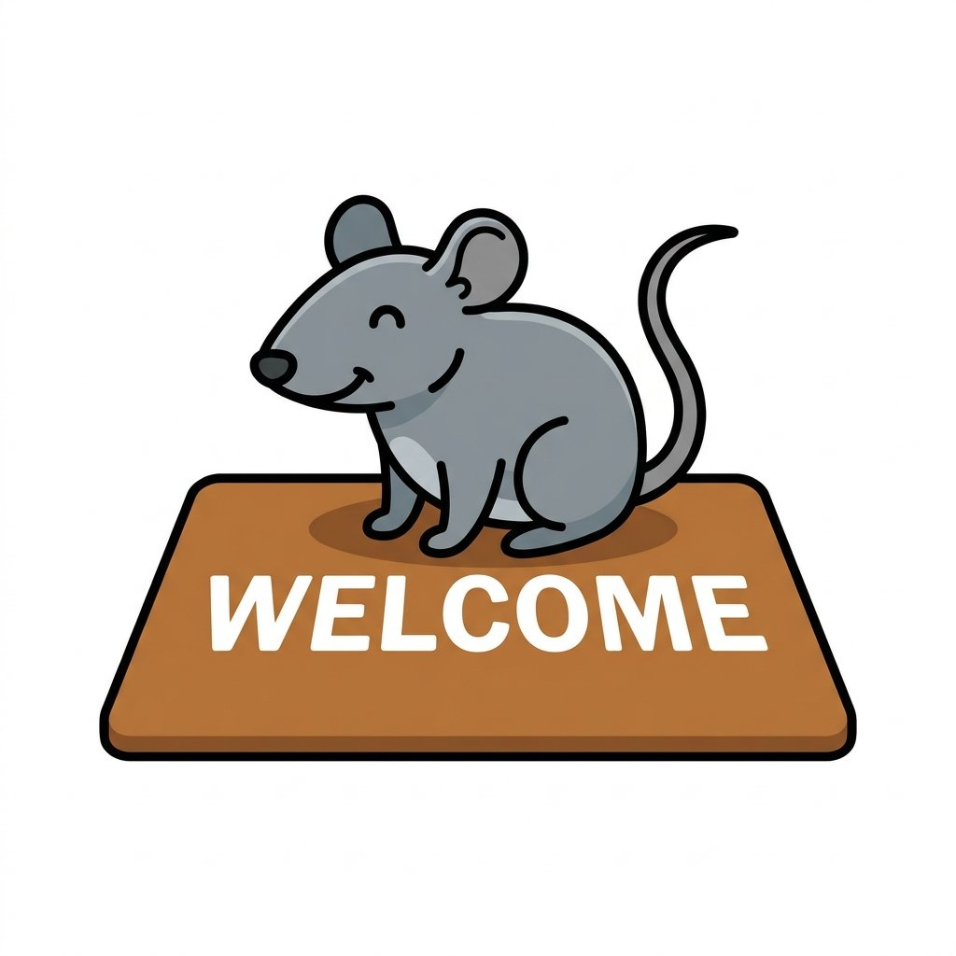
DAY 2
PUSH FURTHER
Read it 👀
A CAT on a mat.
Change one letter! 🔁
A RAT on a mat!
-at family: cat · hat · mat · rat
Notes:
Class reads line 1: 'A CAT on a mat.' Then: 'Watch! Change ONE letter. C becomes R…' Class reads: 'A RAT on a mat!' Circle: 'Is it a cat? No! A RAT!' Then point at the band — students read the -at family: cat, hat, mat, rat.

Slide 3

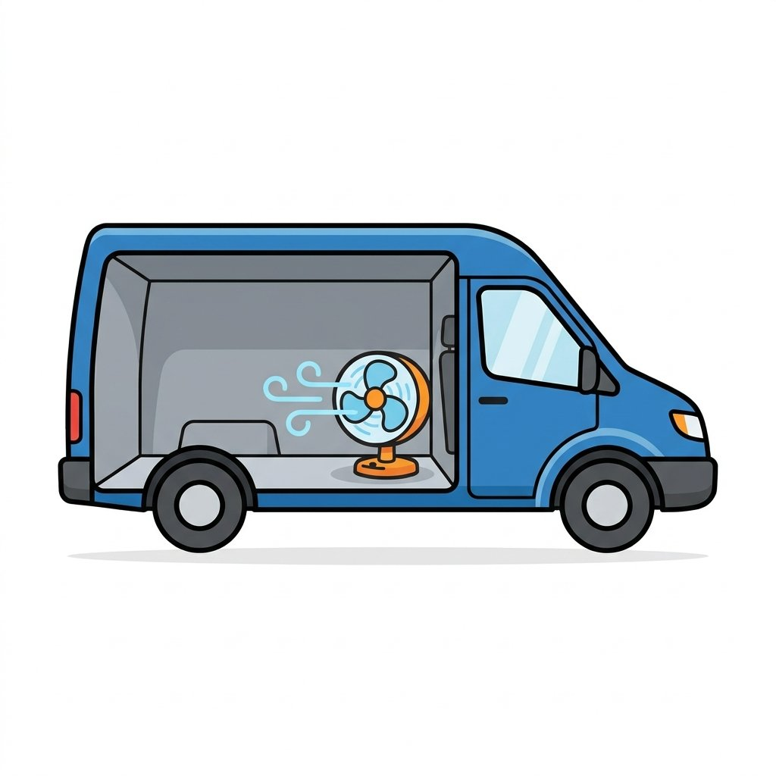
DAY 2
PUSH FURTHER
Read it 👀
A MAN has a pan.
Change one letter! 🔁
A VAN with a fan!
-an family: man · pan · van · fan
Notes:
Read line 1 together. 'Change one letter: M becomes V…' Class reads: 'A VAN and a fan!' Circle: 'Does the man have a van? No! A PAN.' Read the -an family from the band.

Slide 4
DAY 2
PUSH FURTHER
Read it 👀
😴
Take a NAP.
Change one letter! 🔁
Look at the MAP!
-ap family: nap · map · tap · cap
Notes:
Read line 1. Mime sleeping. 'Change one letter: N becomes M…' Class reads: 'Look at the MAP!' Circle: 'Do we sleep on a map? No! We take a NAP.' Read the -ap family from the band.

Slide 5
DAY 2
PUSH FURTHER
Look around you 👀
🛑
🚪
STOP
EXIT
Real signs — you can READ them!
Notes:
'You see these signs EVERY day. Read this one!' (STOP) 'And this one!' (EXIT) Circle: 'Where do you see EXIT?' Elicit: the store, the school, the bus. 'You are reading real English in the real world!'

Slide 6
DAY 2
PUSH FURTHER
two words together 🧩
🐕
💧🐱
A BIG dog.
A WET cat!
Read the pair!
Notes:
Class reads pair 1: 'A BIG dog.' Class reads pair 2: 'A WET cat!' Circle: 'Is the DOG wet? No! The CAT is wet. Is the cat big? No! The DOG is big.' Two words together — they can read the pair.

Slide 7
DAY 2
PUSH FURTHER
💬
You can read!
“STOP” · “EXIT” · “a big dog”
Read the world today! 🎉
Notes:
Celebrate. Point at each: 'STOP. EXIT. A big dog. You READ all of these!' Homework beat: 'Today, on the street, read ONE sign. Tell me tomorrow.'

