Slide 1
M U R R A Y ' S E N G L I S H
long & short vowels
Look, listen, say it with me! 🖼️
DAY 3
murraycohen.com
Notes:
Long and Short Vowels. Every English vowel has two sounds — a short sound and a long sound. The long sound says the letter's name. Look at the picture, listen, and say it with me.

Slide 2


DAY 3
LOOK & SAY
the letter a
🔴 SHORT /æ/
🔵 LONG /eɪ/
apple
ape
murraycohen.com
Notes:
The letter A. Short A — apple, /æ/. Say it: apple. Now the long A — ape, /eɪ/. The long vowel says its name. Say it: ape.

Slide 3


DAY 3
LOOK & SAY
the letter a
🔴 SHORT /æ/
🔵 LONG /eɪ/
ant
acorn
murraycohen.com
Notes:
The letter A. Short A — ant, /æ/. Say it: ant. Now the long A — acorn, /eɪ/. The long vowel says its name. Say it: acorn.

Slide 4



DAY 3
LOOK & SAY
the letter a
🔴 SHORT /æ/
🔵 LONG /eɪ/
ambulance
apron
murraycohen.com
Notes:
The letter A. Short A — axe, /æ/. Say it: axe. Now the long A — apron, /eɪ/. The long vowel says its name. Say it: apron.

Slide 5
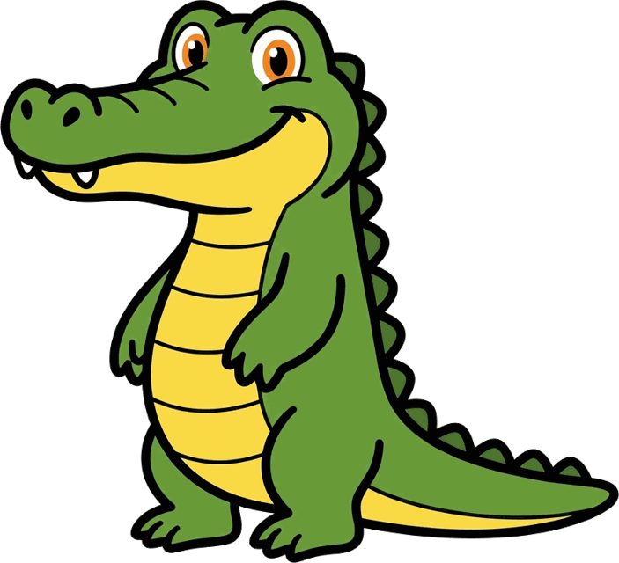

DAY 3
LOOK & SAY
the letter a
🔴 SHORT /æ/
🔵 LONG /eɪ/
alligator
angel
murraycohen.com
Notes:
The letter A. Short A — alligator, /æ/. Say it: alligator. Now the long A — angel, /eɪ/. The long vowel says its name. Say it: angel.

Slide 6


DAY 3
LOOK & SAY
the letter e
🔴 SHORT /ɛ/
🔵 LONG /iː/
egg
eagle
murraycohen.com
Notes:
The letter E. Short E — egg, /ɛ/. Say it: egg. Now the long E — eagle, /iː/. The long vowel says its name. Say it: eagle.

Slide 7
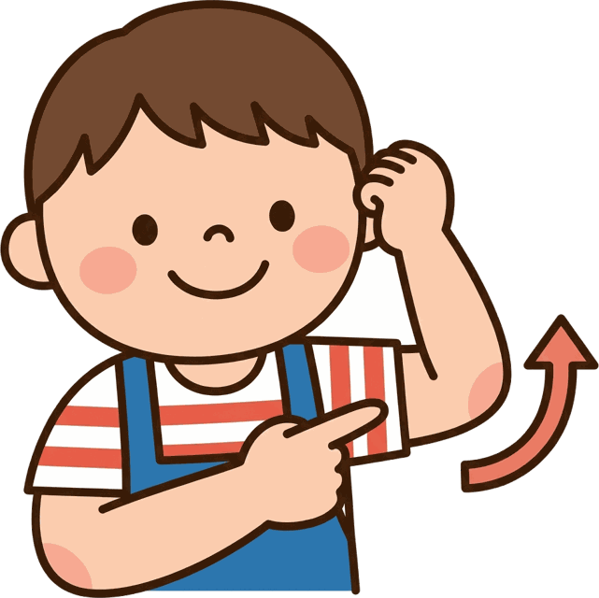

DAY 3
LOOK & SAY
the letter e
🔴 SHORT /ɛ/
🔵 LONG /iː/
elbow
ear
murraycohen.com
Notes:
The letter E. Short E — elbow, /ɛ/. Say it: elbow. Now the long E — ear, /iː/. The long vowel says its name. Say it: ear.

Slide 8


DAY 3
LOOK & SAY
the letter e
🔴 SHORT /ɛ/
🔵 LONG /iː/
elephant
evening
murraycohen.com
Notes:
The letter E. Short E — elephant, /ɛ/. Say it: elephant. Now the long E — evening, /iː/. The long vowel says its name. Say it: evening.

Slide 9


DAY 3
LOOK & SAY
the letter i
🔴 SHORT /ɪ/
🔵 LONG /aɪ/
igloo
island
murraycohen.com
Notes:
The letter I. Short I — igloo, /ɪ/. Say it: igloo. Now the long I — island, /aɪ/. The long vowel says its name. Say it: island.

Slide 10


DAY 3
LOOK & SAY
the letter i
🔴 SHORT /ɪ/
🔵 LONG /aɪ/
insect
iron
murraycohen.com
Notes:
The letter I. Short I — insect, /ɪ/. Say it: insect. Now the long I — iron, /aɪ/. The long vowel says its name. Say it: iron.

Slide 11
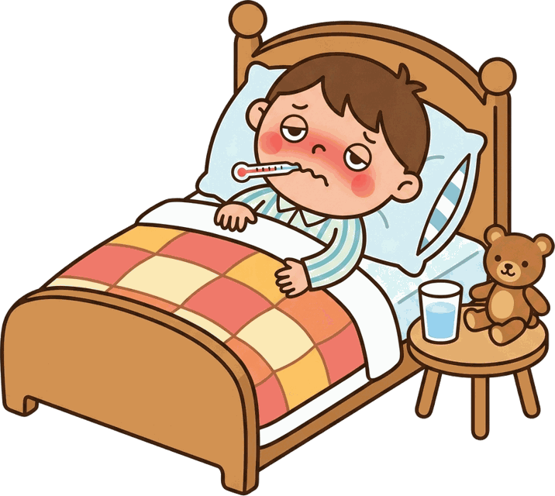

DAY 3
LOOK & SAY
the letter i
🔴 SHORT /ɪ/
🔵 LONG /aɪ/
illness
ice cream
murraycohen.com
Notes:
The letter I. Short I — illness, /ɪ/. Say it: illness. Now the long I — ice cream, /aɪ/. The long vowel says its name. Say it: ice cream.

Slide 12


DAY 3
LOOK & SAY
the letter o
🔴 SHORT /ɑ/
🔵 LONG /oʊ/
octopus
oatmeal
murraycohen.com
Notes:
The letter O. Short O — octopus, /ɑ/. Say it: octopus. Now the long O — oatmeal, /oʊ/. The long vowel says its name. Say it: oatmeal.

Slide 13


DAY 3
LOOK & SAY
the letter o
🔴 SHORT /ɑ/
🔵 LONG /oʊ/
onion
Open
murraycohen.com
Notes:
The letter O. Short O — onion, /ɑ/. Say it: onion. Now the long O — open, /oʊ/. The long vowel says its name. Say it: open.

Slide 14
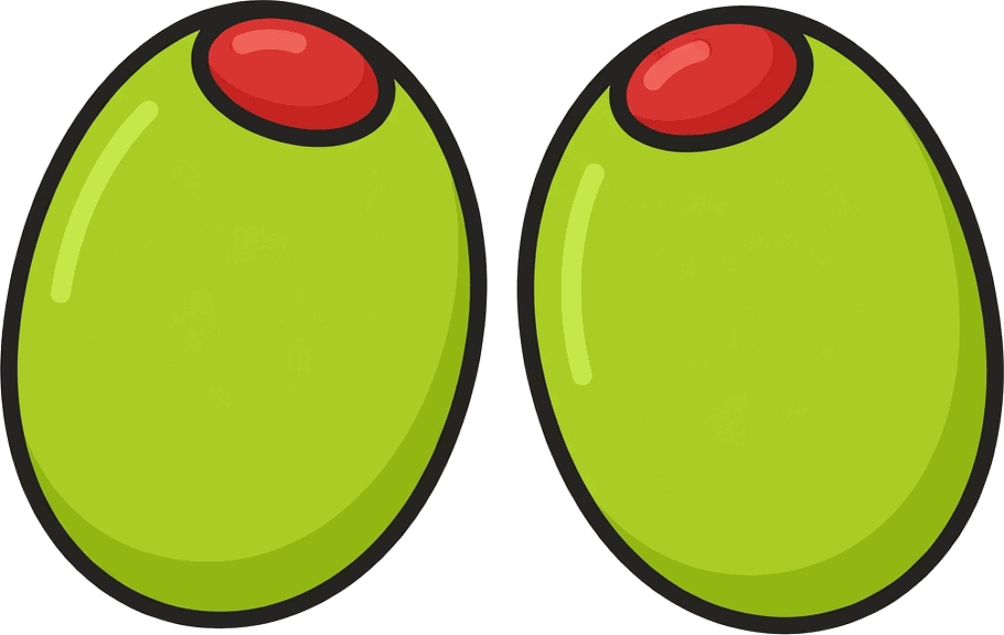

DAY 3
LOOK & SAY
the letter o
🔴 SHORT /ɑ/
🔵 LONG /oʊ/
olive
oak tree
murraycohen.com
Notes:
The letter O. Short O — olive, /ɑ/. Say it: olive. Now the long O — oak, /oʊ/. The
long vowel says its name. Say it: oak.

Slide 15


DAY 3
LOOK & SAY
the letter u
🔴 SHORT /ʌ/
🔵 LONG /juː/
umbrella
unicorn
murraycohen.com
Notes:
The letter U. Short U — umbrella, /ʌ/. Say it: umbrella. Now the long U — unicorn, /juː/. The long vowel says its name. Say it: unicorn.

Slide 16


DAY 3
LOOK & SAY
the letter u
🔴 SHORT /ʌ/
🔵 LONG /juː/
▶ Listen
under
ukulele
murraycohen.com
Notes:
The letter U. Short U — under, /ʌ/. Say it: under. Now the long U — ukulele, /juː/. The long vowel says its name. Say it: ukulele.

Slide 17


DAY 3
LOOK & SAY
the letter u
🔴 SHORT /ʌ/
🔵 LONG /juː/
up
uniform
murraycohen.com
Notes:
The letter U. Short U — up, /ʌ/. Say it: up. Now the long U — uniform, /juː/. The long vowel says its name. Say it: uniform.

