Slide 1
M U R R A Y ' S E N G L I S H
image guessing game 🖼️
Look at the picture. Guess the word!
Then say the vowel sound — short or long?
DAY 3
murraycohen.com
Notes:
Image Guessing Game! I show a picture. You guess the word. Then we say it together and decide — is the vowel short or long?

Slide 2

DAY 3
GUESS
What is it? 🤔
Notes:
What is it? Look carefully… (pause) Can you guess? Say it with me on the next slide.

Slide 3
DAY 3
ANSWER
ant
🔴 SHORT /æ/
Notes:
It's ant! Say it with me: ant. The A is a short vowel — /æ/.

Slide 4

DAY 3
GUESS
What is it? 🤔
Notes:
What is it? Look carefully… (pause) Can you guess? Say it with me on the next slide.

Slide 5
DAY 3
ANSWER
ice cream
🔵 LONG /aɪ/
Notes:
It's ice cream! Say it with me: ice cream. The I is a long vowel — /aɪ/.

Slide 6

DAY 3
GUESS
What is it? 🤔
Notes:
What is it? Look carefully… (pause) Can you guess? Say it with me on the next slide.

Slide 7
DAY 3
ANSWER
unicorn
🔵 LONG /juː/
Notes:
It's unicorn! Say it with me: unicorn. The U is a long vowel — /juː/.

Slide 8

DAY 3
GUESS
What is it? 🤔
Notes:
What is it? Look carefully… (pause) Can you guess? Say it with me on the next slide.

Slide 9
DAY 3
ANSWER
umbrella
🔴 SHORT /ʌ/
Notes:
It's umbrella! Say it with me: umbrella. The U is a short vowel — /ʌ/.

Slide 10

DAY 3
GUESS
What is it? 🤔
Notes:
What is it? Look carefully… (pause) Can you guess? Say it with me on the next slide.

Slide 11
DAY 3
ANSWER
uniform
🔵 LONG /juː/
Notes:
It's uniform! Say it with me: uniform. The U is a long vowel — /juː/.

Slide 12

DAY 3
GUESS
What is it? 🤔
Notes:
What is it? Look carefully… (pause) Can you guess? Say it with me on the next slide.

Slide 13
DAY 3
ANSWER
under
🔴 SHORT /ʌ/
Notes:
It's under! Say it with me: under. The U is a short vowel — /ʌ/.

Slide 14

DAY 3
GUESS
What is it? 🤔
Notes:
What is it? Look carefully… (pause) Can you guess? Say it with me on the next slide.

Slide 15
DAY 3
ANSWER
evening
🔵 LONG /iː/
Notes:
It's evening! Say it with me: evening. The E is a long vowel — /iː/.

Slide 16

DAY 3
GUESS
What is it? 🤔
Notes:
What is it? Look carefully… (pause) Can you guess? Say it with me on the next slide.

Slide 17
DAY 3
ANSWER
oatmeal
🔵 LONG /oʊ/
Notes:
It's oatmeal! Say it with me: oatmeal. The O is a long vowel — /oʊ/.

Slide 18

DAY 3
GUESS
What is it? 🤔
Notes:
What is it? Look carefully… (pause) Can you guess? Say it with me on the next slide.

Slide 19
DAY 3
ANSWER
onion
🔴 SHORT /ɑ/
Notes:
It's onion! Say it with me: onion. The O is a short vowel — /ɑ/.

Slide 20

DAY 3
GUESS
What is it? 🤔
Notes:
What is it? Look carefully… (pause) Can you guess? Say it with me on the next slide.

Slide 21
DAY 3
ANSWER
oak tree
🔵 LONG /oʊ/
Notes:
It's oak tree! Say it with me: oak tree. The O is a long vowel — /oʊ/.

Slide 22

DAY 3
GUESS
What is it? 🤔
Notes:
What is it? Look carefully… (pause) Can you guess? Say it with me on the next slide.

Slide 23
DAY 3
ANSWER
octopus
🔴 SHORT /ɑ/
Notes:
It's octopus! Say it with me: octopus. The O is a short vowel — /ɑ/.

Slide 24

DAY 3
GUESS
What is it? 🤔
Notes:
What is it? Look carefully… (pause) Can you guess? Say it with me on the next slide.

Slide 25
DAY 3
ANSWER
island
🔵 LONG /aɪ/
Notes:
It's island! Say it with me: island. The I is a long vowel — /aɪ/.

Slide 26
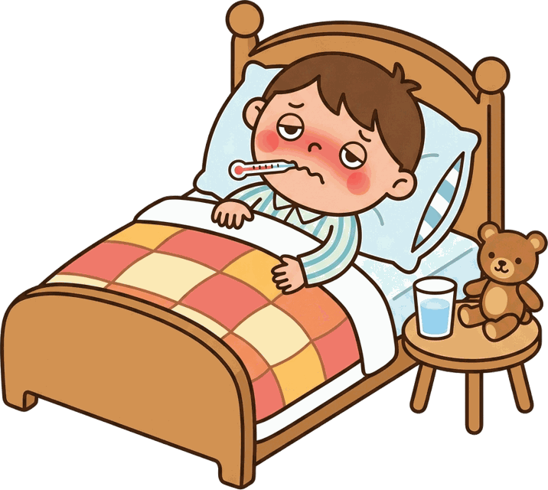
DAY 3
GUESS
What is it? 🤔
Notes:
What is it? Look carefully… (pause) Can you guess? Say it with me on the next slide.

Slide 27
DAY 3
ANSWER
illness
🔴 SHORT /ɪ/
Notes:
It's illness! Say it with me: illness. The I is a short vowel — /ɪ/.

Slide 28

DAY 3
GUESS
What is it? 🤔
Notes:
What is it? Look carefully… (pause) Can you guess? Say it with me on the next slide.

Slide 29
DAY 3
ANSWER
iron
🔵 LONG /aɪ/
Notes:
It's iron! Say it with me: iron. The I is a long vowel — /aɪ/.

Slide 30

DAY 3
GUESS
What is it? 🤔
Notes:
What is it? Look carefully… (pause) Can you guess? Say it with me on the next slide.

Slide 31
DAY 3
ANSWER
insect
🔴 SHORT /ɪ/
Notes:
It's insect! Say it with me: insect. The I is a short vowel — /ɪ/.

Slide 32

DAY 3
GUESS
What is it? 🤔
Notes:
What is it? Look carefully… (pause) Can you guess? Say it with me on the next slide.

Slide 33
DAY 3
ANSWER
igloo
🔴 SHORT /ɪ/
Notes:
It's igloo! Say it with me: igloo. The I is a short vowel — /ɪ/.

Slide 34

DAY 3
GUESS
What is it? 🤔
Notes:
What is it? Look carefully… (pause) Can you guess? Say it with me on the next slide.

Slide 35
DAY 3
ANSWER
elbow
🔴 SHORT /ɛ/
Notes:
It's elbow! Say it with me: elbow. The E is a short vowel — /ɛ/.

Slide 36

DAY 3
GUESS
What is it? 🤔
Notes:
What is it? Look carefully… (pause) Can you guess? Say it with me on the next slide.

Slide 37
DAY 3
ANSWER
olive
🔴 SHORT /ɑ/
Notes:
It's olive! Say it with me: olive. The O is a short vowel — /ɑ/.

Slide 38

DAY 3
GUESS
What is it? 🤔
Notes:
What is it? Look carefully… (pause) Can you guess? Say it with me on the next slide.

Slide 39
DAY 3
ANSWER
eagle
🔵 LONG /iː/
Notes:
It's eagle! Say it with me: eagle. The E is a long vowel — /iː/.

Slide 40

DAY 3
GUESS
What is it? 🤔
Notes:
What is it? Look carefully… (pause) Can you guess? Say it with me on the next slide.

Slide 41
DAY 3
ANSWER
elephant
🔴 SHORT /ɛ/
Notes:
It's elephant! Say it with me: elephant. The E is a short vowel — /ɛ/.

Slide 42

DAY 3
GUESS
What is it? 🤔
Notes:
What is it? Look carefully… (pause) Can you guess? Say it with me on the next slide.

Slide 43
DAY 3
ANSWER
ear
🔵 LONG /iː/
Notes:
It's ear! Say it with me: ear. The E is a long vowel — /iː/.

Slide 44

DAY 3
GUESS
What is it? 🤔
Notes:
What is it? Look carefully… (pause) Can you guess? Say it with me on the next slide.

Slide 45
DAY 3
ANSWER
egg
🔴 SHORT /ɛ/
Notes:
It's egg! Say it with me: egg. The E is a short vowel — /ɛ/.

Slide 46

DAY 3
GUESS
What is it? 🤔
Notes:
What is it? Look carefully… (pause) Can you guess? Say it with me on the next slide.

Slide 47
DAY 3
ANSWER
angel
🔵 LONG /eɪ/
Notes:
It's angel! Say it with me: angel. The A is a long vowel — /eɪ/.

Slide 48
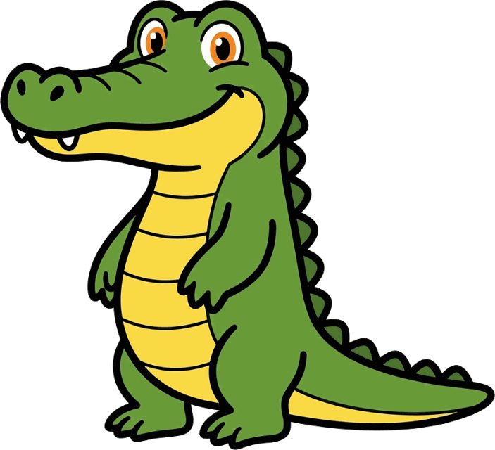
DAY 3
GUESS
What is it? 🤔
Notes:
What is it? Look carefully… (pause) Can you guess? Say it with me on the next slide.

Slide 49
DAY 3
ANSWER
alligator
🔴 SHORT /æ/
Notes:
It's alligator! Say it with me: alligator. The A is a short vowel — /æ/.

Slide 50

DAY 3
GUESS
What is it? 🤔
Notes:
What is it? Look carefully… (pause) Can you guess? Say it with me on the next slide.

Slide 51
DAY 3
ANSWER
apron
🔵 LONG /eɪ/
Notes:
It's apron! Say it with me: apron. The A is a long vowel — /eɪ/.

Slide 52

DAY 3
GUESS
What is it? 🤔
Notes:
What is it? Look carefully… (pause) Can you guess? Say it with me on the next slide.

Slide 53

DAY 3
ANSWER
ambulance
🔴 SHORT /æ/
Notes:
It's axe! Say it with me: axe. The A is a short vowel — /æ/.

Slide 54

DAY 3
GUESS
What is it? 🤔
Notes:
What is it? Look carefully… (pause) Can you guess? Say it with me on the next slide.

Slide 55
DAY 3
ANSWER
acorn
🔵 LONG /eɪ/
Notes:
It's acorn! Say it with me: acorn. The A is a long vowel — /eɪ/.

