Slide 1
M U R R A Y ' S E N G L I S H
Repeat & Echo
Long vowels — say it with me! 🎤
DAY 3
murraycohen.com
Notes:
Repeat and Echo! Here's how we play: One — look at the picture. Two — I say the word. Three — you repeat it. Four — add a gesture, stretch your hands wide for the long vowel. Five — then we speed up the rhythm! These are all LONG vowel words. Ready? Let's go.

Slide 2

DAY 3
REPEAT
Notes:
Cake. Listen — cake. That's the long A sound. Say it with me… cake. (pause) Again — stretch the long vowel! Now a little faster.

Slide 3

DAY 3
REPEAT
Notes:
Bike. Listen — bike. That's the long I sound. Say it with me… bike. (pause) Again — stretch the long vowel! Now a little faster.

Slide 4

DAY 3
REPEAT
Notes:
Rope. Listen — rope. That's the long O sound. Say it with me… rope. (pause) Again — stretch the long vowel! Now a little faster.

Slide 5

DAY 3
REPEAT
Notes:
Cube. Listen — cube. That's the long U sound. Say it with me… cube. (pause) Again — stretch the long vowel! Now a little faster.

Slide 6

DAY 3
REPEAT
Notes:
Leaf. Listen — leaf. That's the long E sound. Say it with me… leaf. (pause) Again — stretch the long vowel! Now a little faster.

Slide 7

DAY 3
REPEAT
Notes:
Bee. Listen — bee. That's the long E sound. Say it with me… bee. (pause) Again — stretch the long vowel! Now a little faster.

Slide 8

DAY 3
REPEAT
Notes:
Feet. Listen — feet. That's the long E sound. Say it with me… feet. (pause) Again — stretch the long vowel! Now a little faster.

Slide 9

DAY 3
REPEAT
Notes:
Kite. Listen — kite. That's the long I sound. Say it with me… kite. (pause) Again — stretch the long vowel! Now a little faster.

Slide 10

DAY 3
REPEAT
Notes:
Cone. Listen — cone. That's the long O sound. Say it with me… cone. (pause) Again — stretch the long vowel! Now a little faster.

Slide 11
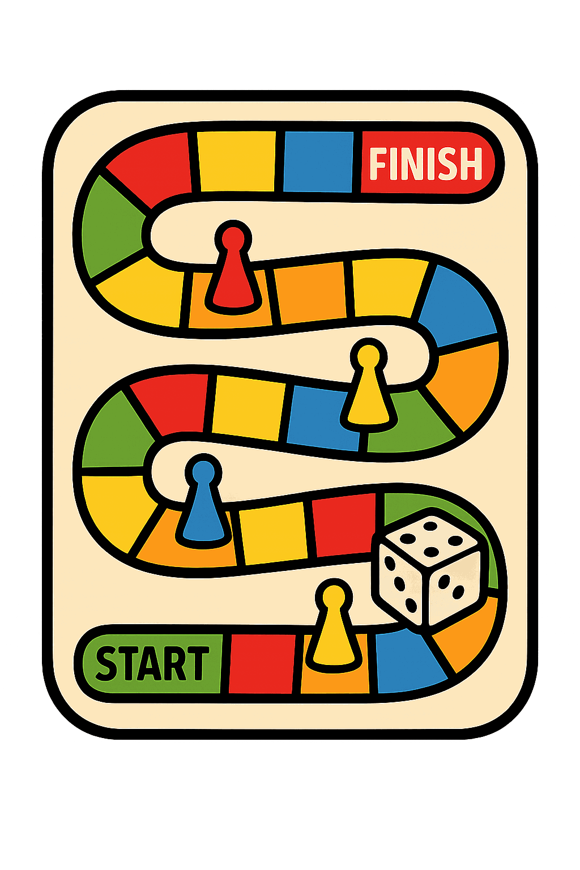
DAY 3
REPEAT
Notes:
Game. Listen — game. That's the long A sound. Say it with me… game. (pause) Again — stretch the long vowel! Now a little faster.

