Slide 1
M U R R A Y ' S E N G L I S H
I'm a Little Teapot 🫖
Stretch the vowel — shout it OUT!
DAY 3
murraycohen.com
Notes:
🎙️ SCRIPT — read aloud:
Welcome to Rhyme Time. Now, I know — nursery rhymes might feel a little silly for grown-ups. But here's the secret: these little songs carry the RHYTHM of English, the natural beat of the language. American children learn English rhythm this way, and it works beautifully for us too. And if you have children, you'll know these songs — and you can sing them together. So let's have a little fun. Say and sing it all out loud with me.

Slide 2
DAY 3
SING
🫖 I'm a Little Teapot
Today's sound: OUT /aʊ/ — stout · spout · shout · out
Mouth opens BIG then closes: a→ʊ (like “ow!”)
Notes:
🎙️ SCRIPT — read aloud:
Our first song is "I'm a Little Teapot," and today's sound is the OUT sound — /aʊ/. It's the sound you make when something surprises you: "ow!" Your mouth opens big, then closes — /aʊ/. Listen to our four words: stout… spout… shout… out. Say them with me, slowly. (pause) Good. They all share that same /aʊ/ — the OUT sound.

Slide 3

DAY 3
SING
🎬 Sing along — I'm a Little Teapot!
🫖 Gestures ready: handle… spout… tip over!
Notes:
🎙️ SCRIPT — read aloud:
Now let's sing the whole thing together, with the motions. One hand on your hip for the handle… the other arm out for the spout… and when we get to the end, tip over and pour out! Sing it with me, nice and full. (pause) Wonderful. You sounded great.

Slide 4
DAY 3
SING
🫖 I'm a Little Teapot
I'm a little teapot, short and stout
Here is my handle, here is my spout
When I get all steamed up, hear me shout
Tip me over and pour me out!
🔴 All four rhyme words = the same /aʊ/ sound!
Notes:
🎙️ SCRIPT — read aloud:
Now let's sing it, line by line. I'll sing a line, you sing it back. "I'm a little teapot, short and stout." (pause) "Here is my handle, here is my spout." (pause) "When I get all steamed up, hear me shout." (pause) "Tip me over and pour me out!" (pause) Did you hear it? Stout, spout, shout, out — all the same /aʊ/ sound. Beautiful.

Slide 5
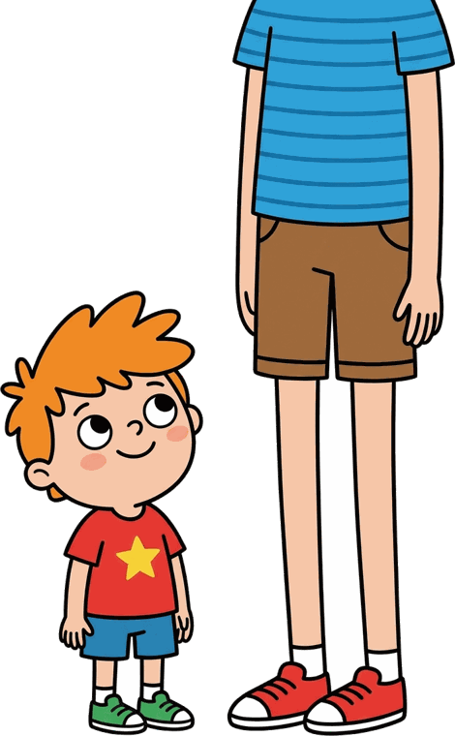

🫖
teapot
short
stout
I'm a little teapot, short and stout.

Slide 6



handle
spout
Here is my handle, here is my spout.

Slide 7


steamed
shout
When I get all steamed up, hear me shout!

Slide 8


tip
pour
Tip me over and pour me out!

Slide 9
DAY 3
SING
🎬 Sing along — I'm a Little Teapot!
🫖 Gestures ready: handle… spout… tip over!
Notes:
🎙️ SCRIPT — read aloud:
Now let's sing the whole thing together, with the motions. One hand on your hip for the handle… the other arm out for the spout… and when we get to the end, tip over and pour out! Sing it with me, nice and full. (pause) Wonderful. You sounded great.

Slide 10
🎵 Homework: sing ONE song with your family!
(Your kids will love that you know it)
Notes:
🎙️ SCRIPT — read aloud:
Here's your homework, and there's no worksheet — just this. Sing ONE of these songs with your family this week. Your kids will love that you know it. And singing together is one of the best ways to feel English rhythm. You did beautifully today, and that wraps up Day Four. I'm proud of you. See you next time.

