Slide 1
DAY 4
M U R R A Y ' S E N G L I S H
☀️ Good morning! Clap the alphabet!
Stand up! Big voice, big claps!
Chant it with me! 👏
murraycohen.com
Notes:
Good morning! Clap every letter with me, A to Z. Ready?

Slide 2
👏 CLAP THE ALPHABET!
A B C D E F G
H I J K L M N O P

Slide 3
👏 CLAP THE ALPHABET!
Q R S · T U V
W X · Y & Z

Slide 4
DAY 4
M U R R A Y ' S E N G L I S H
📍 Where we are
Yesterday: short & long vowels → Today: sound-alike words
Missed a day? Full replay!
murraycohen.com
Notes:
Yesterday: tricky sounds. Today: the schwa. Missed a day? We'll do all of yesterday again, fast.

Slide 5
DAY 4
M U R R A Y ' S E N G L I S H
Yesterday: short and long vowels
A E I O U · ✊ short · 🙆 long · the Magic E ✨
let's do it all again!
murraycohen.com
Notes:
Here's everything from yesterday. Let's run through it all, quickly.

Slide 6


DAY 3
TEACH
Every vowel has TWO sounds
🔴 SHORT — quick!
🔵 LONG — says its NAME!

Slide 7
DAY 3
TEACH
the letter a
🔴 SHORT /æ/
🔵 LONG /eɪ/
🍎
🍰
apple
cake
says its name: “A”

Slide 8
DAY 3
TEACH
the letter e
🔴 SHORT /ɛ/
🔵 LONG /iː/
🥚
🐝
egg
bee
says its name: “E”

Slide 9
DAY 3
TEACH
the letter i
🔴 SHORT /ɪ/
🔵 LONG /aɪ/
🐛
🪁
insect
kite
says its name: “I”

Slide 10
DAY 3
TEACH
the letter o
🔴 SHORT /ɑ/
🔵 LONG /oʊ/
🐙
⛵
octopus
boat
says its name: “O”

Slide 11
DAY 3
TEACH
the letter u
🔴 SHORT /ʌ/
🔵 LONG /juː/
☂️
🦄
umbrella
unicorn
says its name: “U”

Slide 12
DAY 3
REVIEW
⭐ Every vowel — short and long!
a 🍎 apple → 🍰 cake
e 🥚 egg → 🐝 bee
i 🐛 insect → 🪁 kite
o 🐙 octopus → ⛵ boat
u ☂️ umbrella → 🦄 unicorn
🔴 short 🔵 long (says its name!)

Slide 13
DAY 3
CHANT
the gestures
SHORT = pinch!
LONG = stretch!
quick! a!
aaaaaa!

Slide 14
DAY 3
CHANT
A
🍎
🍰
✊ apple
🙆 cake
✊ a! a! apple! 🙆 aːːː! cake!

Slide 15
DAY 3
MAGIC
🪄 the Magic E rule
can + e = cane
The e is SILENT 🤫 … but it makes a say its NAME!
can → cane man → mane pan → pane tap → tape

Slide 16

DAY 3
TEACH
Short a or Long a?
🥫
can
cane
SHORT — quick!
LONG — says its name!
🔴 Red = SHORT vowel 🔵 Blue = LONG vowel (same colors all 11 days!)

Slide 17
DAY 3
GAME
👂 Which word do you hear?
💬 TYPE 1 or 2 IN THE CHAT
👨
🦁
1
2
man
mane

Slide 18
DAY 3
GAME
✅ Great ears!
👨
man

Slide 19

DAY 3
REVIEW
⭐ Four magic pairs!
🥫 can
👨 man
🍳 pan
🚰 tap
🦯 cane
🦁 mane
🪟 pane
tape

Slide 20

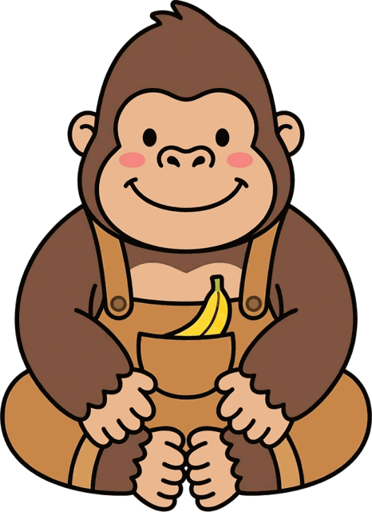
DAY 3
LOOK & SAY
the letter a
🔴 SHORT /æ/
🔵 LONG /eɪ/
apple
ape
murraycohen.com

Slide 21


DAY 3
LOOK & SAY
the letter e
🔴 SHORT /ɛ/
🔵 LONG /iː/
egg
eagle
murraycohen.com

Slide 22

DAY 3
GUESS
What is it? 🤔

Slide 23
DAY 3
ANSWER
ant
🔴 SHORT /æ/

Slide 24

DAY 3
GUESS
What is it? 🤔

Slide 25
DAY 3
ANSWER
island
🔵 LONG /aɪ/

Slide 26
DAY 4
M U R R A Y ' S E N G L I S H
Vowel masters! 🎉👏
Today: sound-alikes — ship or sheep? 🚢🐑
let's go!
murraycohen.com
Notes:
You did all of yesterday — TH, B/V/W, CH/SH, S/Z, cup/cop. Today: the laziest sound in English, the schwa. Let's go!

