Slide 1
M U R R A Y ' S E N G L I S H
Ship or Sheep? 🚢🐑
Listen. Say 1 or 2!
SOUND-ALIKES
murraycohen.com
Notes:
Hey everybody, welcome back! Today we're going to play with two sounds that are very, very close — so close they're tricky. Ship… or sheep? Can you hear it? I'm going to say a word, and you're going to say the number — one or two. Listen carefully with me. Ready? Let's go.

Slide 2
SOUND-ALIKES
Two sounds
ee
ih
/iː/ long ee
/ɪ/ short i
Smile! Lips wide.
Relax. Short & quick.
🐑 sheep
🚢 ship
Notes:
First, let's hear the two sounds. The first one is long. Smile big and say it with me: eeee. Like in sheep — sheeep. Now the second one is short and quick. Relax your mouth: ih. Like in ship — ship. Feel the difference. Smile: eeee. Relax: ih. Eeee… ih. Say them with me. Eeee. (pause) Ih. (pause) Good!

Slide 3
SOUND-ALIKES
👂 Listen — say 1 or 2!
1
2
🚢
🐑
sheep
ship
Notes:
Look. Number one is sheep. Number two is ship. I say one word. You say the number — one or two. Listen… sheep. (pause) One or two? (pause) Number one! Sheep. Listen… ship. (pause) One or two? (pause) Number two! Ship. Great listening, everybody!

Slide 4
SOUND-ALIKES
👂 Listen — say 1 or 2!
1
2
🗑️
🫘
bin
bean
Notes:
Look. Number one is bin. Number two is bean. I say one word. You say the number — one or two. Listen… bin. (pause) One or two? (pause) Number one! Bin. Listen… bean. (pause) One or two? (pause) Number two! Bean. Great listening, everybody!

Slide 5


SOUND-ALIKES
👂 Listen — say 1 or 2!
1
2
seat
sit
Notes:
Look. Number one is seat. Number two is sit. I say one word. You say the number — one or two. Listen… seat. (pause) One or two? (pause) Number one! Seat. Listen… sit. (pause) One or two? (pause) Number two! Sit. Great listening, everybody!

Slide 6


SOUND-ALIKES
👂 Listen — say 1 or 2!
1
2
hill
heel
Notes:
Look. Number one is hill. Number two is heel. I say one word. You say the number — one or two. Listen… hill. (pause) One or two? (pause) Number one! Hill. Listen… heel. (pause) One or two? (pause) Number two! Heel. Great listening, everybody!

Slide 7
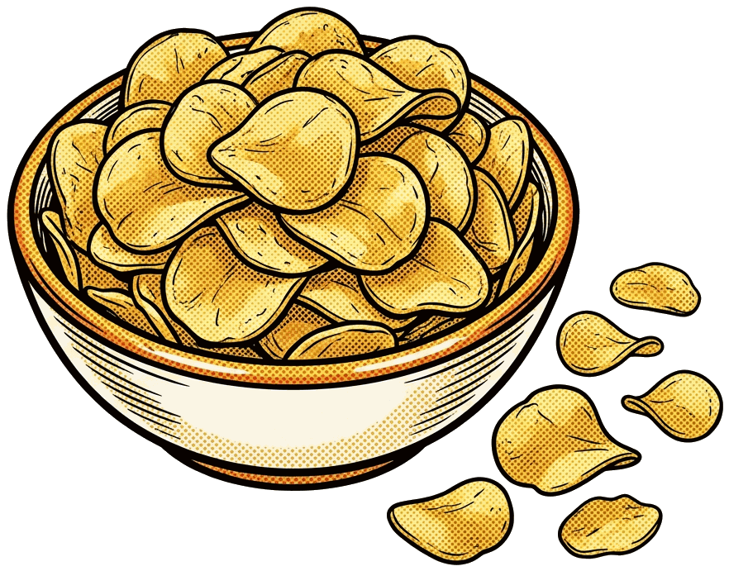

SOUND-ALIKES
👂 Listen — say 1 or 2!
1
2
chip
cheap

Slide 8
SOUND-ALIKES
👂 Listen — say 1 or 2!
1
2
💪
🦶
fit
feet

Slide 9
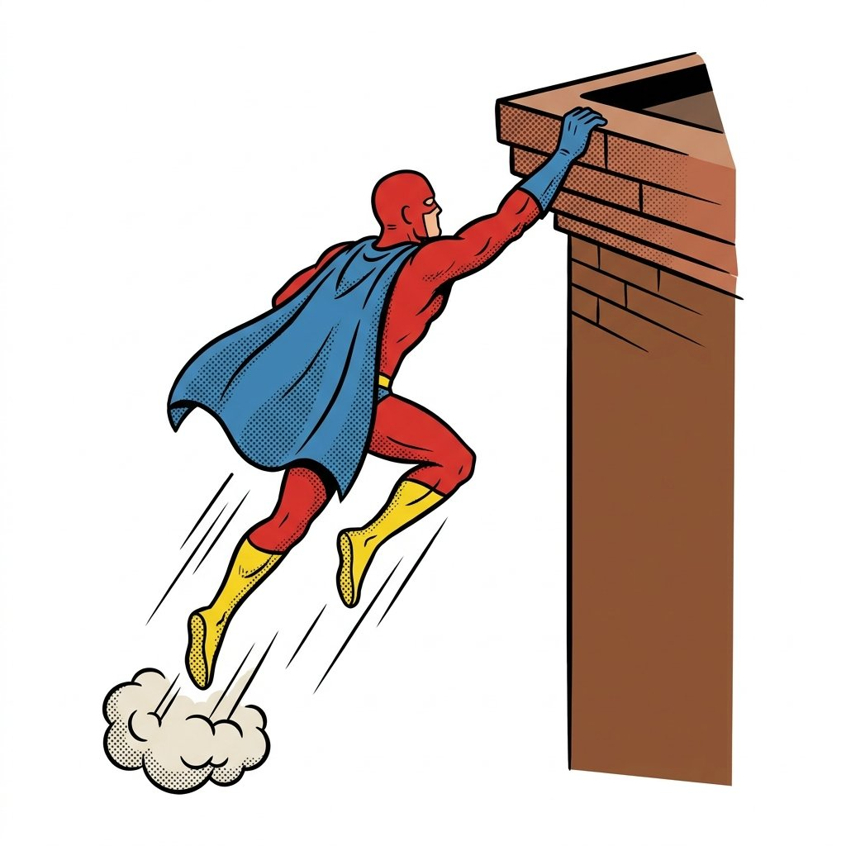
SOUND-ALIKES
👂 Listen — say 1 or 2!
1
2
👄
lip
leap

Slide 10
SOUND-ALIKES
👂 Listen — say 1 or 2!
1
2
💊
🍌
pill
peel

Slide 11
SOUND-ALIKES
Your turn — say it with me 🗣️
ee
sheep · bean · seat · heel · cheap · feet
ih
ship · bin · sit · hill · chip · fit
Say each one slowly. Feel your mouth change.
Notes:
Now say them all with me. Sheep — ship. (pause) Bean — bin. (pause) Seat — sit. (pause) Heel — hill. (pause) Feel the long sound and the short sound in your mouth. Sheep. Ship. Beautiful.

Slide 12

SOUND-ALIKES
🎮 Game! Say 1 or 2!
1
2
🐑
ship
sheep
Notes:
Game time! Number one is ship. Number two is sheep. Listen… sheep. (pause) Say the number! (pause) Number two — Sheep. Again… ship. (pause) What number? (pause) Number one — Ship. Nice work!

Slide 13
SOUND-ALIKES
🎮 Game! Say 1 or 2!
1
2
🫘
🗑️
bean
bin
Notes:
Game time! Number one is bean. Number two is bin. Listen… bin. (pause) Say the number! (pause) Number two — Bin. Again… bean. (pause) What number? (pause) Number one — Bean. Nice work!

Slide 14
SOUND-ALIKES
🎮 Game! Say 1 or 2!
1
2
sit
seat
Notes:
Game time! Number one is sit. Number two is seat. Listen… seat. (pause) Say the number! (pause) Number two — Seat. Again… sit. (pause) What number? (pause) Number one — Sit. Nice work!

Slide 15
SOUND-ALIKES
🎮 Game! Say 1 or 2!
1
2
👠
⛰️
heel
hill

Slide 16
SOUND-ALIKES
🎮 Game! Say 1 or 2!
1
2
🦶
💪
feet
fit

Slide 17
SOUND-ALIKES
🎮 Game! Say 1 or 2!
1
2
cheap
chip

Slide 18
Great job! 🎉
Say them again with me!
Notes:
Great job today, everybody. These were tricky sounds — long eeee and short ih — and you listened so carefully. Keep saying them at home: sheep, ship. Sheep, ship. I'm proud of you. See you next time!

