Slide 1
M U R R A Y ' S E N G L I S H
Pen or Pan? 🖊️🍳
The trickiest sound-alikes yet! 👯
SOUND-ALIKES
murraycohen.com
Notes:
🎙️ SCRIPT — read aloud:
Welcome back — and get ready, because these are the trickiest sound-alikes of all. Pen… or pan? They're both SHORT sounds, very close together, so this one is the real ear workout. I'll say a word, you say the number — one or two. Don't worry if it's hard; that means you're learning. Ready? Let's listen.

Slide 2
SOUND-ALIKES
Two sounds
eh
a
/ɛ/ as in pen
/æ/ as in pan
Open, relaxed.
Wide, bright 'aaa'.
🖊️ pen
🍳 pan
Notes:
Let's hear them first. The first sound is "eh." Your mouth is a little open: eh. Like in pen — pen. Now the second sound is bigger and wider: "aaa." Open your mouth like at the doctor: aaa. Like in pan — pan. Feel it. Eh… aaa. A little open: eh. Wide open: aaa. Say them with me. Eh. (pause) Aaa. (pause) Good!

Slide 3
SOUND-ALIKES
Your turn — say it with me 🗣️
eh
pen · men · bend · bed · beg · ten · pet · bet · send · gem
a
pan · man · band · bad · bag · tan · pat · bat · sand · jam
Say each one slowly. Feel your mouth change.
Notes:
Now say them with me. Pen — pan. (pause) Man — men. (pause) Here are two more to say — band, and bend. Band… bend. (pause) Feel the sounds. Eh — aaa. Pen, pan. Beautiful.

Slide 4
SOUND-ALIKES
🎮 Game! Say 1 or 2!
1
2
🍳
🖊️
pan
pen
✅ It’s PEN!
Notes:
━━━━━━ GAME: pan or pen? ━━━━━━
① pan 🍳 (a frying pan)
② pen 🖊️ (the pen you write with)
✅ ANSWER: pen = NUMBER 2
─────────────────────────────
SAY THIS:
"Number ONE is pan — a frying pan.
Number TWO is pen — the pen you write with.
So — number one, pan… number two, pen.
Now listen! I'll say ONE word — only one word — and you tell me the number. You ready?
Here it is… Pen. (pause) Again — pen. Is that one, or two? (pause) pen… one or two?"
[ CLICK to reveal ] → "Yes! It's NUMBER 2 — pen!"

Slide 5
SOUND-ALIKES
🎮 Game! Say 1 or 2!
1
2
😠
🛏️
bad
bed
✅ It’s BAD!
Notes:
━━━━━━ GAME: bad or bed? ━━━━━━
① bad 😠 (feeling bad — angry)
② bed 🛏️ (the bed you sleep in)
✅ ANSWER: bad = NUMBER 1
─────────────────────────────
SAY THIS:
"Number ONE is bad — feeling bad — angry.
Number TWO is bed — the bed you sleep in.
So — number one, bad… number two, bed.
Now listen! I'll say ONE word — only one word — and you tell me the number. You ready?
Here it is… Bad. (pause) Again — bad. Is that one, or two? (pause) bad… one or two?"
[ CLICK to reveal ] → "Yes! It's NUMBER 1 — bad!"

Slide 6
SOUND-ALIKES
🎮 Game! Say 1 or 2!
1
2
🛍️
🙏
bag
beg
✅ It’s BEG!
Notes:
━━━━━━ GAME: bag or beg? ━━━━━━
① bag 🛍️ (a shopping bag)
② beg 🙏 (to beg — "please!")
✅ ANSWER: beg = NUMBER 2
─────────────────────────────
SAY THIS:
"Number ONE is bag — a shopping bag.
Number TWO is beg — to beg — "please!".
So — number one, bag… number two, beg.
Now listen! I'll say ONE word — only one word — and you tell me the number. You ready?
Here it is… Beg. (pause) Again — beg. Is that one, or two? (pause) beg… one or two?"
[ CLICK to reveal ] → "Yes! It's NUMBER 2 — beg!"

Slide 7
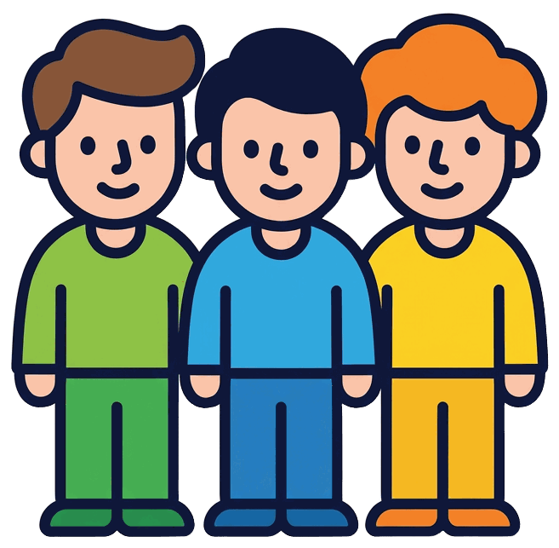
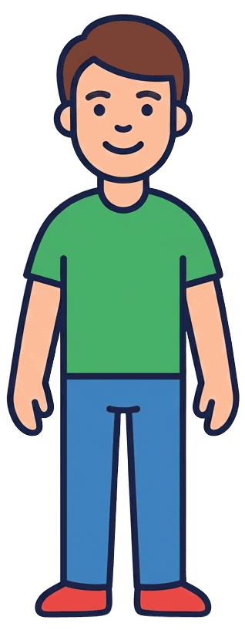
SOUND-ALIKES
🎮 Game! Say 1 or 2!
1
2
men
man
✅ It’s MAN!
Notes:
━━━━━━ GAME: men or man? ━━━━━━
① men (MORE than one man — a group)
② man (just ONE man)
✅ ANSWER: man = NUMBER 2
─────────────────────────────
SAY THIS:
"Number ONE is men — MORE than one man — a group.
Number TWO is man — just ONE man.
So — number one, men… number two, man.
Now listen! I'll say ONE word — only one word — and you tell me the number. You ready?
Here it is… Man. (pause) Again — man. Is that one, or two? (pause) man… one or two?"
[ CLICK to reveal ] → "Yes! It's NUMBER 2 — man!"

Slide 8
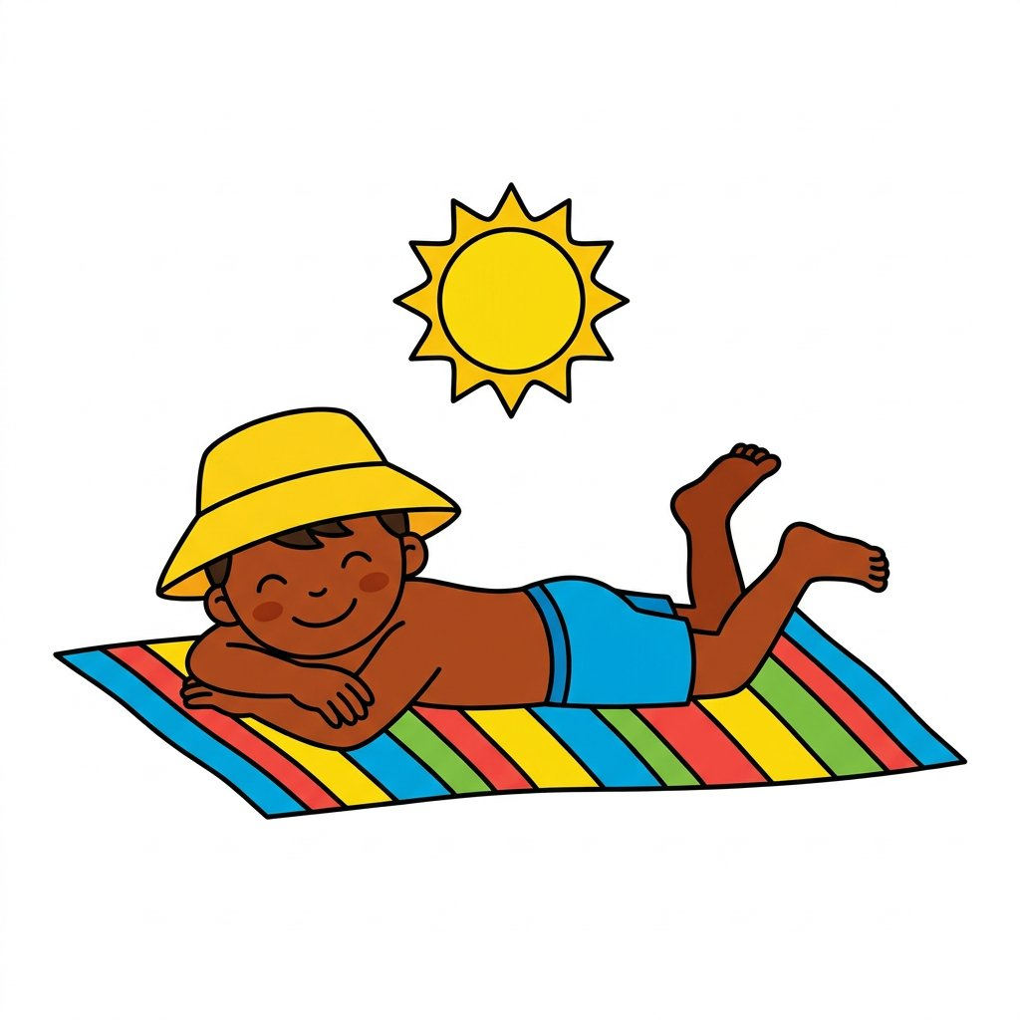
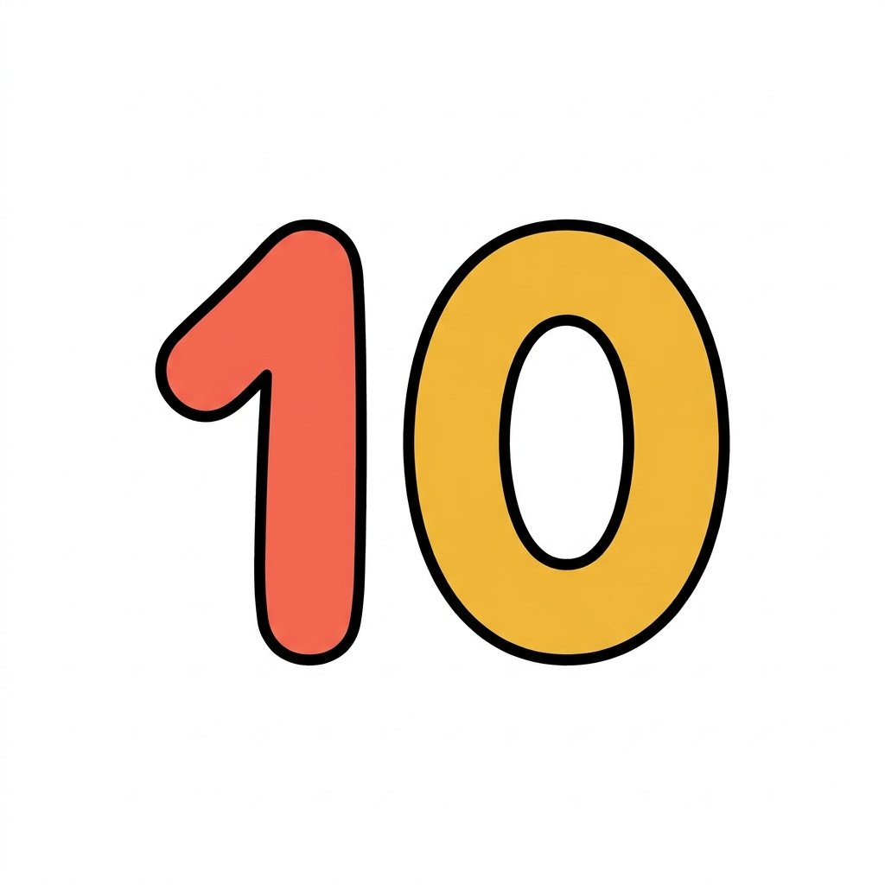
SOUND-ALIKES
🎮 Game! Say 1 or 2!
1
2
tan
ten
✅ It’s TEN!
Notes:
━━━━━━ GAME: tan or ten? ━━━━━━
① tan ☀️ (a suntan at the beach)
② ten (the number ten — 10)
✅ ANSWER: ten = NUMBER 2
─────────────────────────────
SAY THIS:
"Number ONE is tan — a suntan at the beach.
Number TWO is ten — the number ten — 10.
So — number one, tan… number two, ten.
Now listen! I'll say ONE word — only one word — and you tell me the number. You ready?
Here it is… Ten. (pause) Again — ten. Is that one, or two? (pause) ten… one or two?"
[ CLICK to reveal ] → "Yes! It's NUMBER 2 — ten!"

Slide 9
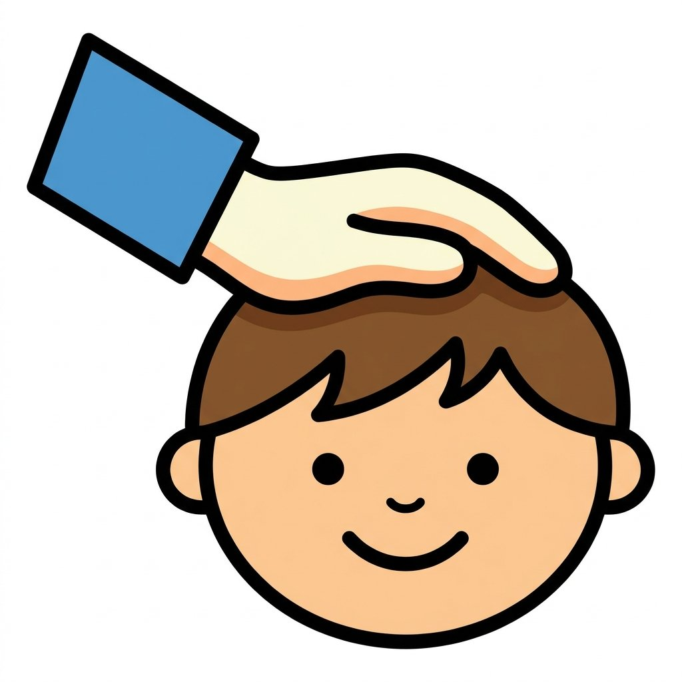
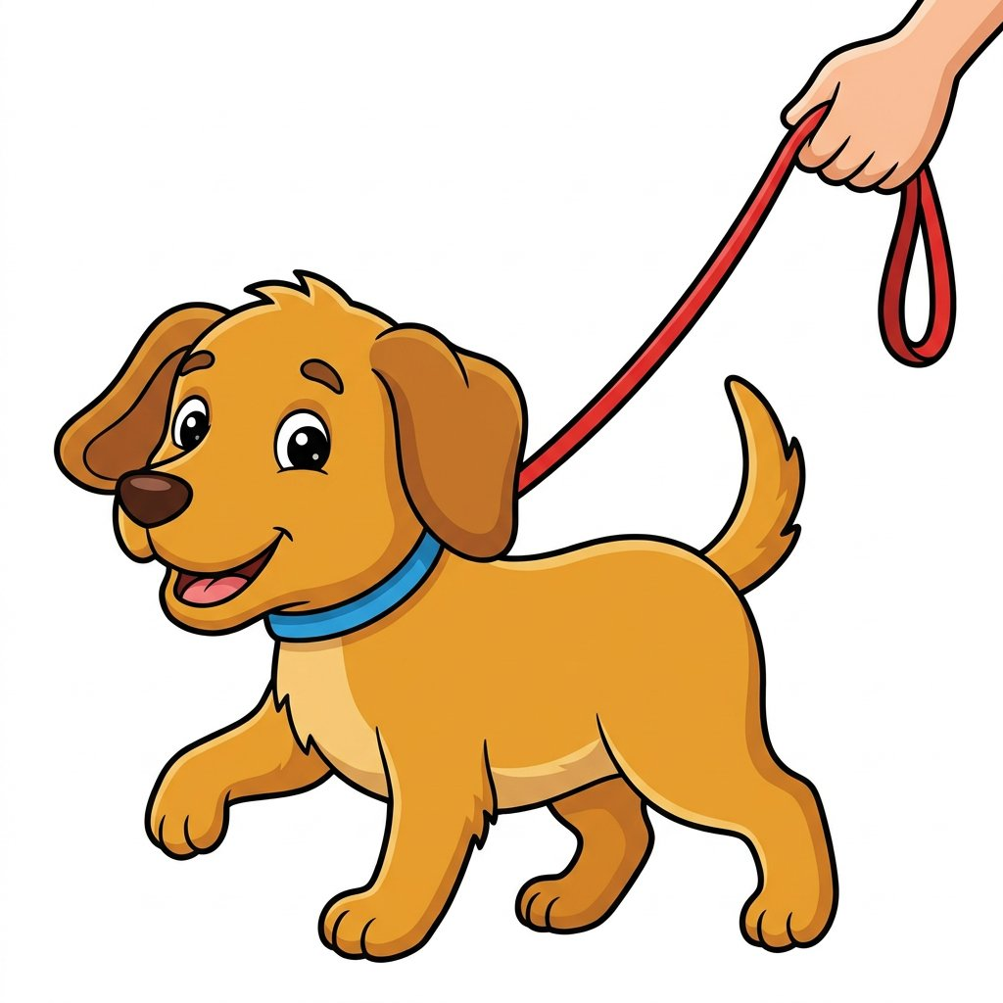
SOUND-ALIKES
🎮 Game! Say 1 or 2!
1
2
pat
pet
✅ It’s PAT!
Notes:
━━━━━━ GAME: pat or pet? ━━━━━━
① pat (patting the top of a head)
② pet 🐕 (a pet dog on a leash)
✅ ANSWER: pat = NUMBER 1
─────────────────────────────
SAY THIS:
"Number ONE is pat — patting the top of a head.
Number TWO is pet — a pet dog on a leash.
So — number one, pat… number two, pet.
Now listen! I'll say ONE word — only one word — and you tell me the number. You ready?
Here it is… Pat. (pause) Again — pat. Is that one, or two? (pause) pat… one or two?"
[ CLICK to reveal ] → "Yes! It's NUMBER 1 — pat!"

Slide 10
SOUND-ALIKES
🎮 Game! Say 1 or 2!
1
2
🦇
🎲
bat
bet
✅ It’s BET!
Notes:
━━━━━━ GAME: bat or bet? ━━━━━━
① bat 🦇 (a bat — the animal)
② bet 🎲 (to make a bet)
✅ ANSWER: bet = NUMBER 2
─────────────────────────────
SAY THIS:
"Number ONE is bat — a bat — the animal.
Number TWO is bet — to make a bet.
So — number one, bat… number two, bet.
Now listen! I'll say ONE word — only one word — and you tell me the number. You ready?
Here it is… Bet. (pause) Again — bet. Is that one, or two? (pause) bet… one or two?"
[ CLICK to reveal ] → "Yes! It's NUMBER 2 — bet!"

Slide 11
SOUND-ALIKES
🎮 Game! Say 1 or 2!
1
2
🏖️
📤
sand
send
✅ It’s SAND!
Notes:
━━━━━━ GAME: sand or send? ━━━━━━
① sand 🏖️ (sand at the beach)
② send 📤 (to send a package)
✅ ANSWER: sand = NUMBER 1
─────────────────────────────
SAY THIS:
"Number ONE is sand — sand at the beach.
Number TWO is send — to send a package.
So — number one, sand… number two, send.
Now listen! I'll say ONE word — only one word — and you tell me the number. You ready?
Here it is… Sand. (pause) Again — sand. Is that one, or two? (pause) sand… one or two?"
[ CLICK to reveal ] → "Yes! It's NUMBER 1 — sand!"

Slide 12
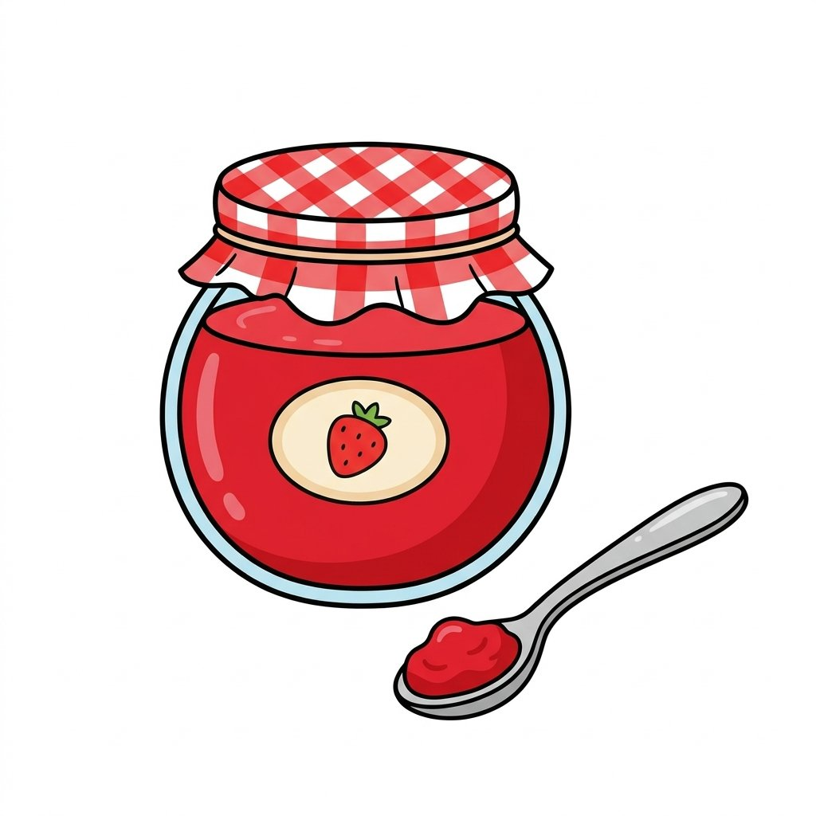
SOUND-ALIKES
🎮 Game! Say 1 or 2!
1
2
💎
jam
gem
✅ It’s JAM!
Notes:
━━━━━━ GAME: jam or gem? ━━━━━━
① jam 🍓 (strawberry jam)
② gem 💎 (a shiny gem — a diamond)
✅ ANSWER: jam = NUMBER 1
─────────────────────────────
SAY THIS:
"Number ONE is jam — strawberry jam.
Number TWO is gem — a shiny gem — a diamond.
So — number one, jam… number two, gem.
Now listen! I'll say ONE word — only one word — and you tell me the number. You ready?
Here it is… Jam. (pause) Again — jam. Is that one, or two? (pause) jam… one or two?"
[ CLICK to reveal ] → "Yes! It's NUMBER 1 — jam!"

Slide 13
Great job — the hardest sound-alikes! 🎉👯
Say them again with me!
Notes:
🎙️ SCRIPT — read aloud:
Wonderful work, everybody. Those were the hardest sound-alikes of the week — eh and aaa, so close together — and you listened so carefully. Pen, pan. Pen, pan. Be proud of those sharp ears. Keep saying them at home. Next, let's relax and sing. See you there.

