Slide 1

M U R R A Y ' S E N G L I S H
the Itsy Bitsy Spider 🕷️
Sing the long A — rain, again!
SOUND-ALIKES
murraycohen.com
Notes:
🎙️ SCRIPT — read aloud:
Welcome to Rhyme Time. Now, I know — nursery rhymes might feel a little silly for grown-ups. But here's the secret: these little songs carry the RHYTHM of English, the natural beat of the language. American children learn English rhythm this way, and it works beautifully for us too. And if you have children, you'll know these songs — and you can sing them together. So let's have a little fun. Say and sing it all out loud with me.

Slide 2

SOUND-ALIKES
SING
🕷️ the Itsy Bitsy Spider
Today's sound: RAIN /eɪ/ — rain · again
🕷️
…and our friend OUT /aʊ/ comes back: spout · out
Notes:
🎙️ SCRIPT — read aloud:
Our next song is "The Itsy Bitsy Spider," and today we listen for the RAIN sound — long A, /eɪ/. Listen: rain… again. Hear that long A? It's the very same sound as in cane, from our Magic E day. And our friend the OUT sound comes back too — in spout and out. Say them with me: rain… again… spout… out. (pause) Good.

Slide 3
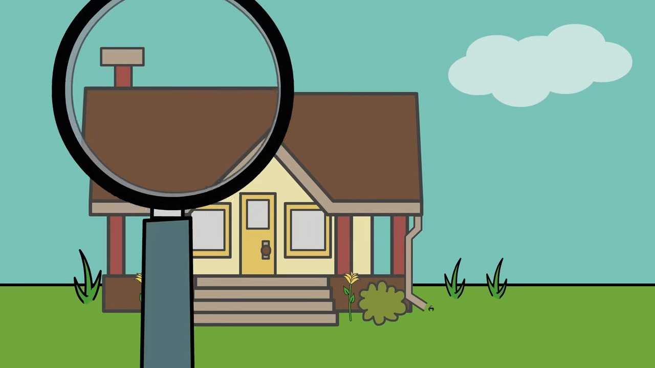
🎬 Sing along with the video!
SOUND-ALIKES
SING
Notes:
🎙️ SCRIPT — read aloud:
Now let's sing the whole spider song together, walking our fingers up as we go. Sing it with me, full voice. (pause) Lovely. Feel that bouncy English rhythm carrying you along.

Slide 4

SOUND-ALIKES
SING
🕷️ the Itsy Bitsy Spider
The itsy bitsy spider climbed up the water spout
Down came the rain and washed the spider out
Out came the sun and dried up all the rain
And the itsy bitsy spider climbed up the spout again
🟢 rain · again = long A (like cane!) 🔴 spout · out = /aʊ/
Notes:
🎙️ SCRIPT — read aloud:
Let's sing it line by line. Walk your fingers up like a little spider as you go. "The itsy bitsy spider climbed up the water spout." (pause) "Down came the rain and washed the spider out." (pause) "Out came the sun and dried up all the rain." (pause) "And the itsy bitsy spider climbed up the spout again." (pause) Now — which words sound like "cane"? Rain, and again. And which sound like "out"? Spout, and out. You're hearing it.

Slide 5

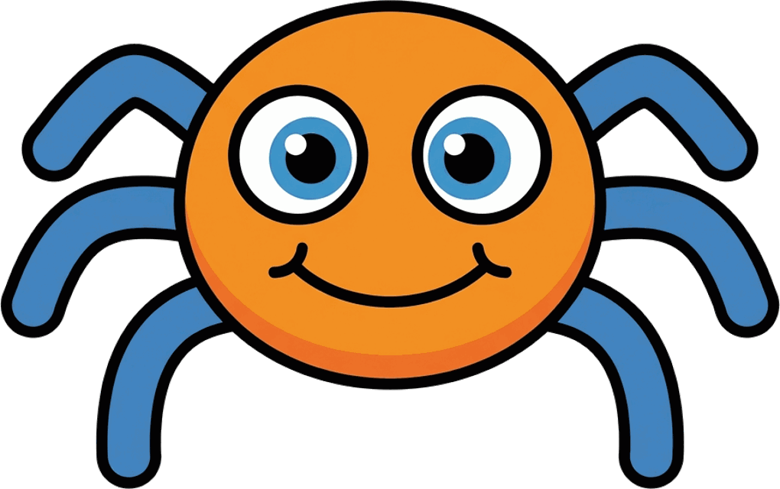
⬆️
spider
up
water spout
The itsy bitsy spider climbed up the water spout.

Slide 6
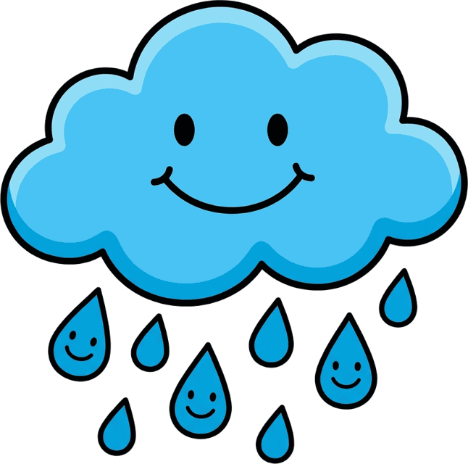
⬇️
down
rain
spider
Down came the rain and washed the spider out.

Slide 7

sun
rain
Out came the sun and dried up all the rain.

Slide 8
🔁
spider
spout
again
And the itsy bitsy spider climbed up the spout again.

Slide 9
SOUND-ALIKES
SING
🎵 more long A — from our song!
Long A words: rain · again · came · day
🕷️
Say them big: play · say · way!

Slide 10

🎬 Sing along with the video!
SOUND-ALIKES
SING
Notes:
🎙️ SCRIPT — read aloud:
Now let's sing the whole spider song together, walking our fingers up as we go. Sing it with me, full voice. (pause) Lovely. Feel that bouncy English rhythm carrying you along.

Slide 11

🎵 Homework: sing ONE song with your family!
(Your kids will love that you know it)
Notes:
🎙️ SCRIPT — read aloud:
Here's your homework, and there's no worksheet — just this. Sing ONE of these songs with your family this week. Your kids will love that you know it. And singing together is one of the best ways to feel English rhythm. You did beautifully today, and that wraps up Day Four. I'm proud of you. See you next time.

