Slide 1
DAY 4
PUSH FURTHER
🚀
Push Further!
One vowel — a whole new meaning!
Real talk!
Notes:
'One vowel changes EVERYTHING. Live… leave. Sit… seat. Ready? Real talk!'

Slide 2
DAY 4
PUSH FURTHER
live or leave? 👂
🏠
🕗
I LIVE here.
I LEAVE at 8.
short i · long ee — big difference!
Notes:
Read card 1: 'I LIVE here.' Short ih — quick, fist gesture. Card 2: 'I LEAVE at 8.' Long ee — smile and stretch. Circle: 'I LIVE in LA. I LEAVE at 8. Do you live here? When do you leave?' Elicit answers.

Slide 3
DAY 4
PUSH FURTHER
sit or seat? 👂
🪑
💺
Please SIT.
Take a SEAT.
sit is short · seat is long
Notes:
'Please SIT' — short. 'Take a SEAT' — long ee. Pat the chair. Circle: 'Same chair! SIT is the action, SEAT is the chair.' Hear-and-choose: say sit or seat — students show fist (short) or stretch (long). Answers as you call them.

Slide 4
DAY 4
PUSH FURTHER
fill or feel? 👂
🥛
🌞
FILL the cup.
FEEL the sun!
fill is short · feel is long
Notes:
'FILL the cup' — short ih. 'FEEL the sun!' — long ee, smile. Mime both. Hear-and-choose: fill / feel / feel / fill — students gesture fist or stretch. Answers as you call them.

Slide 5
DAY 4
PUSH FURTHER
Two sounds of OO 👂
📖
🌙
Read a BOOK.
Look at the MOON!
two OO sounds — book & moon
Notes:
Day 4 memory: two OO sounds. 'Read a BOOK' — short oo. 'Look at the MOON!' — long oo. Chin trick: moon drops the jaw more. Circle: 'Do we read the moon? No! We read a BOOK.'

Slide 6
DAY 4
PUSH FURTHER
pen or pan? 👂
🖊️
🍳
A PEN for you.
A PAN for eggs.
eh vs a — the trickiest pair!
Notes:
'A PEN for you. A PAN for eggs.' eh vs a — the trickiest pair! Jaw trick: pan opens wider. Circle: 'Do we cook eggs in a pen? NO! A PAN!' Hear-and-choose: pen / pan.

Slide 7
DAY 4
PUSH FURTHER
ship or sheep? 👂
🚢
🐑
A big SHIP.
A white SHEEP.
ship is short · sheep is long

Slide 8
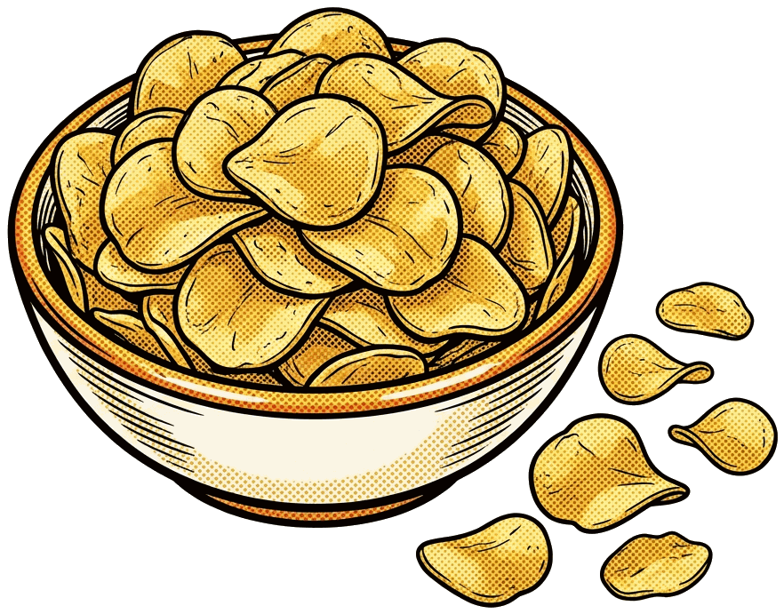

DAY 4
PUSH FURTHER
chip or cheap? 👂
Eat a CHIP.
So CHEAP!
chip is short · cheap is long

Slide 9
DAY 4
PUSH FURTHER
man or men? 👂
👨
👥
One MAN.
Two MEN.
a vs e — listen close!

Slide 10
DAY 4
PUSH FURTHER
cap or cape? 👂
🧢
🦸
Wear a CAP.
A hero's CAPE!
the Magic E again! ✨

Slide 11
DAY 4
PUSH FURTHER
good or food? 👂
👍
🍜
GOOD morning!
Hot FOOD!
two OO sounds — book & moon

Slide 12
DAY 4
PUSH FURTHER
💬
Say it like a native!
“I live here.” · “I leave at 8.”
Use it today! 🎉
Notes:
Celebrate. 'I live here. I leave at 8.' Say it like a native. Homework beat: 'Use LIVE and LEAVE today — one sentence each. Tell me tomorrow.'

