Slide 1
M U R R A Y ' S E N G L I S H
Head, Shoulders, Knees & Toes 🙆
Feel the beat — faster, faster!
DAY 5
murraycohen.com
Notes:
🎙️ SCRIPT — read aloud:
Welcome to Rhyme Time. Now, I know — nursery rhymes might feel a little silly for grown-ups. But here's the secret: these little songs carry the RHYTHM of English, the natural beat of the language. American children learn English rhythm this way, and it works beautifully for us too. And if you have children, you'll know these songs — and you can sing them together. So let's have a little fun. Say and sing it all out loud with me.

Slide 2
DAY 5
MOVE
🙆 Head, Shoulders, Knees & Toes
Today's skill: RHYTHM — faster… faster… FASTER!
👆 Touch each body part as you sing it!
Notes:
🎙️ SCRIPT — read aloud:
Last one — "Head, Shoulders, Knees and Toes." Today's skill is RHYTHM, and speed! Stand up if you can. You touch each body part as you sing it — head, shoulders, knees, and toes. We'll go slow first, then faster, then ridiculously fast. Ready? Let's get moving.

Slide 3

DAY 5
MOVE
🎬 Sing & move with the video!
Everybody stand up — let's move!

Slide 4


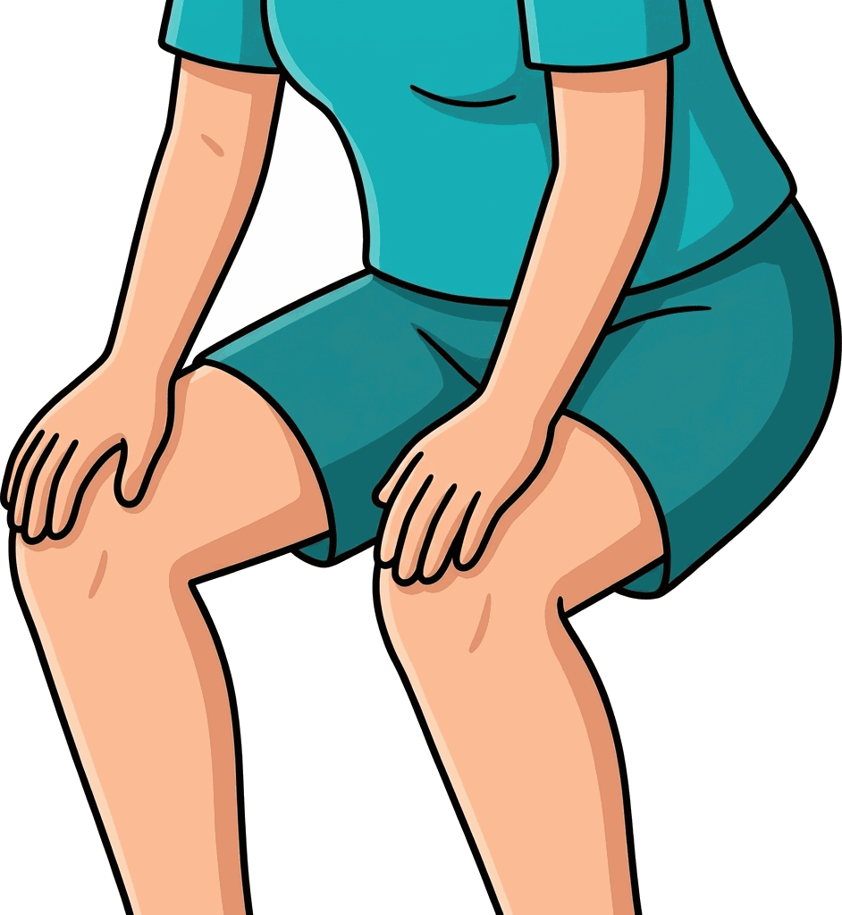
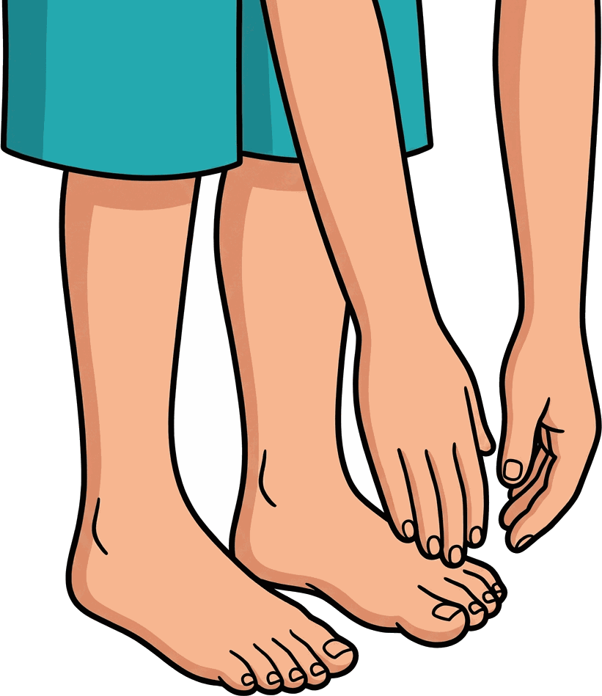
head
shoulders
knees
toes
Head, shoulders, knees and toes, knees and toes

Slide 5




eyes
ears
mouth
nose
Eyes and ears and mouth and nose

Slide 6
DAY 5
SING
🎵 Let's sing it ONE more time!
You know it now — sing along!

Slide 7
🎵 Homework: sing ONE song with your family!
(Your kids will love that you know it)
Notes:
🎙️ SCRIPT — read aloud:
Here's your homework, and there's no worksheet — just this. Sing ONE of these songs with your family this week. Your kids will love that you know it. And singing together is one of the best ways to feel English rhythm. You did beautifully today, and that wraps up Day Six. I'm proud of you. See you next time.

