Slide 1

SYLLABLE STRESS
One beat is strong.
Find it and you can say the word!
Notes:
Welcome back. Today is one of the most important days for your speaking. Every word has ONE strong beat — one strong syllable. It is louder. It is longer. It is higher. And here is the secret: when you know where the strong beat is, you can say the word. Find the strong beat, and the word is yours. Let's find it together.

Slide 2
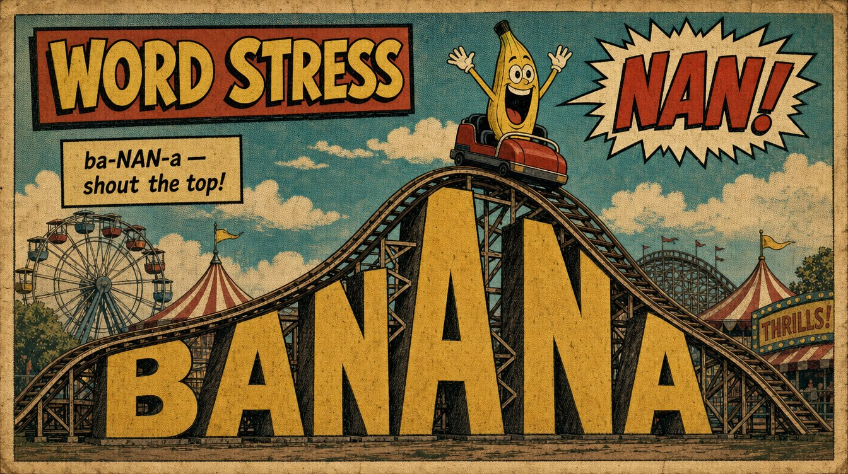
Notes:
Here's the big idea. Every word is a little hill. We climb UP to the strong beat, then come back down. And the top is not just louder — it is LONGER and HIGHER. Listen — ba-NAN-a. (stretch NAN) Pull your hands apart on the top, like a rubber band: ba — NAAAN — a. Say it with me: ba-NAN-a. (pause) Feel it climb, stretch, and fall? Good.

Slide 3
🎵
HUM THE TUNE
🎵
mm•MM•mm
= banana — every word has a little song inside!
Notes:
Here's a way to HEAR the top. Let me hum banana — no letters, just the music. Listen: mm-MM-mm. (hum it) That's the tune of the word. Hear how the middle is the top? Now the word: ba-NAN-a — same tune. Hum it with me: mm-MM-mm. (pause) Now the word. (pause) Every word has a little song inside it.

Slide 4
WRONG ON PURPOSE!
ba•na•NA
❌
ba•NAN•a
✅
The top in the wrong place sounds funny!
Notes:
Now let's have some fun — let's do it WRONG. Listen: ba-na-NA. (top on the last beat) Does that sound right? No! It sounds funny. The top is in the wrong place. Now the right way: ba-NAN-a. (pause) Hear the difference? When the top is wrong, the word is hard to understand. When the top is right, the word is easy. Say the right one with me: ba-NAN-a. (pause) Good.

Slide 5
Notes:
Let's hang a word on its top. Banana. Listen: ba-NAN-a. (up to NAN, then down) The top is in the middle — NAN. Louder, longer, higher. Say it big and long on the middle: ba-NAAAN-a. Now you — hand up to the top, and down. (pause) Beautiful. The strong beat is number two.

Slide 6
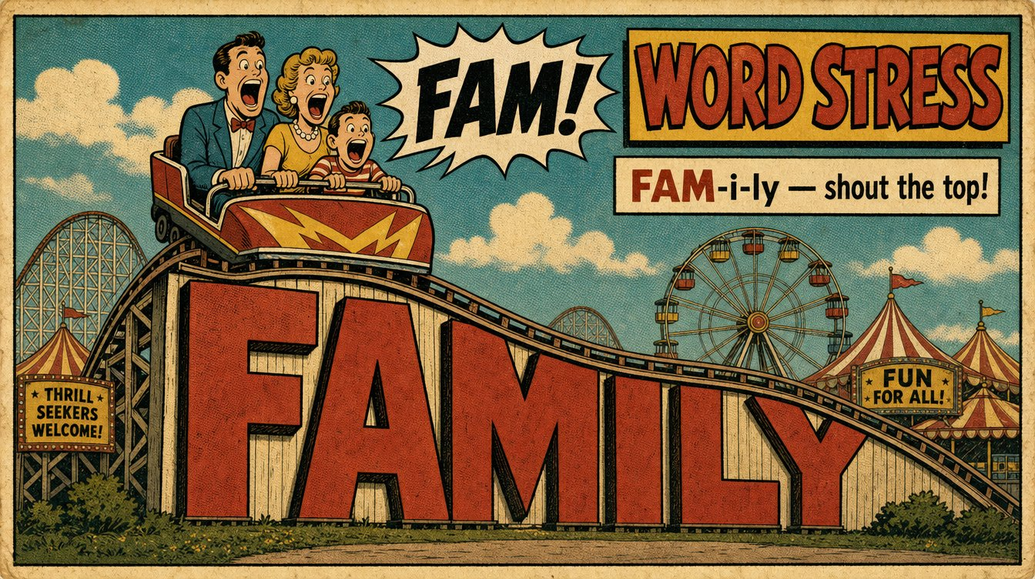
Notes:
Now a different hill. Family. FAM-i-ly. This time the top is at the START — FAM. We start high, and we come down: FAAAM-i-ly. The other beats are small and quiet. Say it — hand high first, then down. (pause) Good. The top can be at the front, too.

Slide 7
JUST ONE BEAT IS THE STRONG SYLLABLE
ba•NAN•a
FAM•i•ly
top in the MIDDLE
top at the START
Find the top. Hang the word on it.
Notes:
Here's the whole idea in one picture. Every word has just ONE strong beat — one top of the hill, one strong. Sometimes the strong syllable is in the middle, like ba-NAN-a. Sometimes the strong syllable is at the start, like FAM-i-ly. Your job is simple: find the top, and hang the word on it. Build up to it, drop down from it. That's how English sounds like English.

Slide 8
THE SMALL BEATS GET LAZY
ba•NAN•a
⬇️
b’•NAN•uh
Not the top? It goes soft — “uh”.
Notes:
One more secret. The beats that are NOT the top get lazy. Your mouth relaxes. They turn into a soft little 'uh.' Listen — banana isn't three big equal beats. It's b'-NAN-uh. Only the top is big; the rest go soft and lazy. We'll learn much more about that lazy 'uh' very soon. For now, just feel it: one beat big, the others small.

Slide 9
Find the top.
Next: practice, a game, and move!
Build UP … drop DOWN.
Notes:
That's our teaching for syllable stress. Remember: every word is a little hill, the strong beat is the top, and when you find the top, you can say the word. Build up to it, drop down from it, hang the word on it. Next, we practice with pictures, then play a game, and then we feel it in our hands. Great work.

