Slide 1
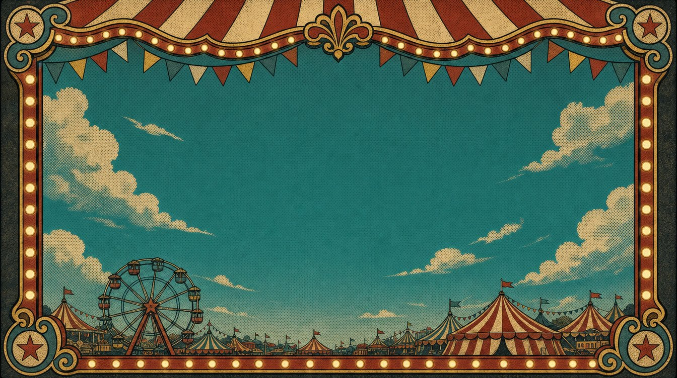
FIND THE STRONG SYLLABLE
Every word has one strong beat — the top of the hill.
Notes:
Welcome back. Now we practice — and you can SEE the hill. On each slide, the strong beat is at the top. I say the word, you say it right after me. Move your hand up to the top and down. You can hum the tune first if it helps. Ready? Let's climb.

Slide 2
Do you see the strong syllable?
WA•ter
💧
💧
top = WA (the START)
Notes:
Water. WA-ter. The top is at the start — WA. Build up, drop down: WAA-ter. Now you. (pause) Good. Strong beat number one.

Slide 3
Do you see the strong syllable?
COF•fee
☕
☕
top = COF (the START)
Notes:
Coffee. COF-fee. Top at the start — COF. COOF-fee, then down. Your turn. (pause) Nice.

Slide 4
Do you see the strong syllable?
to•MA•to
🍅
🍅
top = MA (the MIDDLE)
Notes:
Tomato. to-MA-to. Now the top is in the middle — MA. to-MAA-to. Up… and down. Say it. (pause) Good. Strong beat number two.

Slide 5
Do you see the strong syllable?
a•PART•ment
🏢
🏢
top = PART (the MIDDLE)
Notes:
Apartment — a word you use a lot. a-PART-ment. The top is in the middle — PART. a-PAART-ment. Build up, drop down. You try. (pause) Beautiful. Number two.

Slide 6
Do you see the strong syllable?
HOS•pi•tal
🏥
🏥
top = HOS (the START)
Notes:
Hospital. HOS-pi-tal. The top is at the start — HOS. HOOS-pi-tal, then down and soft. Say it with me. (pause) Good. Number one.

Slide 7
Do you see the strong syllable?
MON•key
🐵
🐵
top = MON (the START)
Notes:
Monkey. MON-key. Top at the start — MON. MOON-key. Up and down. Your turn. (pause) Nice work.

Slide 8
You can SEE the top —
and SAY it!
Every word has just one strong beat. Next: a game!
Notes:
Wonderful. You can see the top of the hill, and you can say it. Some tops are at the start, some in the middle — but every word has just one. Next, let's play a game. Great climbing.

