Slide 1
M U R R A Y ' S E N G L I S H
Strong Syllable Game! 👑
Hear it · clap it · say the strong syllable
DAY 6
murraycohen.com
Notes:
🎙️ SCRIPT — read aloud:
Welcome to the Strong Syllable Game. Here's how it works — you hear the word, you clap the beats, and you find the strong syllable. I'll say each word, you take a guess, and then I'll show you the answer. Say your guesses out loud — let's play!

Slide 2
DAY 6
GAME
How to play
👂 I say the word
👏 You clap it — count the beats
beats + strong syllable (banana → 3, 2)
Notes:
🎙️ SCRIPT — read aloud:
Here's the game. I say the word. You clap it and count the beats. Then you tell me two things: how many beats, and which beat is the strong syllable. Like banana — three beats, strong syllable is number two. So your answer is: three, two. Let's try the first one.

Slide 3
DAY 6
GAME
beats + strong syllable (like 3, 2)
🍌
banana
✅ 3 beats — strong syllable is #2! ba·NAN·a
Notes:
🎙️ SCRIPT — read aloud:
Listen. Banana… banana. (pause — clap and guess) How many beats, and which one is the strong syllable?

Slide 4
DAY 6
GAME
beats + strong syllable (like 3, 2)
👨‍👩‍👧
family
✅ 3 beats — strong syllable is #1! FAM·i·ly
Notes:
🎙️ SCRIPT — read aloud:
Next. Family… family. (pause) How many beats? Which is the strong syllable?

Slide 5
DAY 6
GAME
beats + strong syllable (like 3, 2)
💻
computer
✅ 3 beats — strong syllable is #2! com·PUT·er
Notes:
🎙️ SCRIPT — read aloud:
Computer… computer. (pause) Beats, and strong syllable?

Slide 6
DAY 6
GAME
beats + strong syllable (like 3, 2)
📱
telephone
✅ 3 beats — strong syllable is #1! TEL·e·phone
Notes:
🎙️ SCRIPT — read aloud:
Telephone… telephone. (pause) How many, and which is strong?

Slide 7
DAY 6
GAME
beats + strong syllable (like 3, 2)
🎁
surprise
✅ 2 beats — strong syllable is #2! sur·PRISE
Notes:
🎙️ SCRIPT — read aloud:
Surprise… surprise. (pause) Beats and strong syllable?

Slide 8
DAY 6
GAME
beats + strong syllable (like 3, 2)
☂️
umbrella
✅ 3 beats — strong syllable is #2! um·BREL·la
Notes:
🎙️ SCRIPT — read aloud:
Umbrella… umbrella. (pause) How many beats, and which is the strong syllable? (pause) Three beats — um-BREL-la. The strong syllable is number two — BREL. Clap it with me. Good!

Slide 9
DAY 6
GAME
beats + strong syllable (like 3, 2)
🍅
tomato
✅ 3 beats — strong syllable is #2! to·MA·to
Notes:
🎙️ SCRIPT — read aloud:
Tomato… tomato. (pause) Beats and strong syllable?

Slide 10
DAY 6
GAME
beats + strong syllable (like 3, 2)
🦁
animal
✅ 3 beats — strong syllable is #1! AN·i·mal
Notes:
🎙️ SCRIPT — read aloud:
Animal… animal. (pause) How many, which is strong?

Slide 11
DAY 6
GAME
beats + strong syllable (like 3, 2)
🚨
emergency
✅ 4 beats — strong syllable is #2! e·MER·gen·cy
Notes:
🎙️ SCRIPT — read aloud:
Now a longer one. Emergency… emergency. (pause) How many beats, and which is the strong syllable?

Slide 12
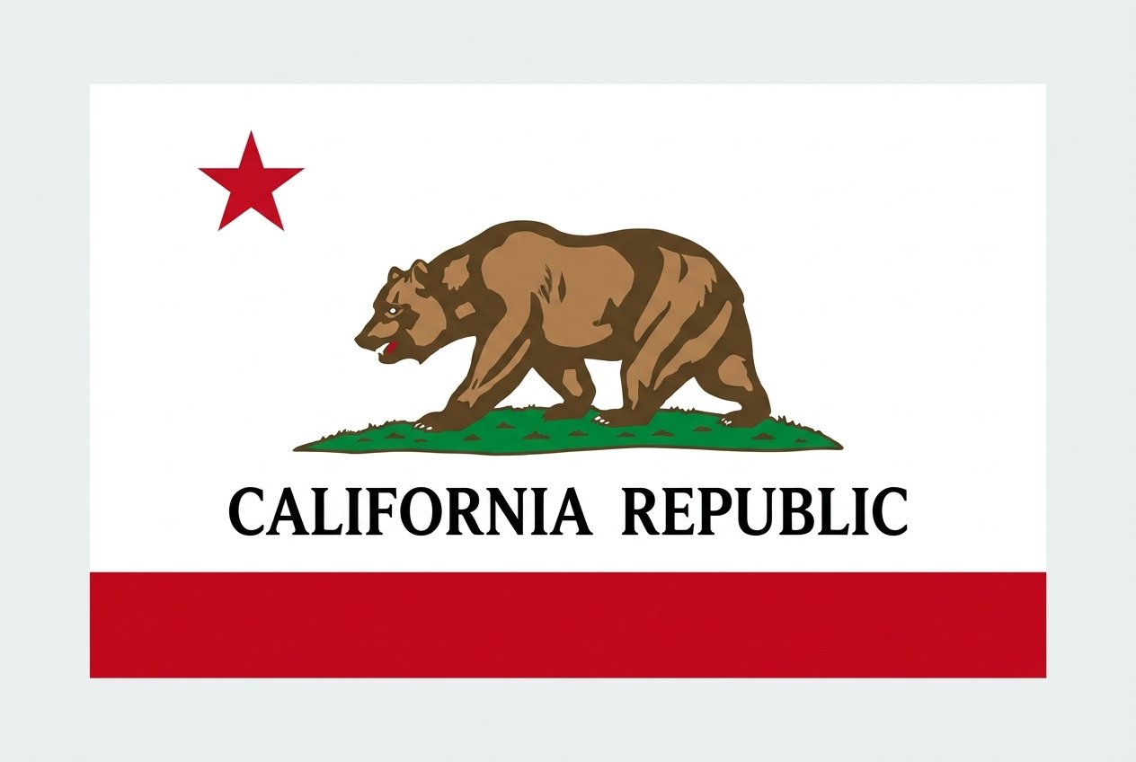
🏆 The grand finale — find the top!
California
👂 How many beats? Which one is strong?

Slide 13
🏆 The grand finale — find the top!
cal-i-FOR-nia
✅ 4 beats — the strong beat is #3

Slide 14
🏆 The grand finale — find the top!
🚁
helicopter
👂 How many beats? Which one is strong?

Slide 15
🏆 The grand finale — find the top!
🚁
helicopter
✅ 4 beats · top #1 · HEL·i·cop·ter

Slide 16
🏆 The grand finale — find the top!
🇺🇸
America
👂 How many beats? Which one is strong?

Slide 17
🏆 The grand finale — find the top!
🇺🇸
America
✅ 4 beats · top #2 · a·MER·i·ca

Slide 18
🏆 The grand finale — find the top!
🥑
avocado
👂 How many beats? Which one is strong?

Slide 19
🏆 The grand finale — find the top!
🥑
avocado
✅ 4 beats · top #3 · a·vo·CA·do

Slide 20
🏆 You found the strong syllable every time!
Notes:
🎙️ SCRIPT — read aloud:
And there it is — cal-i-FOR-nia. You live in a four-beat state! Great playing today. You're hearing the strong syllable like a pro. See you in the next one.

