Slide 1
DAY 7
M U R R A Y ' S E N G L I S H
☀️ Good morning! Clap the alphabet!
Stand up! Big voice, big claps!
Chant it with me! 👏
murraycohen.com
Notes:
Good morning! Wake up your voices — clap every letter with me, A to Z. Ready? A, B, C…

Slide 2
👏 CLAP THE ALPHABET!
A B C D E F G
H I J K L M N O P

Slide 3
👏 CLAP THE ALPHABET!
Q R S · T U V
W X · Y & Z

Slide 4
DAY 7
M U R R A Y ' S E N G L I S H
📍 Where we are
Yesterday: the STRONG beat 👑 → Today: word endings — the throat trick
Missed a day? Full replay!
murraycohen.com
Notes:
Here's our week. Yesterday we found the strong beat in words. Today, word endings — the throat trick. If you missed a day — no problem. We're going to do ALL of yesterday again, fast, right now.

Slide 5

SYLLABLE STRESS
One beat is strong.
Find it and you can say the word!

Slide 6
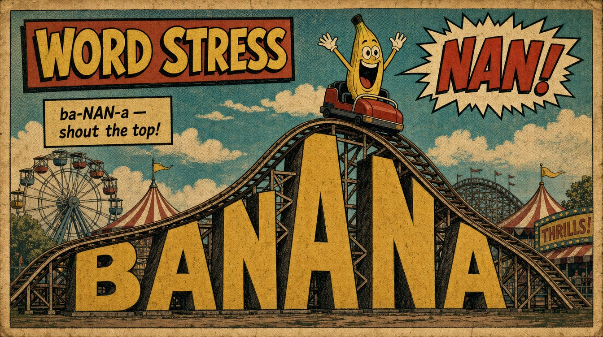

Slide 7
🎵
HUM THE TUNE
🎵
mm•MM•mm
= banana — every word has a little song inside!

Slide 8
WRONG ON PURPOSE!
ba•na•NA
❌
ba•NAN•a
✅
The top in the wrong place sounds funny!

Slide 10
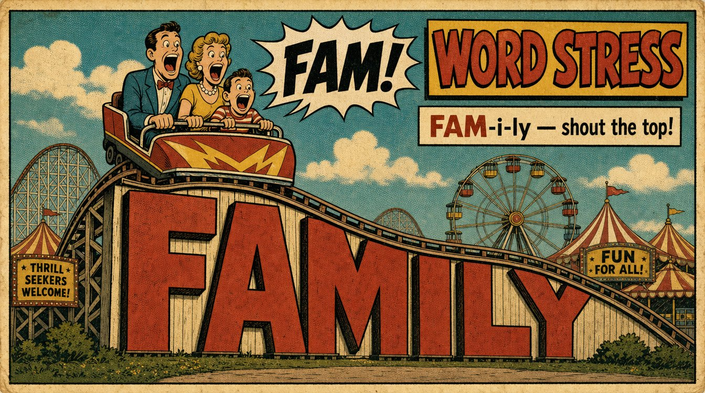

Slide 11
THE SMALL BEATS GET LAZY
ba•NAN•a
⬇️
b’•NAN•uh
Not the top? It goes soft — “uh”.

Slide 12
Do you see the strong syllable?
WA•ter
💧
💧
top = WA (the START)

Slide 13
Do you see the strong syllable?
COF•fee
☕
☕
top = COF (the START)

Slide 14
Do you see the strong syllable?
to•MA•to
🍅
🍅
top = MA (the MIDDLE)

Slide 15
Do you see the strong syllable?
a•PART•ment
🏢
🏢
top = PART (the MIDDLE)

Slide 16
Do you see the strong syllable?
HOS•pi•tal
🏥
🏥
top = HOS (the START)

Slide 17
Do you see the strong syllable?
MON•key
🐵
🐵
top = MON (the START)

Slide 18
DAY 7
GAME
How to play
👂 I say the word
👏 You clap it — count the beats
beats + strong syllable (banana → 3, 2)

Slide 19
DAY 7
GAME
beats + strong syllable (like 3, 2)
🍌
banana
✅ 3 beats — strong syllable is #2! ba·NAN·a

Slide 20
DAY 7
GAME
beats + strong syllable (like 3, 2)
👨‍👩‍👧
family
✅ 3 beats — strong syllable is #1! FAM·i·ly

Slide 21
DAY 7
GAME
beats + strong syllable (like 3, 2)
💻
computer
✅ 3 beats — strong syllable is #2! com·PUT·er

Slide 22
DAY 7
GAME
beats + strong syllable (like 3, 2)
🎁
surprise
✅ 2 beats — strong syllable is #2! sur·PRISE

Slide 23
DAY 7
GAME
beats + strong syllable (like 3, 2)
🍅
tomato
✅ 3 beats — strong syllable is #2! to·MA·to

Slide 24
DAY 7
GAME
beats + strong syllable (like 3, 2)
🥔
potato
✅ 3 beats — strong syllable is #2! po·TA·to

Slide 25
DAY 7
GAME
beats + strong syllable (like 3, 2)
📅
Saturday
✅ 3 beats — strong syllable is #1! SAT·ur·day

Slide 26
DAY 7
GAME
beats + strong syllable (like 3, 2)
🌤️
afternoon
✅ 3 beats — strong syllable is #3! af·ter·NOON

Slide 27
DAY 7
GAME
beats + strong syllable (like 3, 2)
⭐
important
✅ 3 beats — strong syllable is #2! im·POR·tant

Slide 28
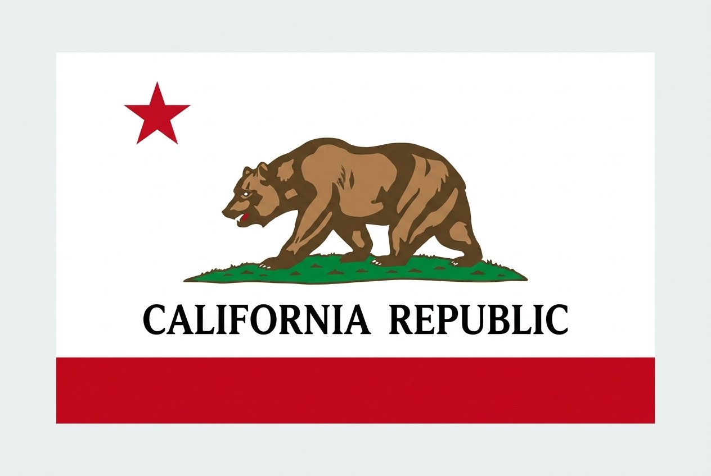
🏆 The grand finale — find the top!
California
👂 How many beats? Which one is strong?

Slide 29
🏆 The grand finale — find the top!
cal-i-FOR-nia
✅ 4 beats — the strong beat is #3

Slide 30
small clap = small beat
BIG clap = strong beat (hand HIGH!)
Build UP to the top… drop DOWN.

Slide 31
CLAP IT!
ba•NAN•a
🍌
🍌
small — BIG — small

Slide 32
CLAP IT!
FAM•i•ly
👨‍👩‍👧
👨‍👩‍👧
BIG — small — small

Slide 33
CLAP YOUR COUNTRY! 🌎
Where is the top of YOUR country?

Slide 34
CLAP IT!
MEX•i•co
🇲🇽
🇲🇽
top = MEX (the START)

Slide 35
CLAP IT!
gua•te•MA•la
🇬🇹
🇬🇹
top = MA (the MIDDLE)

Slide 36
CLAP IT!
al•BAN•ia
🇦🇱
🇦🇱
top = BAN (the MIDDLE)

Slide 37
CLAP A NAME! 🤝
Your name and your friends' names have a top too!

Slide 38
CLAP IT!
ma•RI•a
👋
👋
top = RI

Slide 39
DAY 7
M U R R A Y ' S E N G L I S H
You've got the strong beat! 👑
Today: word endings — cap or cab? 🖐️
let's go!
murraycohen.com
Notes:
Beautiful — you found the strong syllable in every word. That was all of yesterday, and you've got it. Today: word endings — the throat trick. Let's go!

