Slide 1
M U R R A Y ' S E N G L I S H
Listen to the END!
cap/cab · bed/bet · dog/dock
DAY 7
murraycohen.com
Notes:
Hey everybody, welcome back! Today we listen to the END of the word. Three pairs of words sound almost the same — but the very last sound is different. Cap and cab. Bet and bed. Dock and dog. Many people drop that last sound. Today we're going to hear it. Ready? Let's listen.

Slide 2
DAY 7
WORD
A new word!
🚕
cab
cab = taxi 🚖 You take a cab to the airport.
Notes:
First, a new word. This is a cab. A cab is a taxi — a car you pay to ride in. You take a cab to the airport. Say it with me: cab. (pause) Good. Keep that word — we'll use it today.

Slide 3
DAY 7
TRICK
🖐️ the throat trick
b · d · g
p · t · k
🐝 BUZZ!
🤫 QUIET!
hand on throat — it shakes
hand on throat — nothing
Notes:
Here's a wonderful trick — for when YOU say these words. Put your hand gently on your throat. Now say /b/… /b/. Feel that? It buzzes — your throat shakes. /b/, /d/, /g/ are all buzzy. (pause) Now say /p/… /p/. Quiet — nothing shakes. /p/, /t/, /k/ are all quiet. (pause) So when you say cab, you feel a buzz at the end. When you say cap, it's quiet. Keep that hand ready — we'll use it to check our answers.

Slide 4
DAY 7
GUESS
👂 Which word did you hear?
🧢
🚕
1
2
cap
cab
Notes:
Now, listen with your ears. Here are two words — a cap, that you wear on your head, and a cab, a taxi. Look at both pictures. I'm going to say ONE word. Which word did you hear? Point to the picture. Listen carefully… cab. (pause) (pause) Did you point to the cab? Let's check.

Slide 5
DAY 7
ANSWER
✅ the answer
🧢
🚕
1
2
cap
cab
✅ It's CAB!
Notes:
It's cab! The taxi. Now say it with me, and put your hand on your throat — feel that buzzy ending: cab. (pause) Feel the /b/ shake? That's how you know. Cap would be quiet — cap. But I said cab. Nice listening!

Slide 6
DAY 7
GUESS
👂 Which word did you hear?
🎲
🛏️
1
2
bet
bed
Notes:
Next pair. This is bet — money on a game. And this is bed — where you sleep. Look at both pictures. Listen — which word did you hear? Point to the picture. Listen… bet. (pause) (pause) Got it? Let's check.

Slide 7
DAY 7
ANSWER
✅ the answer
🎲
🛏️
1
2
bet
bed
✅ It's BET!
Notes:
It's bet! This time it's the QUIET one — bet, with a /t/. Say it with me, hand on your throat: bet. (pause) Quiet at the end, no buzz. Bed would buzz — bed. But I said bet. You're really listening now!

Slide 8

DAY 7
GUESS
👂 Which word did you hear?
🐕
1
2
dock
dog
Notes:
Last pair. This is a dock — where boats park, by the water. And this is a dog — your pet. Look at both pictures. Which word did you hear? Point. Listen… dog. (pause) (pause) Ready? Let's check.

Slide 9
DAY 7
ANSWER
✅ the answer
🐕
1
2
dock
dog
✅ It's DOG!
Notes:
It's dog! Say it with me, hand on your throat — feel the buzz: dog. (pause) The /g/ shakes. Dock would be quiet — dock. But I said dog. Beautiful work!

Slide 10
DAY 7
GUESS
👂 Which word did you hear?
🚌
🐝
1
2
bus
buzz

Slide 11
DAY 7
ANSWER
✅ the answer
🚌
🐝
1
2
bus
buzz
✅ It's BUZZ!

Slide 12


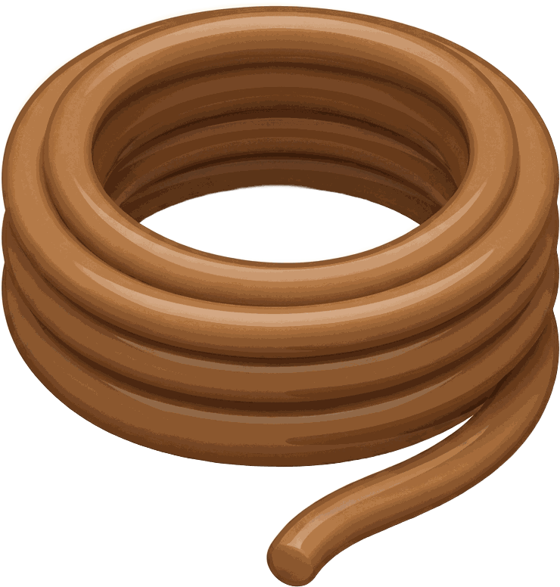
DAY 7
GUESS
👂 Which word did you hear?
1
2
rope
robe

Slide 13
DAY 7
ANSWER
✅ the answer
1
2
rope
robe
✅ It's ROBE!

Slide 14
DAY 7
REVIEW
⭐ Ten words — listen to the END!
🧢 cap
🎲 bet
⚓ dock
🚕 cab
🛏️ bed
🐕 dog
Notes:
Let's review. Six words, three pairs. Put your hand on your throat one more time and say them with me. Cap — quiet. Cab — buzzy. (pause) Bet — quiet. Bed — buzzy. (pause) Dock — quiet. Dog — buzzy. (pause) You can hear it with your ears, and feel it with your hand. Now let's play a game with these endings. See you in the next video. Great work today!

