Slide 1
M U R R A Y ' S E N G L I S H
CH · SH · S · Z
cheap or sheep? Listen close! 👂
DAY 8
murraycohen.com
Notes:
Welcome + energy. Today: FOUR sounds — CH, SH, S, Z.
Say: "cheap… sheep. Same? NO! Small sound — big difference!"
Today we listen with big ears. 👂

Slide 2
DAY 8
TEACH
Four sounds — four mouths
CH
SH
S
Z
🚂
🤫
🐍
🐝
Tongue TIP — quick puff! ch-ch
Tongue BACK — long shhhh
Snake — SSS!
Bee — ZZZ!
chip, cheap, chop
ship, sheep, shop
sip, Sue, ice
zip, zoo, eyes
Notes:
TEACH the four mouths — one at a time, with gestures. Students copy each 3×.
CH = train: CH-CH-CH (chip, cheap, chop)
SH = quiet: shhh, finger on lips (ship, sheep, shop)
S = snake: sss (sip, Sue, ice)
Z = bee: zzz — feel the throat buzz! Hand on throat. (zip, zoo, eyes)
Key check: S vs Z — hand on throat. No buzz = S. Buzz = Z.

Slide 3

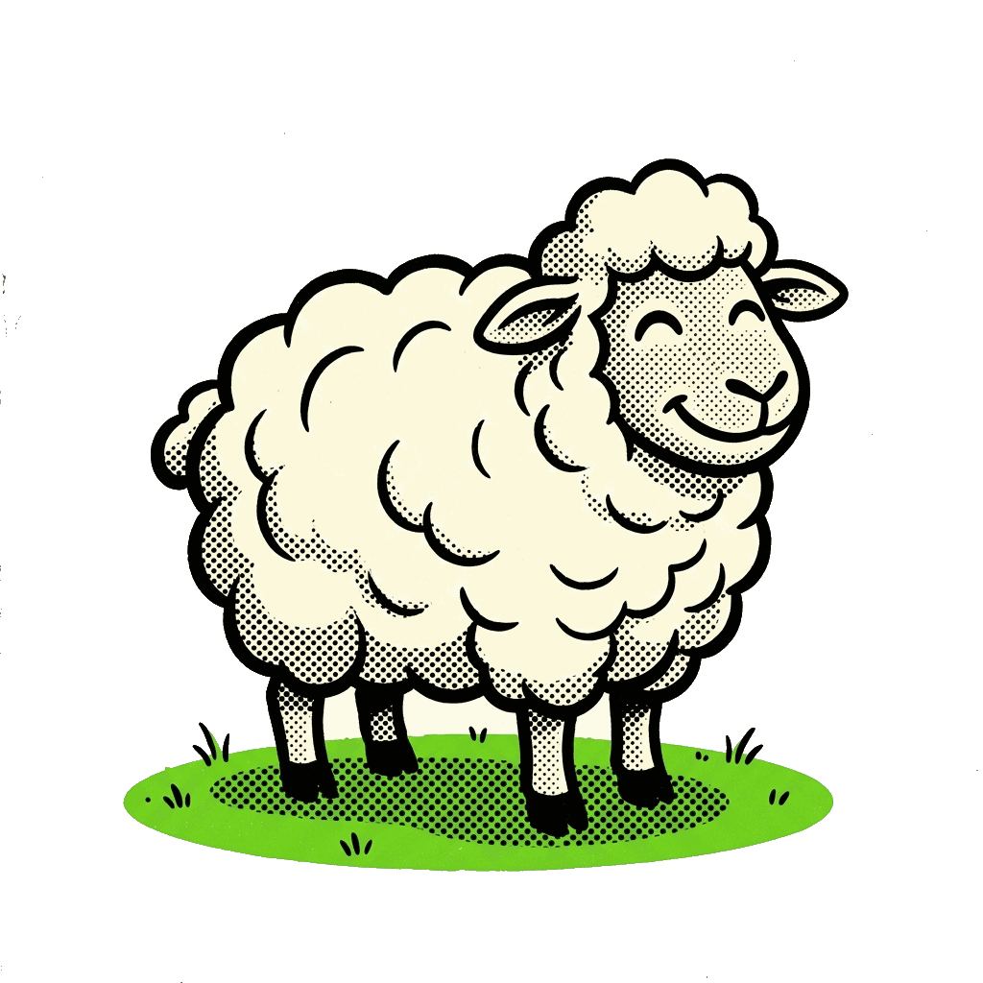
DAY 8
TEACH
CH or SH?
cheap
sheep
Notes:
TEACH — cheap vs sheep
Point LEFT: say "cheap" 3 times. Students echo each time.
Point RIGHT: say "sheep" 3 times. Students echo.
Now alternate: cheap — sheep — cheap — sheep. Big mouth!
Remind: CH = train: CH-CH-CH! (pull the train whistle) | SH = quiet: finger on lips, shhh

Slide 4
DAY 8
GAME
👂 Which word do you hear?
1
2
cheap
sheep
✅ It's SHEEP!
Notes:
GAME — the answer is SHEEP ✅
Say ONLY "sheep" — slowly, 2 or 3 times.
Students type 1 or 2 in the Zoom chat.
CLICK to reveal the answer band. Praise: "Yes! SHEEP!"
If many got it wrong: both words again with the mouth cues (CH vs SH), then repeat once.

Slide 5
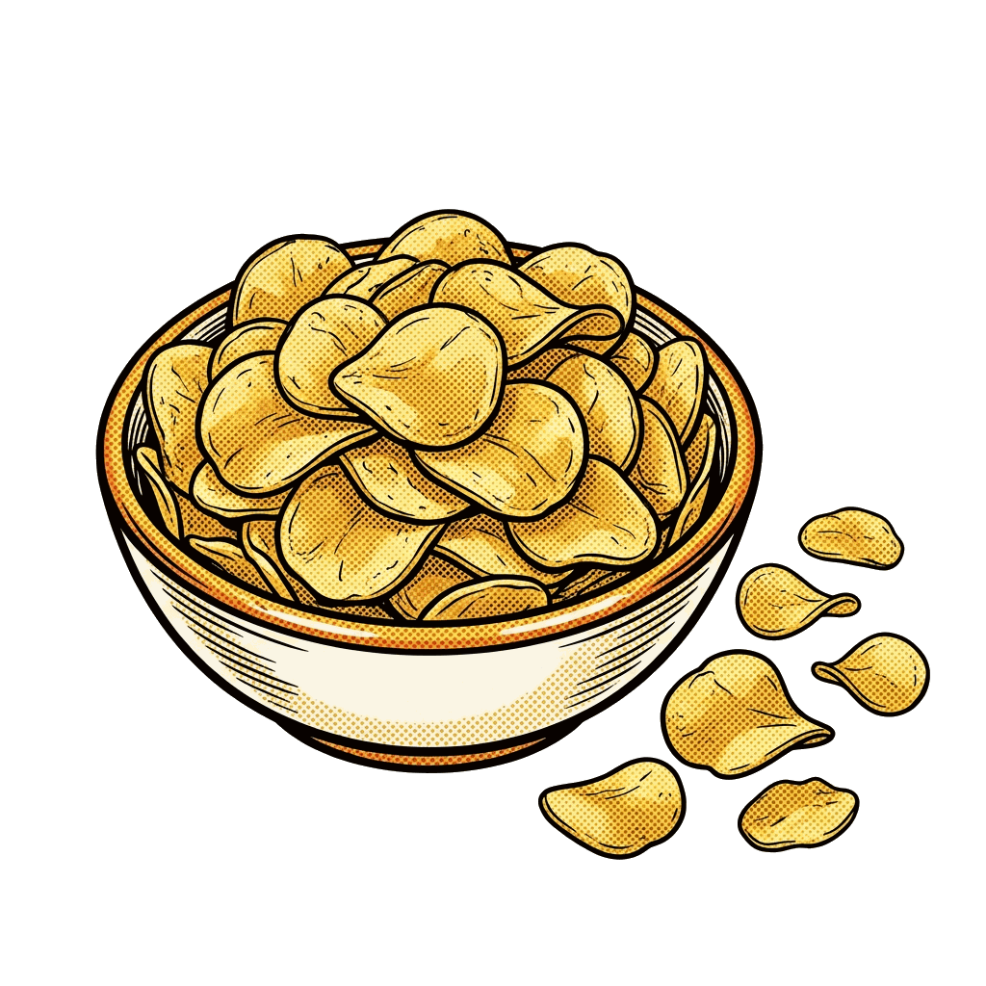

DAY 8
TEACH
CH or SH?
chip
ship
Notes:
TEACH — chip vs ship
Point LEFT: say "chip" 3 times. Students echo each time.
Point RIGHT: say "ship" 3 times. Students echo.
Now alternate: chip — ship — chip — ship. Big mouth!
Remind: CH = train: CH-CH-CH! (pull the train whistle) | SH = quiet: finger on lips, shhh

Slide 6
DAY 8
GAME
👂 Which word do you hear?
1
2
chip
ship
✅ It's CHIP!
Notes:
GAME — the answer is CHIP ✅
Say ONLY "chip" — slowly, 2 or 3 times.
Students type 1 or 2 in the Zoom chat.
CLICK to reveal the answer band. Praise: "Yes! CHIP!"
If many got it wrong: both words again with the mouth cues (CH vs SH), then repeat once.

Slide 7

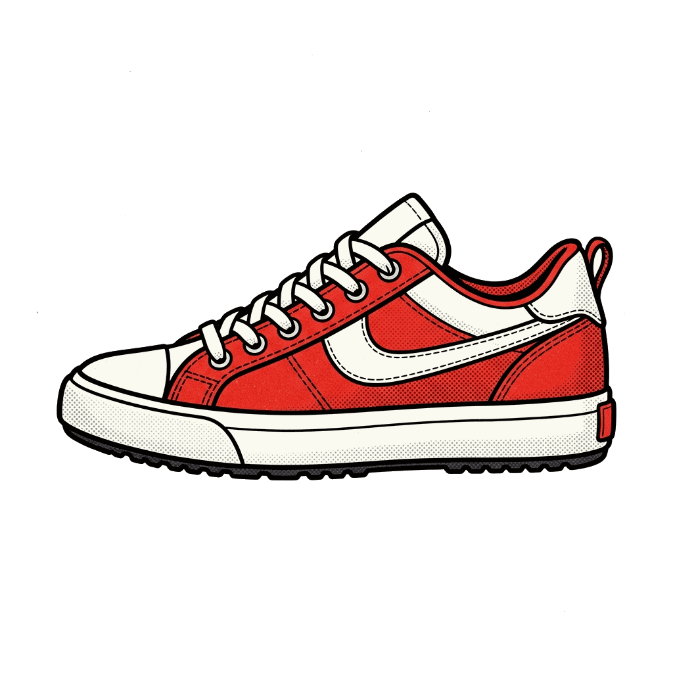
DAY 8
TEACH
CH or SH?
chew
shoe
Notes:
TEACH — chew vs shoe
Point LEFT: say "chew" 3 times. Students echo each time.
Point RIGHT: say "shoe" 3 times. Students echo.
Now alternate: chew — shoe — chew — shoe. Big mouth!
Remind: CH = train: CH-CH-CH! (pull the train whistle) | SH = quiet: finger on lips, shhh

Slide 8
DAY 8
GAME
👂 Which word do you hear?
1
2
chew
shoe
✅ It's SHOE!
Notes:
GAME — the answer is SHOE ✅
Say ONLY "shoe" — slowly, 2 or 3 times.
Students type 1 or 2 in the Zoom chat.
CLICK to reveal the answer band. Praise: "Yes! SHOE!"
If many got it wrong: both words again with the mouth cues (CH vs SH), then repeat once.

Slide 9


DAY 8
TEACH
CH or SH?
chop
shop
Notes:
TEACH — chop vs shop
Point LEFT: say "chop" 3 times. Students echo each time.
Point RIGHT: say "shop" 3 times. Students echo.
Now alternate: chop — shop — chop — shop. Big mouth!
Remind: CH = train: CH-CH-CH! (pull the train whistle) | SH = quiet: finger on lips, shhh

Slide 10
DAY 8
GAME
👂 Which word do you hear?
1
2
chop
shop
✅ It's CHOP!
Notes:
GAME — the answer is CHOP ✅
Say ONLY "chop" — slowly, 2 or 3 times.
Students type 1 or 2 in the Zoom chat.
CLICK to reveal the answer band. Praise: "Yes! CHOP!"
If many got it wrong: both words again with the mouth cues (CH vs SH), then repeat once.

Slide 11
DAY 8
TEACH
CH or SH?
⌚
🧼
watch
wash

Slide 12
DAY 8
GAME
👂 Which word do you hear?
⌚
🧼
1
2
watch
wash
✅ It's WASH!

Slide 13
DAY 8
TEACH
CH or SH?
⚾
💵
catch
cash

Slide 14
DAY 8
GAME
👂 Which word do you hear?
⚾
💵
1
2
catch
cash
✅ It's CATCH!

Slide 15


DAY 8
TEACH
S or Z?
sip
zip
Notes:
TEACH — sip vs zip
Point LEFT: say "sip" 3 times. Students echo each time.
Point RIGHT: say "zip" 3 times. Students echo.
Now alternate: sip — zip — sip — zip. Big mouth!
Remind: S = snake: sss (wiggle your hand like a snake) | Z = bee: zzz (fly your hand like a bee)

Slide 16
DAY 8
GAME
👂 Which word do you hear?
1
2
sip
zip
✅ It's ZIP!
Notes:
GAME — the answer is ZIP ✅
Say ONLY "zip" — slowly, 2 or 3 times.
Students type 1 or 2 in the Zoom chat.
CLICK to reveal the answer band. Praise: "Yes! ZIP!"
If many got it wrong: both words again with the mouth cues (S vs Z), then repeat once.

Slide 17

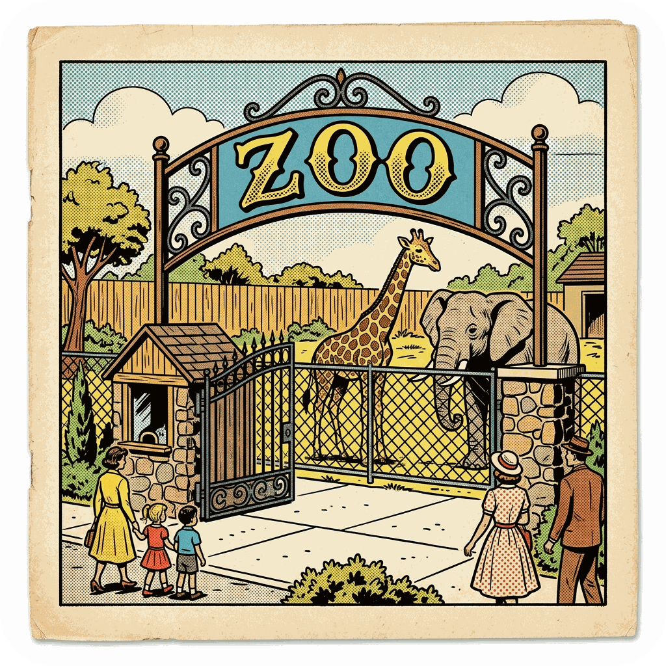
DAY 8
TEACH
S or Z?
sue
zoo
Notes:
TEACH — Sue vs zoo
Point LEFT: say "Sue" 3 times. Students echo each time.
Point RIGHT: say "zoo" 3 times. Students echo.
Now alternate: Sue — zoo — Sue — zoo. Big mouth!
Remind: S = snake: sss (wiggle your hand like a snake) | Z = bee: zzz (fly your hand like a bee)

Slide 18
DAY 8
GAME
👂 Which word do you hear?
1
2
sue
zoo
✅ It's SUE!
Notes:
GAME — the answer is SUE ✅
Say ONLY "Sue" — slowly, 2 or 3 times.
Students type 1 or 2 in the Zoom chat.
CLICK to reveal the answer band. Praise: "Yes! SUE!"
If many got it wrong: both words again with the mouth cues (S vs Z), then repeat once.

Slide 19
DAY 8
TEACH
S or Z?
🧊
👀
ice
eyes
Notes:
TEACH — ice vs eyes
Point LEFT: say "ice" 3 times. Students echo each time.
Point RIGHT: say "eyes" 3 times. Students echo.
Now alternate: ice — eyes — ice — eyes. Big mouth!
Remind: S = snake: sss (wiggle your hand like a snake) | Z = bee: zzz (fly your hand like a bee)

Slide 20
DAY 8
GAME
👂 Which word do you hear?
🧊
👀
1
2
ice
eyes
✅ It's EYES!
Notes:
GAME — the answer is EYES ✅
Say ONLY "eyes" — slowly, 2 or 3 times.
Students type 1 or 2 in the Zoom chat.
CLICK to reveal the answer band. Praise: "Yes! EYES!"
If many got it wrong: both words again with the mouth cues (S vs Z), then repeat once.

Slide 21
DAY 8
TEACH
S or Z?
🚌
🐝
bus
buzz
Notes:
TEACH — bus vs buzz
Point LEFT: say "bus" 3 times. Students echo each time.
Point RIGHT: say "buzz" 3 times. Students echo.
Now alternate: bus — buzz — bus — buzz. Big mouth!
Remind: S = snake: sss (wiggle your hand like a snake) | Z = bee: zzz (fly your hand like a bee)

Slide 22
DAY 8
GAME
👂 Which word do you hear?
🚌
🐝
1
2
bus
buzz
✅ It's BUS!
Notes:
GAME — the answer is BUS ✅
Say ONLY "bus" — slowly, 2 or 3 times.
Students type 1 or 2 in the Zoom chat.
CLICK to reveal the answer band. Praise: "Yes! BUS!"
If many got it wrong: both words again with the mouth cues (S vs Z), then repeat once.

Slide 23
DAY 8
TEACH
S or Z?
💊
😴
dose
doze
Notes:
TEACH — dose vs doze
Point LEFT: say "dose" 3 times. Students echo each time.
Point RIGHT: say "doze" 3 times. Students echo.
Now alternate: dose — doze — dose — doze. Big mouth!
Remind: S = snake: sss (wiggle your hand like a snake) | Z = bee: zzz (fly your hand like a bee)

Slide 24
DAY 8
GAME
👂 Which word do you hear?
💊
😴
1
2
dose
doze
✅ It's DOZE!
Notes:
GAME — the answer is DOZE ✅
Say ONLY "doze" — slowly, 2 or 3 times.
Students type 1 or 2 in the Zoom chat.
CLICK to reveal the answer band. Praise: "Yes! DOZE!"
If many got it wrong: both words again with the mouth cues (S vs Z), then repeat once.

Slide 25
DAY 8
REVIEW
⭐ Your mouth knows the difference now!
cheap / sheep
chip / ship
chew / shoe
chop / shop
sip / zip
sue / zoo
ice / eyes
bus / buzz
dose / doze
Notes:
REVIEW — fast and loud!
Point at each pair. Class says BOTH words together.
Then lightning round: you say ONE word from any pair — class shouts 1 or 2.
Finish: "Your ears are strong now! 👂💪"

