Slide 1
M U R R A Y ' S E N G L I S H
Tongue Twisters!
Thirty-three thieves… can you say it? 😝
DAY 8
Notes:
🎙️ SCRIPT — read aloud:
Welcome to the fun part — tongue twisters! These are silly sentences that tie your tongue in knots. Here's the secret: everybody messes them up. That's the whole point. We laugh, we try again. I'll say each one slowly first, then a little faster, and you try with me. Ready? Let's twist.

Slide 2
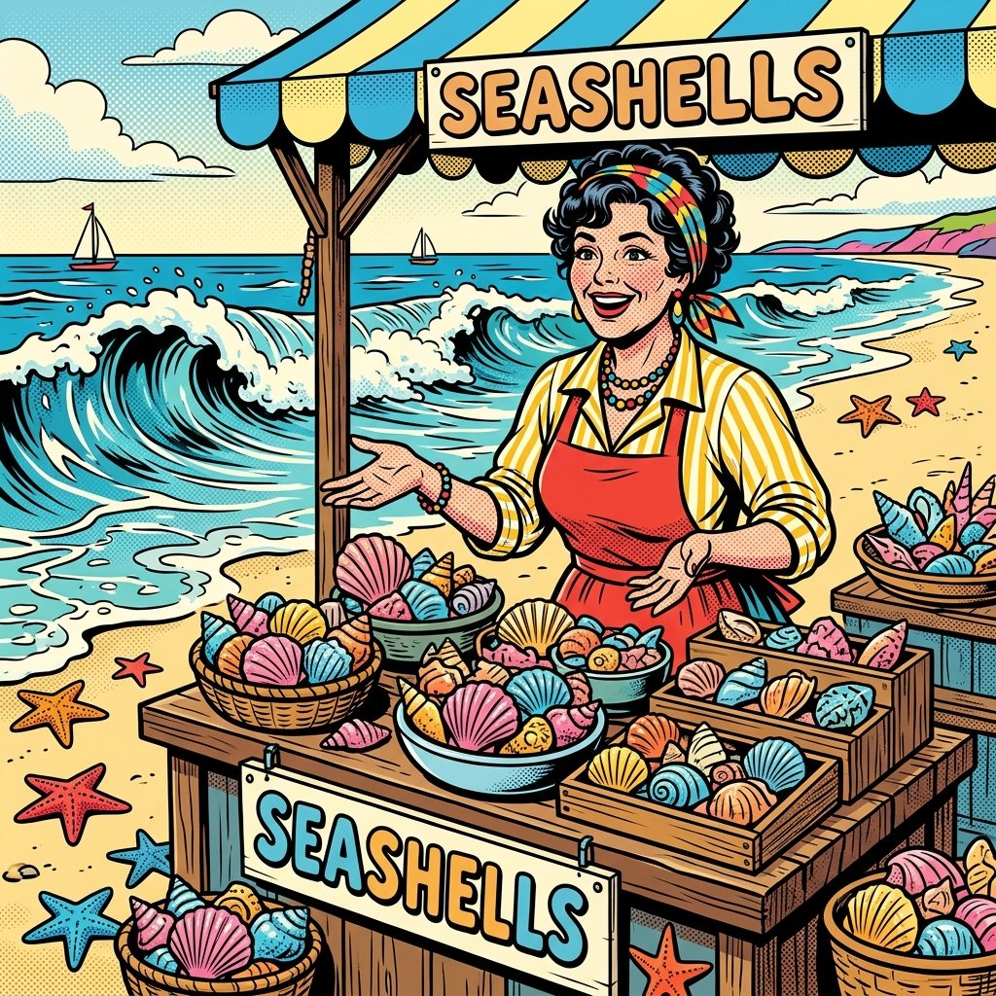
She sells seashells by the seashore.
Practicing S and SH sounds
Notes:
🎙️ SCRIPT — read aloud:
Here's the first one — for the S and SH sounds. Slowly: She… sells… sea-shells… by the… sea-shore. (pause) Hear the soft /shshsh/ and the hissing /sss/ taking turns? Now a bit faster: She sells seashells by the seashore. (pause) Your turn — try it. (pause) If it tangled, that's okay! Laugh and try again.

Slide 3

Zebras zigzagged through the zany zoo.
Practicing Z and ZH sounds
Notes:
🎙️ SCRIPT — read aloud:
Now the Z sound — make your throat buzz like a bee. Slowly: Zebras… zigzagged… through the… zany… zoo. (pause) Feel that /zzzz/ buzz? Faster now: Zebras zigzagged through the zany zoo. (pause) You try. (pause) Tricky one! Nicely done.

Slide 4

Think thick thoughts Tuesdays through Thursdays.
Practicing TH blends and rhythm
Notes:
🎙️ SCRIPT — read aloud:
Back to TH — tongue out between your teeth. Slowly: Think… thick… thoughts… Tuesdays… through… Thursdays. (pause) Tongue out for every /ththth/! Faster: Think thick thoughts Tuesdays through Thursdays. (pause) Give it a go. (pause) Good effort — that's a hard one.

Slide 5
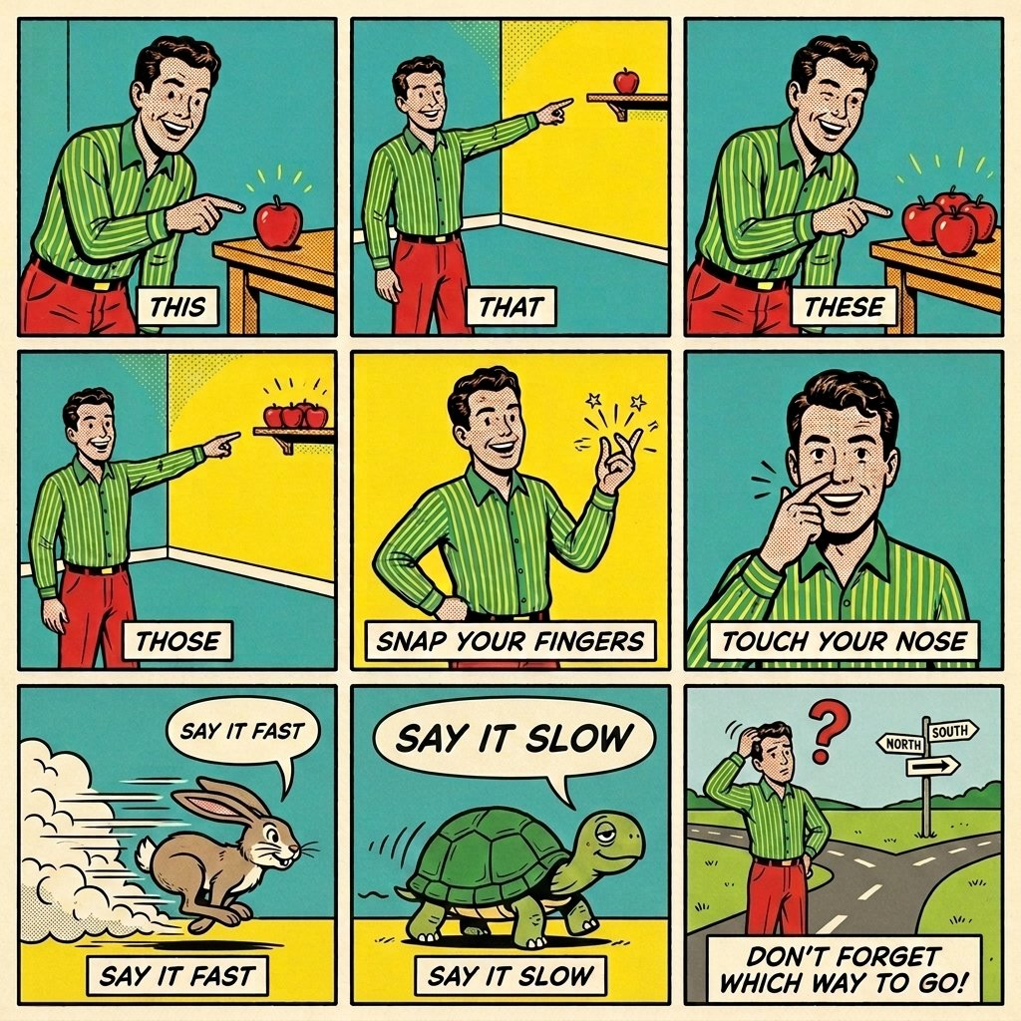
This, that, these, those!
Practicing voiced TH with movement and rhythm
Notes:
🎙️ SCRIPT — read aloud:
This one is a little rhyme, with movement. Read it with me, and do the actions. This, that, these, those — (tongue out for each /ththth/) snap your fingers, touch your nose! Say it fast, say it slow — don't forget which way they go! (pause) Now try it on your own, with the snaps. (pause) Fun, right?

Slide 6

Nathan knew nothing about knitting neat napkins.
Practicing N and KN sounds
Notes:
🎙️ SCRIPT — read aloud:
Now the N sound — and watch out, the K in 'knew' and 'knitting' is silent! Slowly: Nathan… knew… nothing… about… knitting… neat… napkins. (pause) /nnnn/. Faster: Nathan knew nothing about knitting neat napkins. (pause) You try. (pause) Well done.

Slide 7
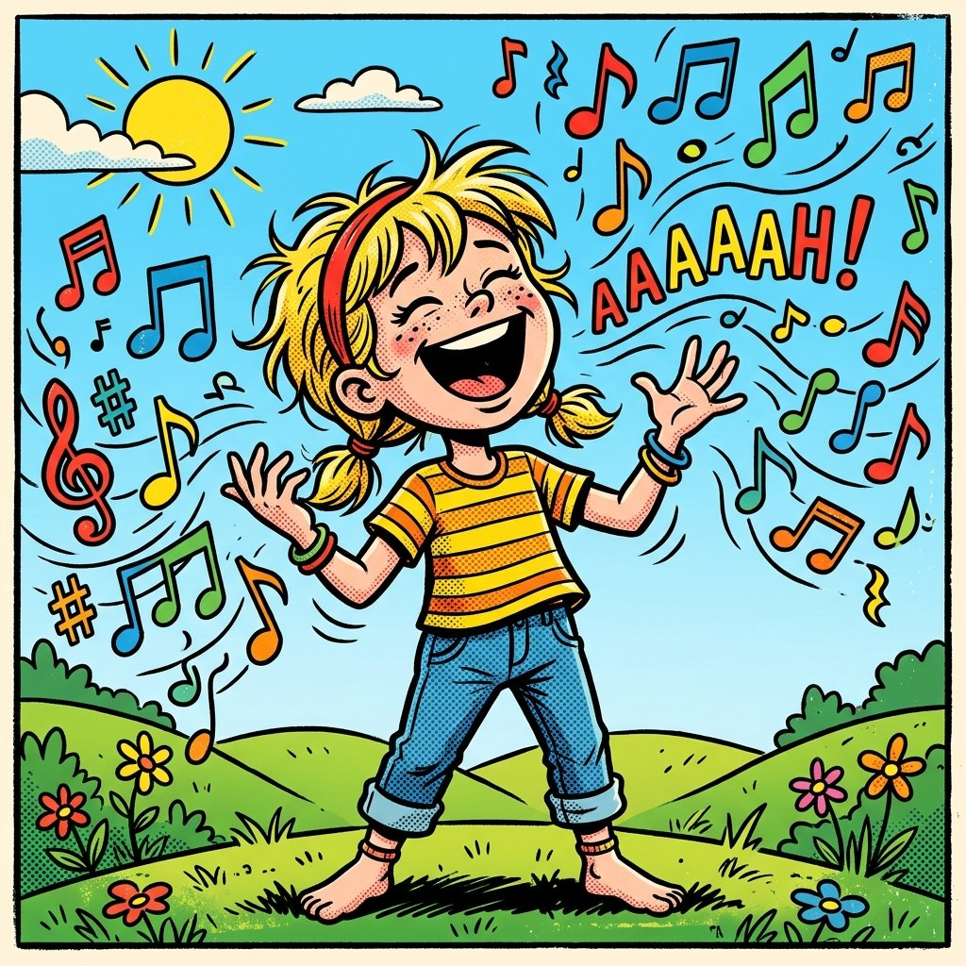
Sam’s silly sister sang seven sharp songs on Sunday.
Practicing S and SH tongue strength
Notes:
🎙️ SCRIPT — read aloud:
Big S sentence now. Slowly: Sam's… silly… sister… sang… seven… sharp… songs… on… Sunday. (pause) Lots of hissing /sss/. Faster: Sam's silly sister sang seven sharp songs on Sunday. (pause) Try it. (pause) Nicely done.

Slide 8
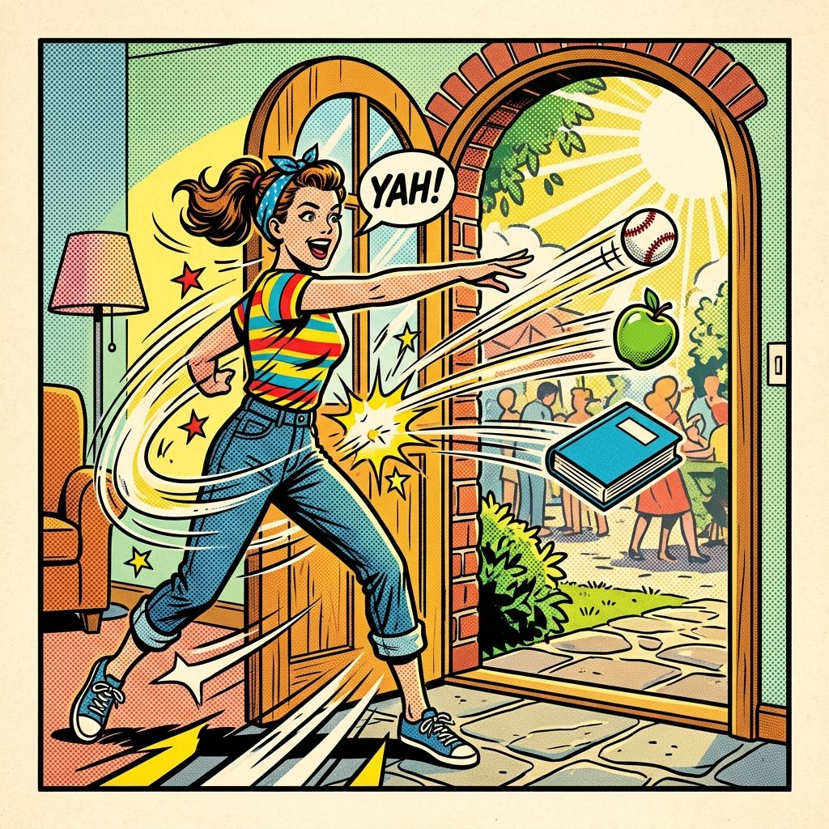
Throw three thrilling things through the threshold.
Practicing TH clusters and linking
Notes:
🎙️ SCRIPT — read aloud:
Last one — TH clusters, the hardest yet. Slowly: Throw… three… thrilling… things… through the… threshold. (pause) Tongue out, /ththth/ and r together. Faster: Throw three thrilling things through the threshold. (pause) Give it your best. (pause) If you got tangled — perfect, that means you tried!

Slide 9
Great job! 😝
Which one was hardest? Say it one more time — slowly, then fast!
Notes:
🎙️ SCRIPT — read aloud:
Beautiful work today. Tongue twisters are hard for everyone — even for people who grew up speaking English. The more you play with them, the stronger and faster your mouth gets. Keep them, and try them again tomorrow. See you next time.

