Slide 1
M U R R A Y ' S E N G L I S H
Funny Sounds!
Two words. One little sound. 😄
Listen and laugh!
murraycohen.com
Notes:
Funny Sounds — Day 8 bonus deck. Ten minimal pairs as absurd pictures. Show the picture, let them laugh, THEN say both words slowly. The laugh is what makes the sound stick.

Slide 2
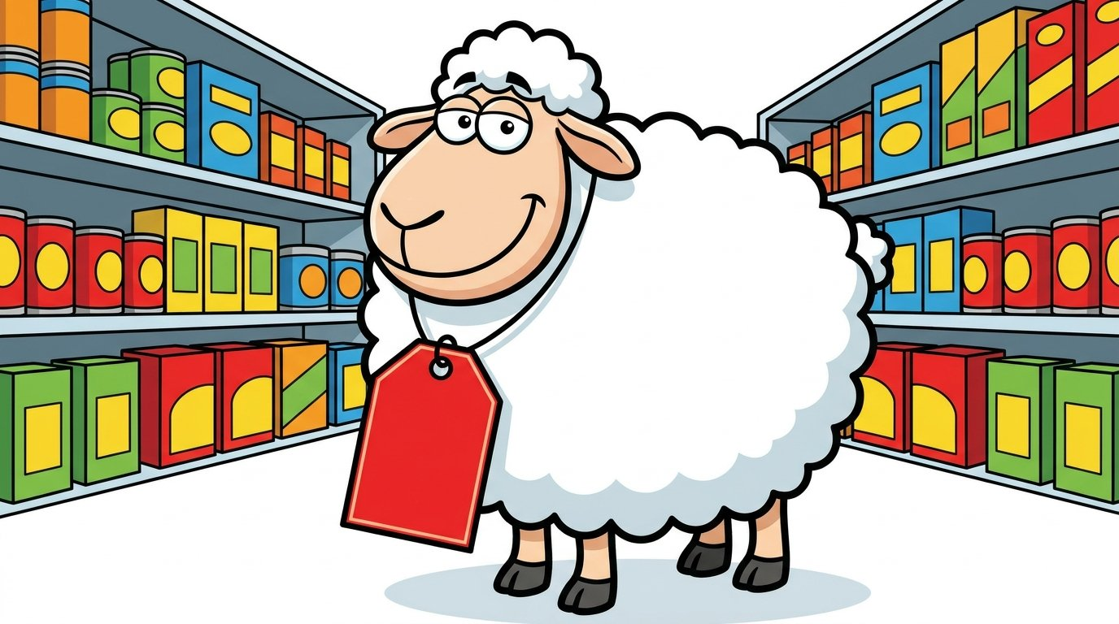
DAY 8
FUNNY!
The sheep is cheap!
cheap
sheep
Notes:
CH / SH. Point at the price tag. 'The sheep is cheap!' Let them laugh, then say both words slowly. cheap = tongue tip, quick puff. sheep = long shhh.

Slide 3
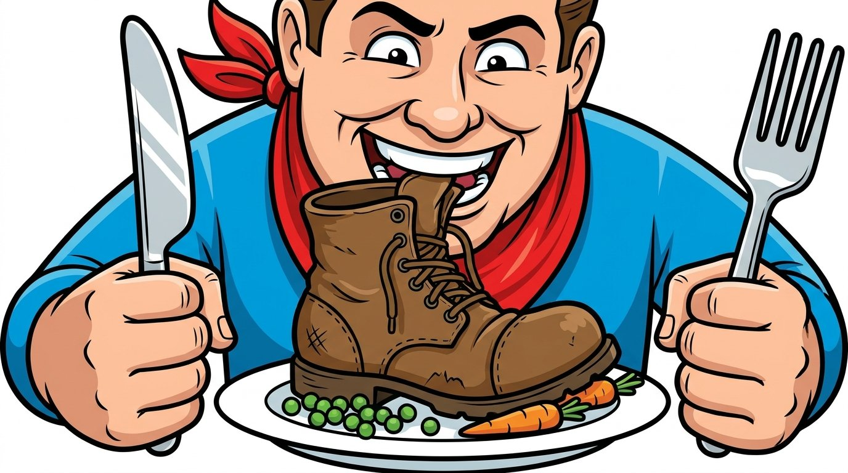
DAY 8
FUNNY!
Don't chew your shoe!
chew
shoe
Notes:
CH / SH. This is the gag from class — pretend to bite your own shoe. chew = ch-ch, fast. shoe = shhh, long.

Slide 4
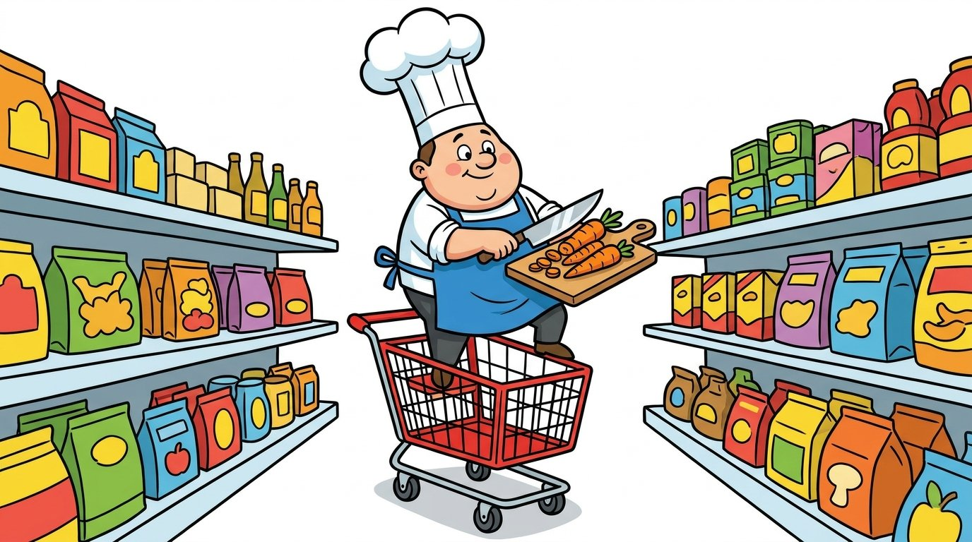
DAY 8
FUNNY!
Chop at the shop!
chop
shop
Notes:
CH / SH. You chop food. You shop for food. Very different!

Slide 5

DAY 8
FUNNY!
A chip is not a ship!
chip
ship
Notes:
CH / SH. A chip is small. You eat it. A ship is big. It sails.

Slide 6
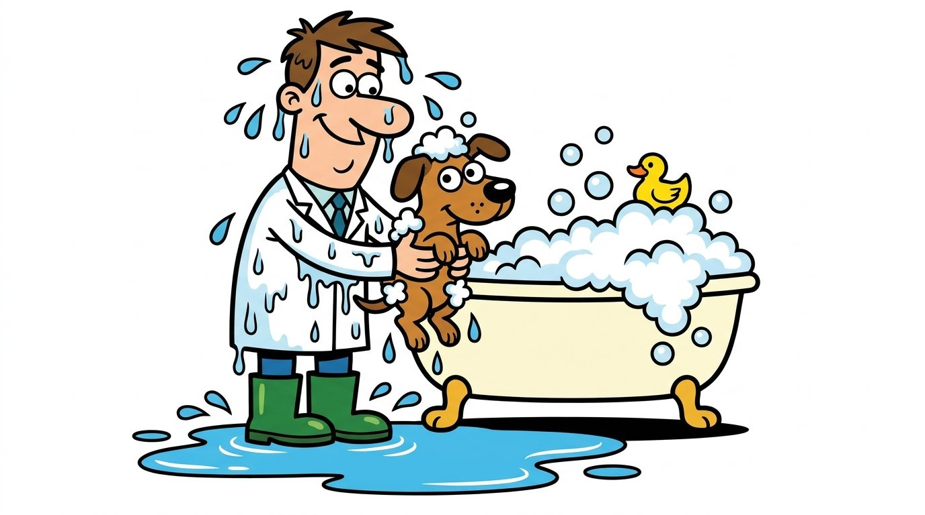
DAY 8
FUNNY!
The wet vet!
wet
vet
Notes:
W / V. wet = round lips, no teeth. vet = teeth on lip, buzz. Show your mouth on the camera.

Slide 7

DAY 8
FUNNY!
Wine on a vine!
wine
vine
Notes:
W / V. wine = you drink it. vine = it grows. Watch my mouth.

Slide 8

DAY 8
FUNNY!
Ice eyes!
ice
eyes
Notes:
S / Z. ice = sss, quiet, no voice. eyes = zzz, buzzy. Put your hand on your throat and feel it.

Slide 9

DAY 8
FUNNY!
The bus can buzz!
bus
buzz
Notes:
S / Z. bus = sss. buzz = zzz, like a bee. Feel your throat.

Slide 10

DAY 8
FUNNY!
A cop in a cup!
cup
cop
Notes:
Tricky vowels. cup = uh, short and relaxed, from the chest. cop = ah, open your mouth wide.

Slide 11
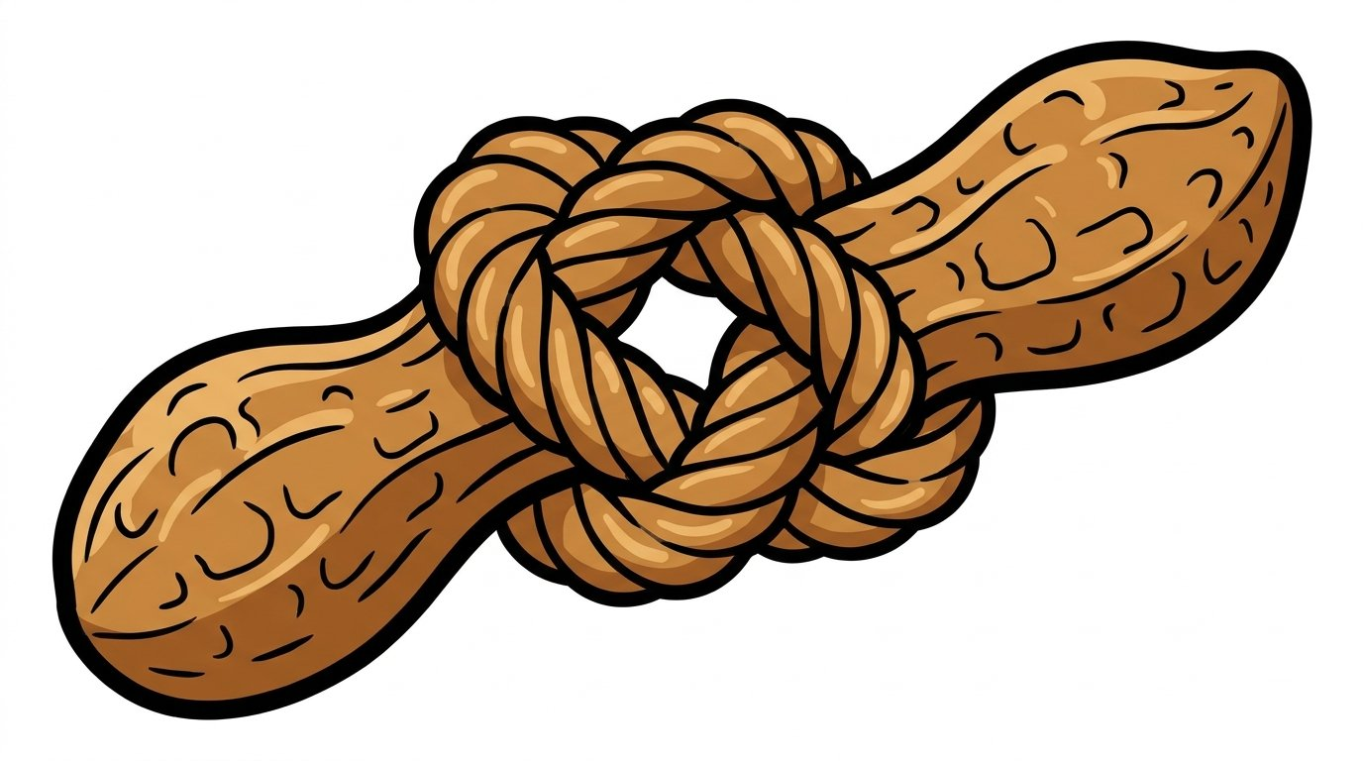
DAY 8
FUNNY!
A nut in a knot!
knot
nut
Notes:
Tricky vowels. knot = ah, open wide. nut = uh, relaxed. The K in knot is silent.

Slide 12
DAY 8
REVIEW
⭐ Say them again with me!
cheap
sheep
chew
shoe
chop
shop
chip
ship
wet
vet
wine
vine
ice
eyes
bus
buzz
cup
cop
knot
nut
Notes:
Fast review. Say each pair. Students repeat. Ask: which picture do you remember?

