Slide 1
DAY 9
M U R R A Y ' S E N G L I S H
☀️ Good morning! Clap the alphabet!
Stand up! Big voice, big claps!
Chant it with me! 👏
murraycohen.com
Notes:
Good morning! Clap every letter with me, A to Z. Ready?

Slide 2
👏 CLAP THE ALPHABET!
A B C D E F G
H I J K L M N O P

Slide 3
👏 CLAP THE ALPHABET!
Q R S · T U V
W X · Y & Z

Slide 4
DAY 9
M U R R A Y ' S E N G L I S H
📍 Where we are
Yesterday: tricky SOUNDS 👅 → Today: the lazy 'uh'
Missed a day? Full replay!
murraycohen.com
Notes:
Yesterday: tricky sounds. Today: the schwa. Missed a day? We'll do all of yesterday again, fast.

Slide 5
DAY 9
M U R R A Y ' S E N G L I S H
Yesterday: tricky sounds
TH · B / V / W · CH / SH · S / Z · uh / ah
let's do it all again!
murraycohen.com
Notes:
Here's everything from yesterday. Let's run through it all, quickly.

Slide 6
DAY 8
tongue between your teeth 👅
Two TH sounds
think
this
/θ/
/ð/
quiet — no buzz
buzzy — feel your throat

Slide 7
DAY 8
👅 TH or T? tongue OUT — or in?
thin · tin
thick · tick
three · tree
I say ONE — you say which! 👂 Then YOU say both.

Slide 8
DAY 8
👅 TH or S? tongue OUT — or smile?
think · sink
thing · sing
mouth · mouse
I say ONE — you say which! 👂 Then YOU say both.

Slide 9
DAY 8
🐝 Buzzy TH or D? tongue OUT — or tap?
they · day
those · doze
there · dare
Hand on your throat — both buzz, but the tongue is OUT for TH!

Slide 10
DAY 8
TEACH
three letters — three mouths
B
V
W
💋
🦷
⭕
Lips together — POP!
Teeth on lip — BUZZ!
Round lips — no teeth!
ball, boat, berry
van, vote, very
water, wine, west

Slide 11
DAY 8
TEACH
B or V?
🚫
🚐
ban
van

Slide 12
DAY 8
GAME
👂 Which word do you hear?
🚫
🚐
1
2
ban
van
✅ It's VAN!

Slide 13

DAY 8
TEACH
W or V?
💧
wet
vet

Slide 14
DAY 8
GAME
👂 Which word do you hear?
💧
1
2
wet
vet
✅ It's VET!

Slide 15
DAY 8
REVIEW
⭐ Your mouth knows the difference now!
🚫 ban
⛵ boat
💧 wet
🍷 wine
🚐 van
🗳️ vote
🩺 vet
🌿 vine

Slide 16
DAY 8
TEACH
Four sounds — four mouths
CH
SH
S
Z
🚂
🤫
🐍
🐝
Stop the air — CHH!
Quiet — SHHH!
Snake — SSS!
Bee — ZZZ!
chip, cheap, chop
ship, sheep, shop
sip, Sue, ice
zip, zoo, eyes

Slide 17

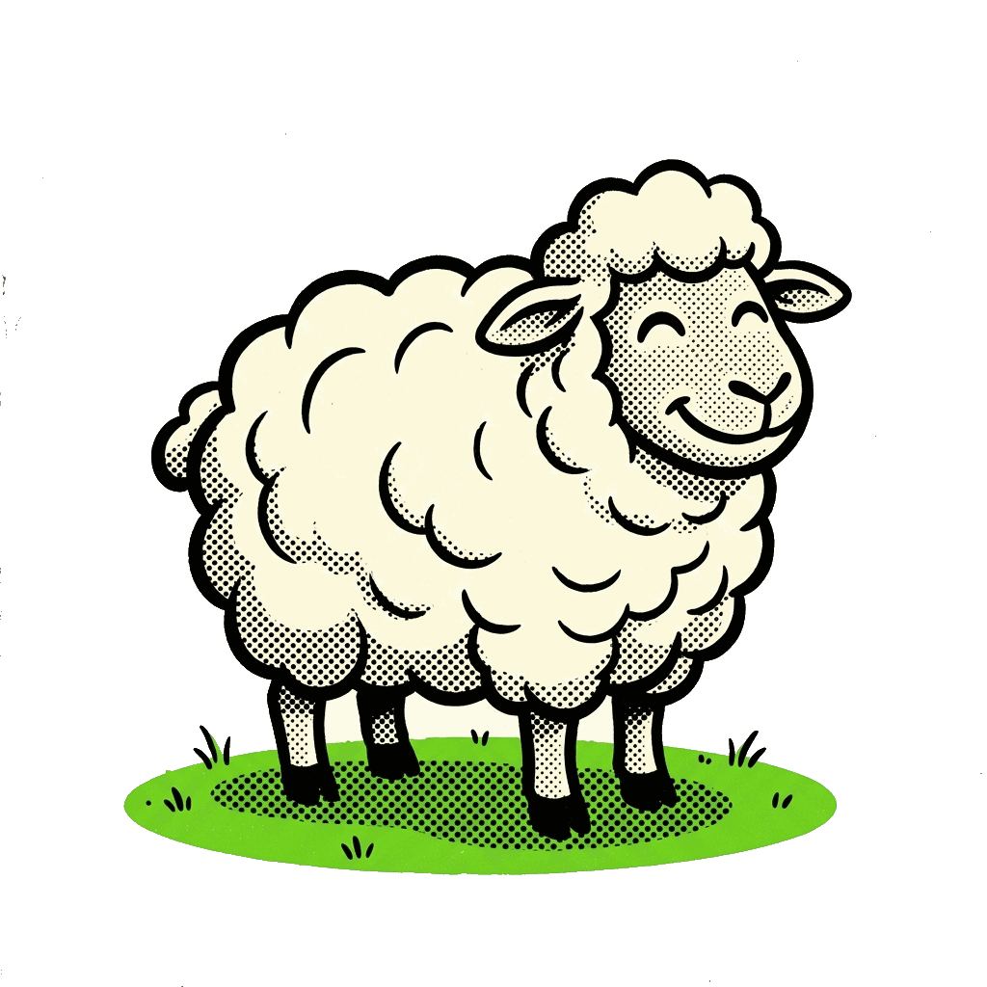
DAY 8
TEACH
CH or SH?
cheap
sheep

Slide 18
DAY 8
GAME
👂 Which word do you hear?
1
2
cheap
sheep
✅ It's SHEEP!

Slide 19

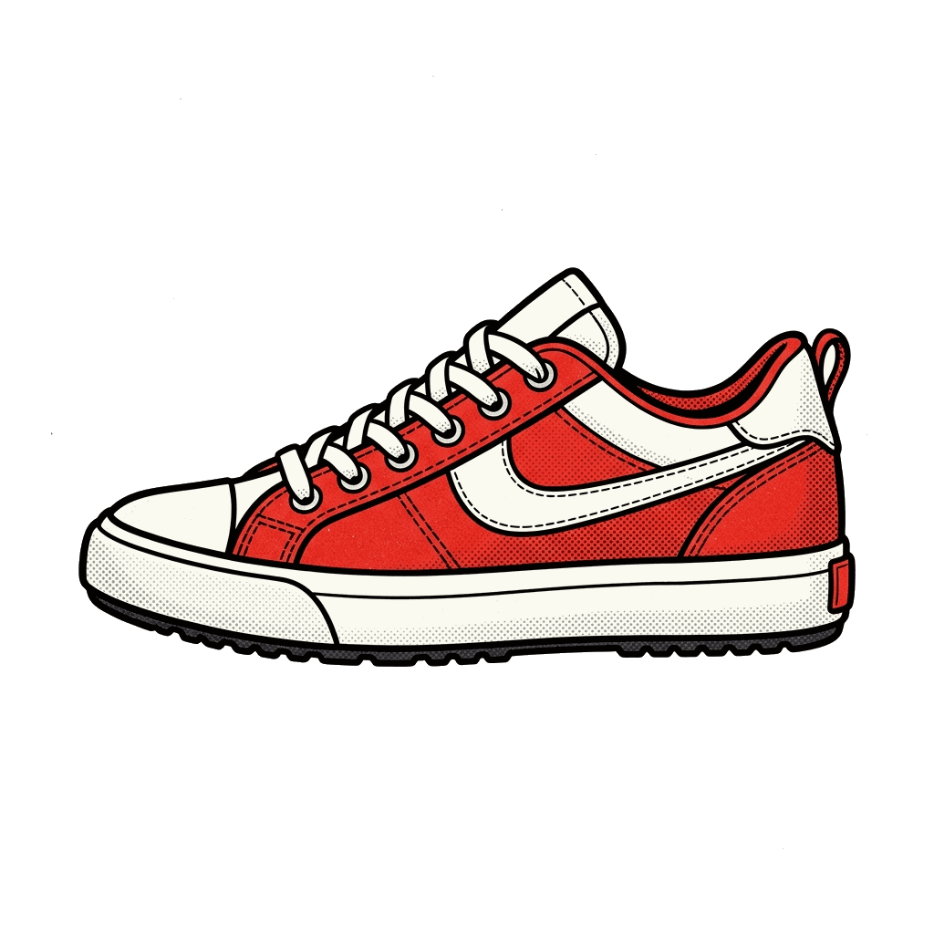
DAY 8
TEACH
CH or SH?
chew
shoe

Slide 20
DAY 8
GAME
👂 Which word do you hear?
1
2
chew
shoe
✅ It's SHOE!

Slide 21
DAY 8
TEACH
S or Z?
🚌
🐝
bus
buzz

Slide 22
DAY 8
GAME
👂 Which word do you hear?
🚌
🐝
1
2
bus
buzz
✅ It's BUS!

Slide 23
DAY 8
REVIEW
⭐ Your mouth knows the difference now!
cheap / sheep
chip / ship
chew / shoe
chop / shop
sip / zip
sue / zoo
ice / eyes
bus / buzz
dose / doze

Slide 24
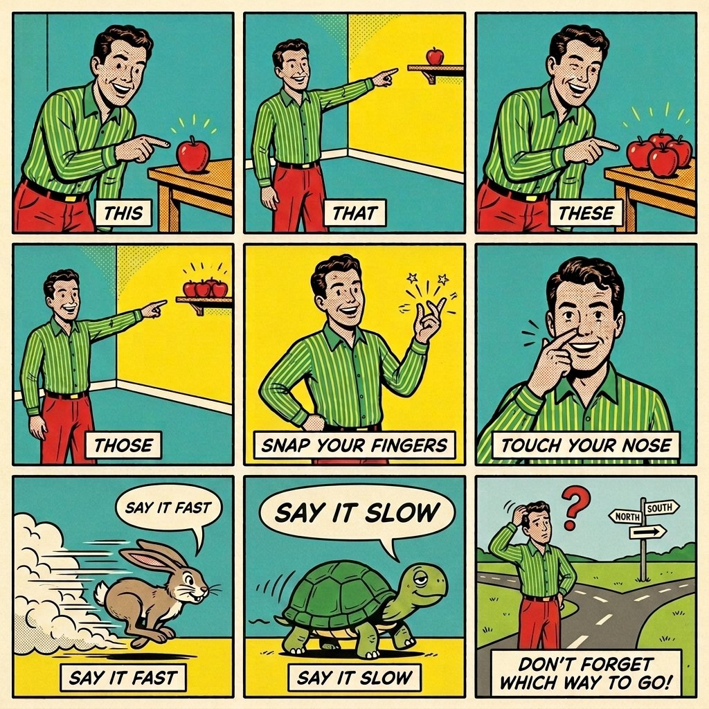
This, that, these, those!
Practicing voiced TH with movement and rhythm

Slide 25

She sells seashells by the seashore.
Practicing S and SH sounds

Slide 26
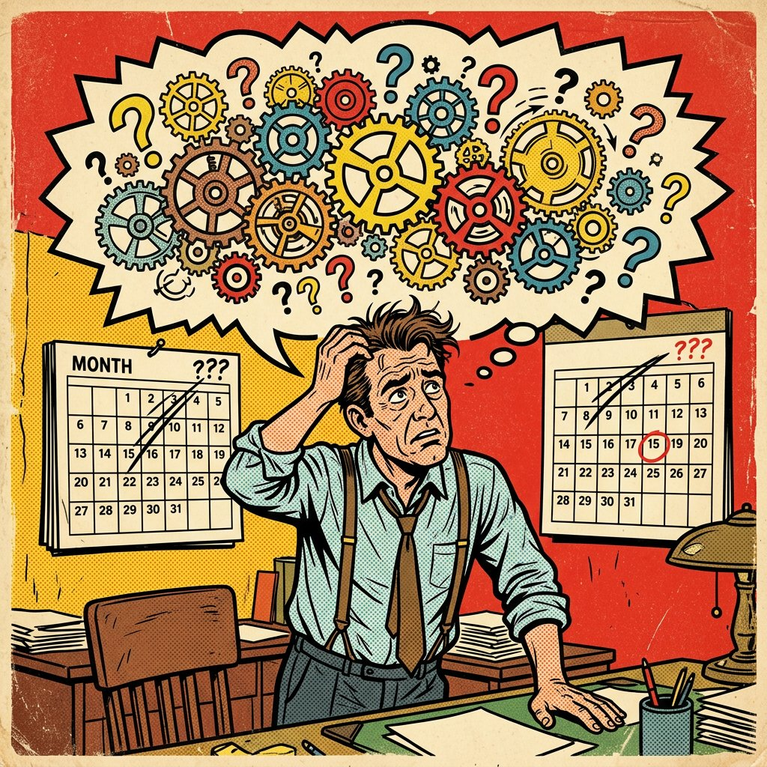
Think thick thoughts Tuesdays through Thursdays.
Practicing TH blends and rhythm

Slide 27
TRICKY VOWELS
Two sounds
uh
ah
/ʌ/ as in cup
/ɑ/ as in cop
Short, relaxed 'uh'.
Open wide 'ah'.
☕ cup
👮 cop

Slide 28
TRICKY VOWELS
👂 Listen — say 1 or 2!
1
2
☕
👮
cup
cop

Slide 29
TRICKY VOWELS
Your turn — say it with me 🗣️
uh
cup · duck · bus · nut
ah
cop · dock · boss · knot
Say each one slowly. Feel your mouth change.

Slide 30
DAY 9
M U R R A Y ' S E N G L I S H
Great ears AND mouths! 👏
Today: the lazy 'uh' — the schwa 😴
let's go!
murraycohen.com
Notes:
You did all of yesterday — TH, B/V/W, CH/SH, S/Z, cup/cop. Today: the laziest sound in English, the schwa. Let's go!

