Slide 1
DAY 10
M U R R A Y ' S E N G L I S H
☀️ Good morning! Clap the alphabet!
Stand up! Big voice, big claps!
Chant it with me! 👏
murraycohen.com
Notes:
Good morning! Clap every letter with me, A to Z. Ready?

Slide 2
👏 CLAP THE ALPHABET!
A B C D E F G
H I J K L M N O P

Slide 3
👏 CLAP THE ALPHABET!
Q R S · T U V
W X · Y Z

Slide 4
DAY 10
M U R R A Y ' S E N G L I S H
📍 Where we are
Yesterday: the lazy 'uh' 😴 → Today: FAST English
Missed a day? Full replay!
murraycohen.com
Notes:
Yesterday: tricky sounds. Today: the schwa. Missed a day? We'll do all of yesterday again, fast.

Slide 5
DAY 10
M U R R A Y ' S E N G L I S H
yesterday: the lazy 'uh'
the schwa 😴 · about · banana · the jaw trick
let's do it all again!
murraycohen.com
Notes:
Here's everything from yesterday. Let's run through it all, quickly.

Slide 6
DAY 9
TEACH
So… what IS the schwa?
😴
👑
🅰️
the LAZY uh
never the strong syllable
Any letter can hide it
mouth relaxed, zero effort
only in NOT-strong beats
a · e · i · o · u — all can say uh!

Slide 7
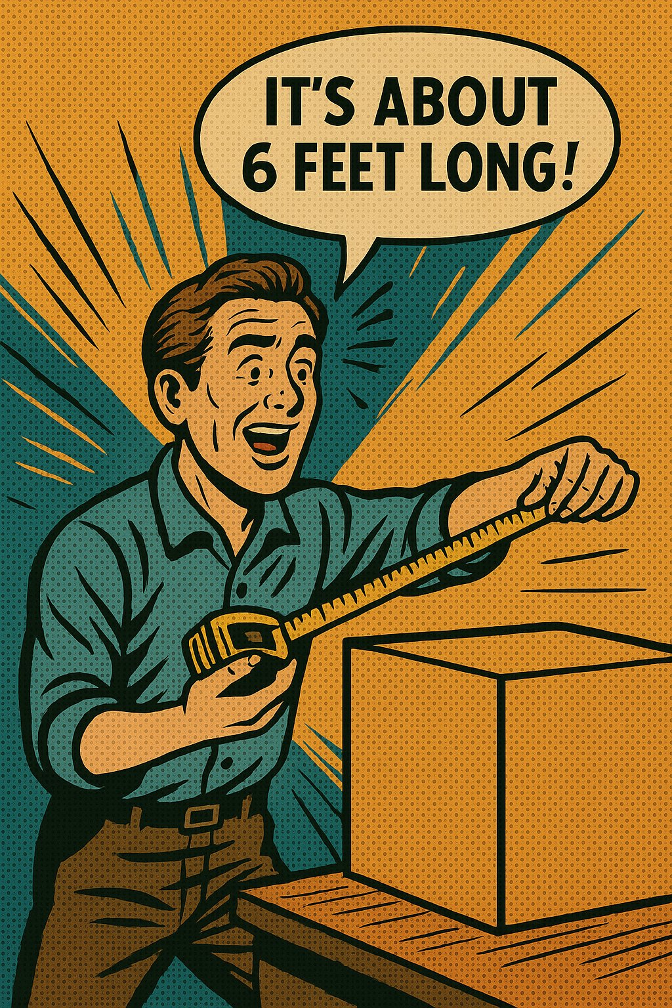
M U R R A Y ' S E N G L I S H
DAY 9
TEACH
about
formal: a-BOUT
↓ the real way
schwa: uh-BOUT
The little “uh” is the schwa 😌
murraycohen.com
Notes:
about → uh-BOUT. The first syllable is the lazy uh. Say careful, then real.

Slide 8

M U R R A Y ' S E N G L I S H
DAY 9
TEACH
banana
formal: ba-NAN-a
↓ the real way
schwa: buh-NAN-uh
The little “uh” is the schwa 😌
murraycohen.com
Notes:
banana → buh-NAN-uh. Two lazy uh's around the strong syllable NAN.

Slide 9
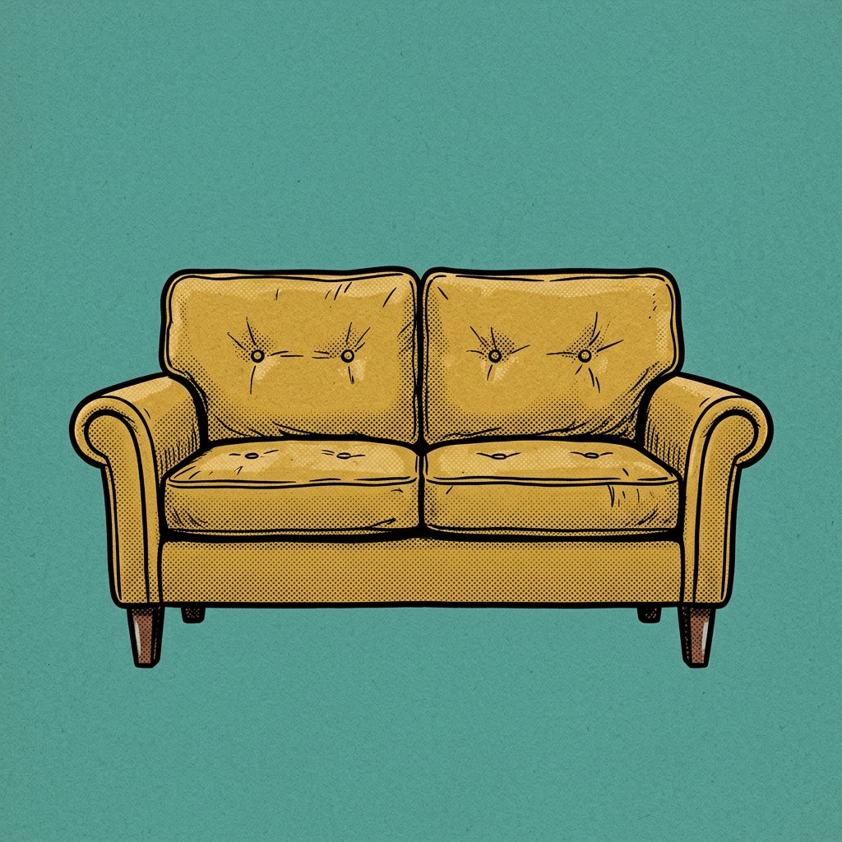
M U R R A Y ' S E N G L I S H
DAY 9
TEACH
sofa
formal: SO-fa
↓ the real way
schwa: SOH-fuh
The little “uh” is the schwa 😌
murraycohen.com
Notes:
sofa → SOH-fuh. Last syllable is the lazy uh. (Sofa image pending image generator.)

Slide 10

M U R R A Y ' S E N G L I S H
DAY 9
TEACH
doctor
formal: DOC-tor
↓ the real way
schwa: DAHK-ter
The little “uh” is the schwa 😌
murraycohen.com
Notes:
doctor → DAHK-ter. The -or ending is the lazy uh.

Slide 11

M U R R A Y ' S E N G L I S H
DAY 9
TEACH
family
formal: FA-mi-ly
↓ the real way
schwa: FAM-uh-lee
The little “uh” is the schwa 😌
murraycohen.com
Notes:
family → FAM-uh-lee. Middle vowel is the lazy uh.

Slide 12

M U R R A Y ' S E N G L I S H
DAY 9
TEACH
computer
formal: com-PU-ter
↓ the real way
schwa: kuhm-PYOO-ter
The little “uh” is the schwa 😌
murraycohen.com
Notes:
computer → kuhm-PYOO-ter. First AND last beats are lazy uh.

Slide 13
DAY 9
TRICK
🖐️ Feel it — the jaw trick!
👑 STRONG beat
😴 lazy uh
😮
😐
BIG jaw drop!
tiny drop … almost nothing

Slide 14
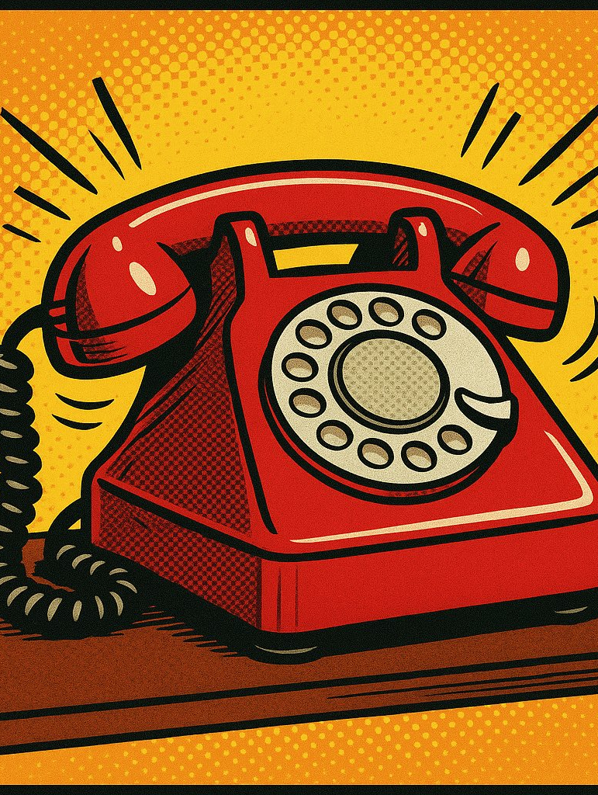
formal:
TEL-e-phone
schwa: TEL-uh-fone

Slide 15
I have a banana
schwa: buh-NAN-uh

Slide 16

I forgot my umbrella!
schwa:
uhm-BREL-uh

Slide 17
What’s this?
a doctor
→ uh DAHK-ter

Slide 18

What’s this?
a pencil
→ uh PEN-suhl

Slide 19
I saw an
uhm-BREL-uh.

Slide 20
It's an umbrella!
☂️
umbrella

Slide 21
DAY 10
M U R R A Y ' S E N G L I S H
You found the lazy uh! 😴👏
Today: FAST English — gonna, wanna! 🏃
let's go!
murraycohen.com
Notes:
You did all of yesterday — TH, B/V/W, CH/SH, S/Z, cup/cop. Today: the laziest sound in English, the schwa. Let's go!

