Slide 1
M U R R A Y ' S E N G L I S H
Intonation — the Music!
Your voice goes UP ↗ and DOWN ↘
DAY 10
Notes:
🎙️ SCRIPT — read aloud:
Welcome back. This is intonation — the music of English. Your voice doesn't stay flat; it goes UP and it goes DOWN, like a melody. That music carries your meaning. I'll model each phrase, exaggerating the up and down, then you'll try it. Let's sing a little.

Slide 2



Notes:
🎙️ SCRIPT — read aloud:
Here's a phrase with melody. Listen as my voice rises and falls — I'll conduct it with my hand like a song. (voice goes up, then down) Hear the music? Say it with me, big and exaggerated. (pause) Don't be flat — let your voice dance. Good.
NOW YOUR TURN — 🎙️ SCRIPT — read aloud:
Your turn — say it right along with me, three times, with a big mouth. Ready? (pause) Again. (pause) One more. (pause) Beautiful. Your voice is making music now.

Slide 3
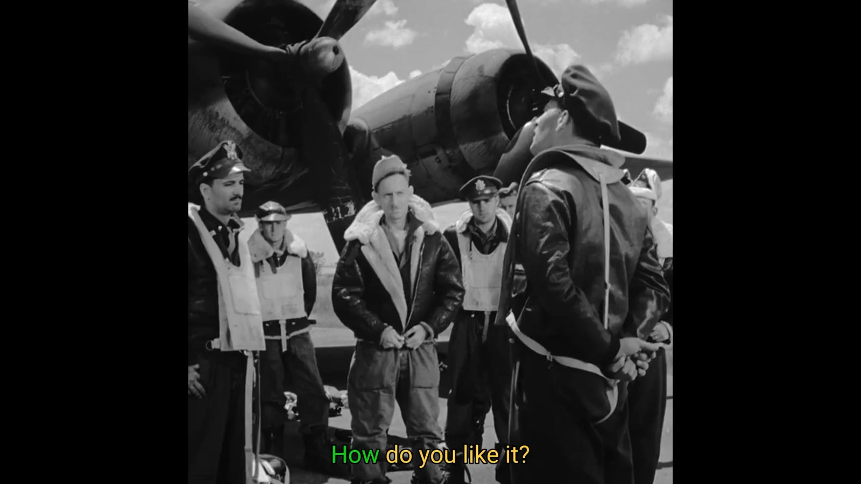
Notes:
🎙️ SCRIPT — read aloud:
Here's a phrase with melody. Listen as my voice rises and falls — I'll conduct it with my hand like a song. (voice goes up, then down) Hear the music? Say it with me, big and exaggerated. (pause) Don't be flat — let your voice dance. Good.

Slide 4

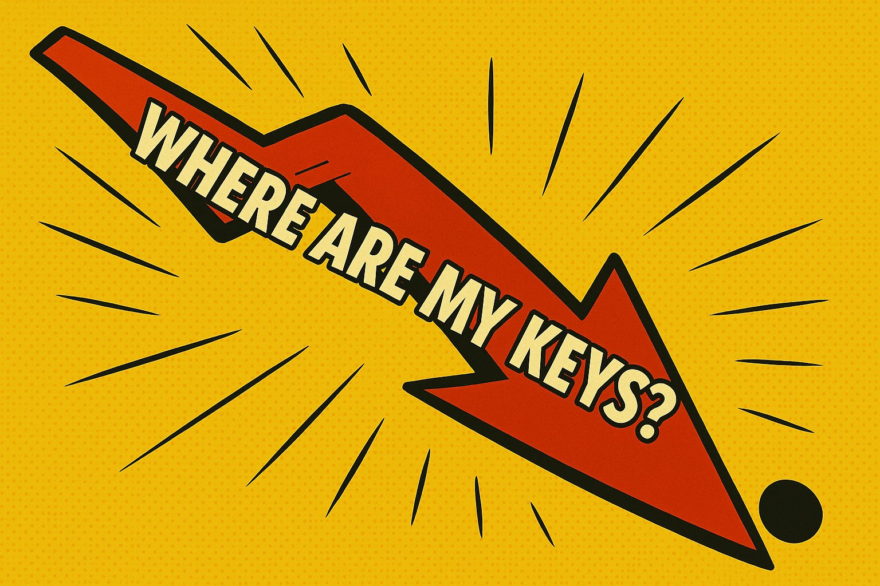
Notes:
🎙️ SCRIPT — read aloud:
Here's a phrase with melody. Listen as my voice rises and falls — I'll conduct it with my hand like a song. (voice goes up, then down) Hear the music? Say it with me, big and exaggerated. (pause) Don't be flat — let your voice dance. Good.
NOW YOUR TURN — 🎙️ SCRIPT — read aloud:
Your turn — say it right along with me, three times, with a big mouth. Ready? (pause) Again. (pause) One more. (pause) Beautiful. Your voice is making music now.

Slide 5
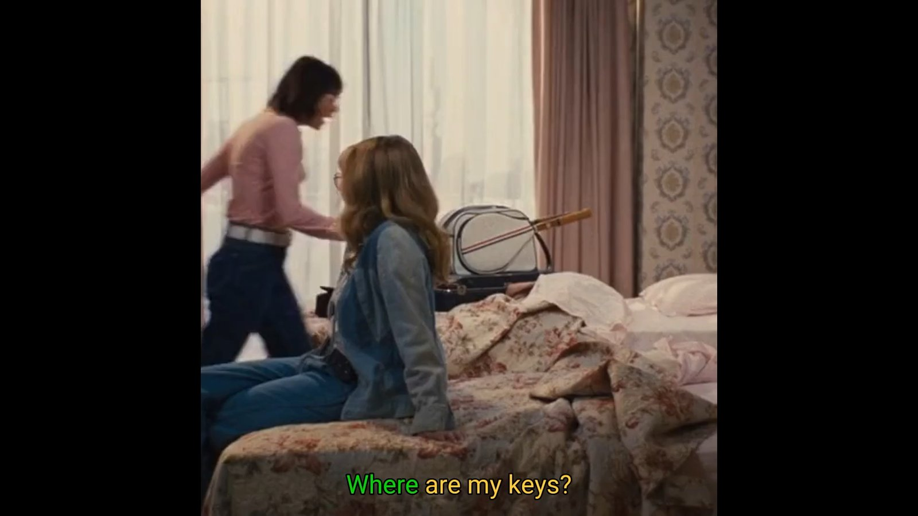
Notes:
🎙️ SCRIPT — read aloud:
Here's a phrase with melody. Listen as my voice rises and falls — I'll conduct it with my hand like a song. (voice goes up, then down) Hear the music? Say it with me, big and exaggerated. (pause) Don't be flat — let your voice dance. Good.

Slide 6


Notes:
🎙️ SCRIPT — read aloud:
Here's a phrase with melody. Listen as my voice rises and falls — I'll conduct it with my hand like a song. (voice goes up, then down) Hear the music? Say it with me, big and exaggerated. (pause) Don't be flat — let your voice dance. Good.
NOW YOUR TURN — 🎙️ SCRIPT — read aloud:
Your turn — say it right along with me, three times, with a big mouth. Ready? (pause) Again. (pause) One more. (pause) Beautiful. Your voice is making music now.

Slide 7
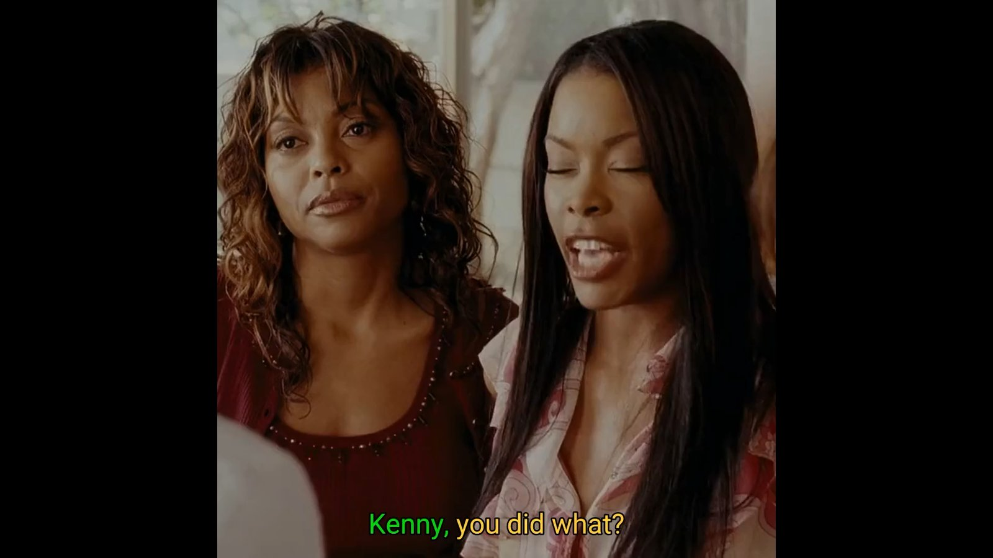
Notes:
🎙️ SCRIPT — read aloud:
Here's a phrase with melody. Listen as my voice rises and falls — I'll conduct it with my hand like a song. (voice goes up, then down) Hear the music? Say it with me, big and exaggerated. (pause) Don't be flat — let your voice dance. Good.

Slide 8
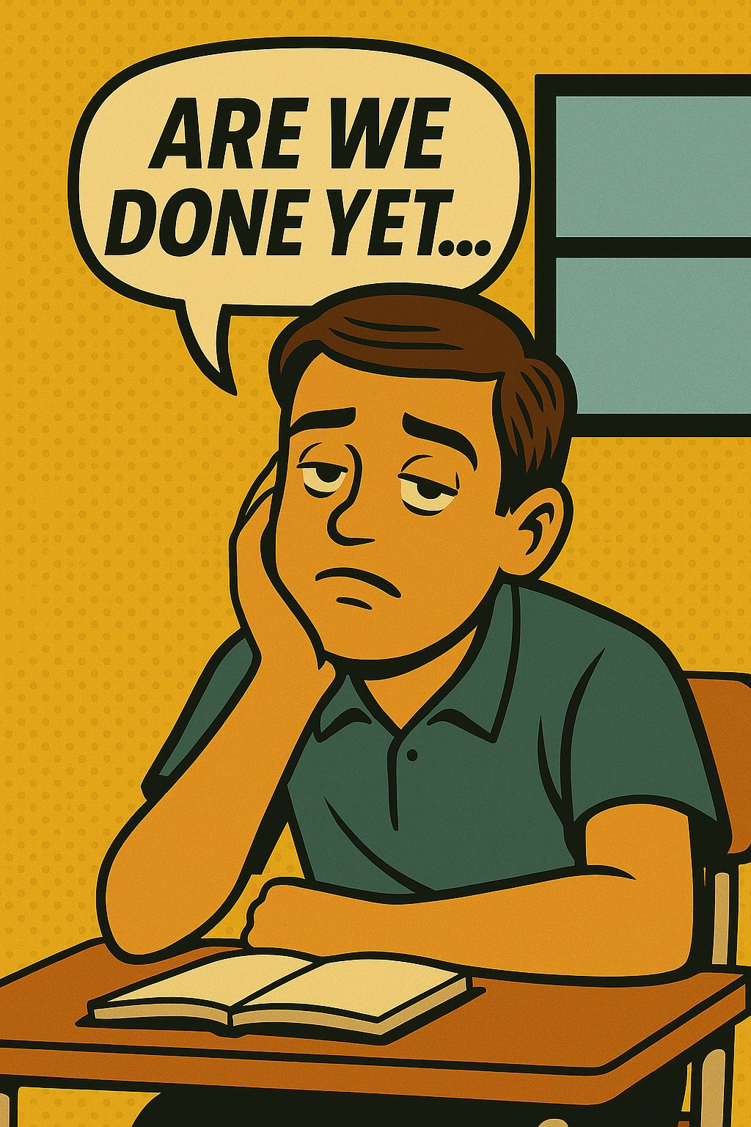


Notes:
🎙️ SCRIPT — read aloud:
Here's a phrase with melody. Listen as my voice rises and falls — I'll conduct it with my hand like a song. (voice goes up, then down) Hear the music? Say it with me, big and exaggerated. (pause) Don't be flat — let your voice dance. Good.
NOW YOUR TURN — 🎙️ SCRIPT — read aloud:
Your turn — say it right along with me, three times, with a big mouth. Ready? (pause) Again. (pause) One more. (pause) Beautiful. Your voice is making music now.

Slide 9
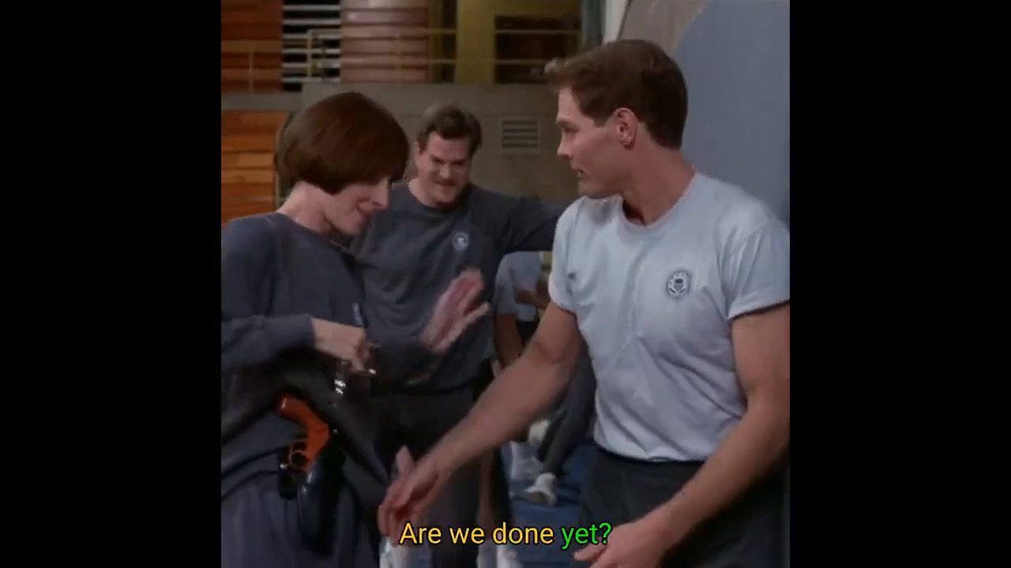
Notes:
🎙️ SCRIPT — read aloud:
Here's another phrase with its own melody. Listen to my voice rise and fall. (voice goes up, then down) Now say it with me, nice and exaggerated. (pause) Let your voice move. Good.

Slide 10


Notes:
🎙️ SCRIPT — read aloud:
Here's a phrase with melody. Listen as my voice rises and falls — I'll conduct it with my hand like a song. (voice goes up, then down) Hear the music? Say it with me, big and exaggerated. (pause) Don't be flat — let your voice dance. Good.
NOW YOUR TURN — 🎙️ SCRIPT — read aloud:
Your turn — say it right along with me, three times, with a big mouth. Ready? (pause) Again. (pause) One more. (pause) Beautiful. Your voice is making music now.

Slide 11
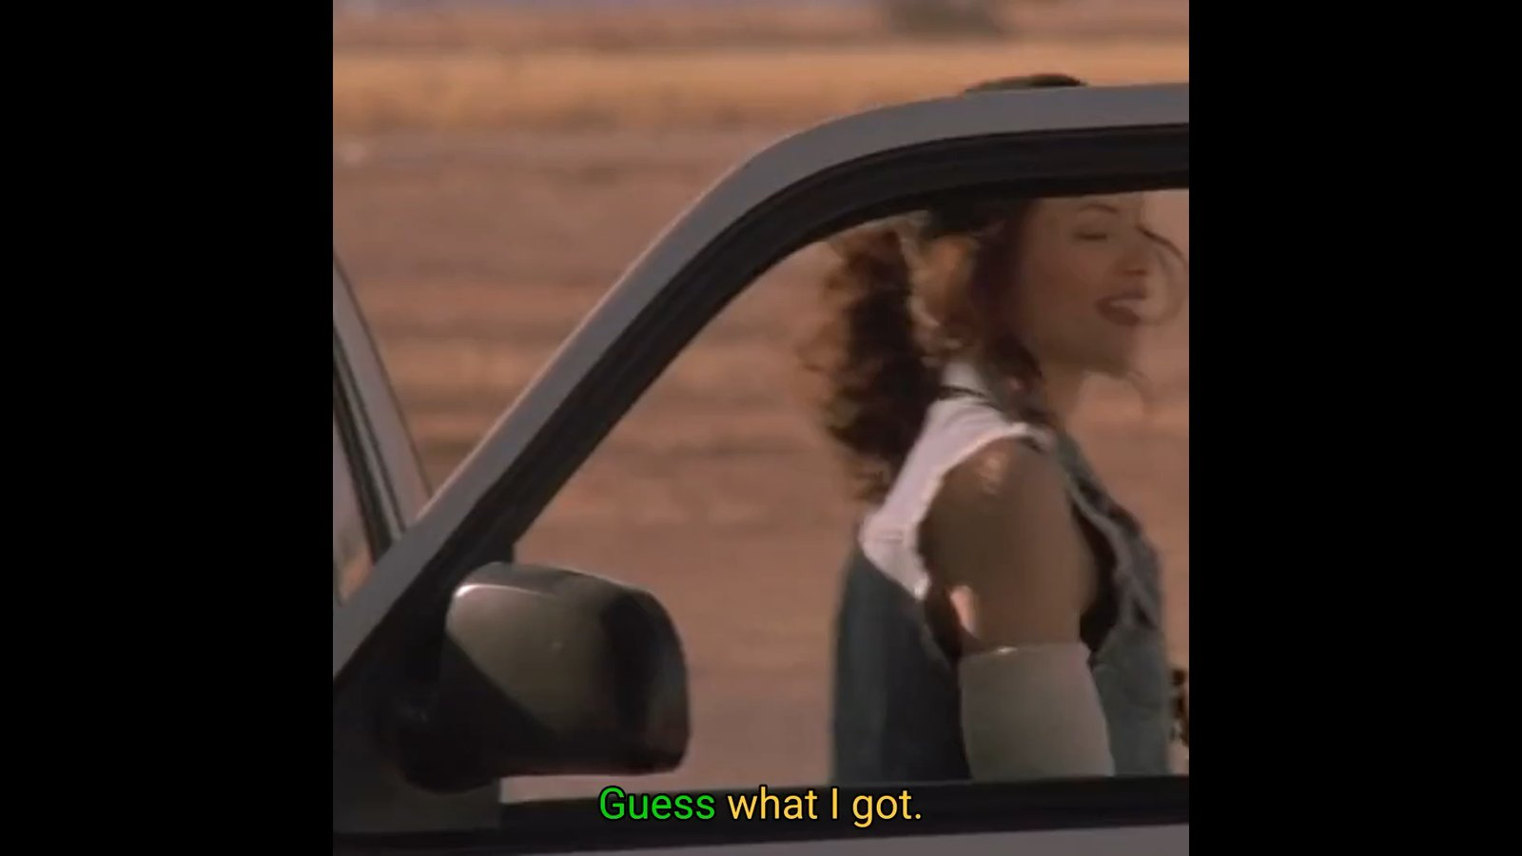
Notes:
🎙️ SCRIPT — read aloud:
Here's a phrase with melody. Listen as my voice rises and falls — I'll conduct it with my hand like a song. (voice goes up, then down) Hear the music? Say it with me, big and exaggerated. (pause) Don't be flat — let your voice dance. Good.

Slide 12
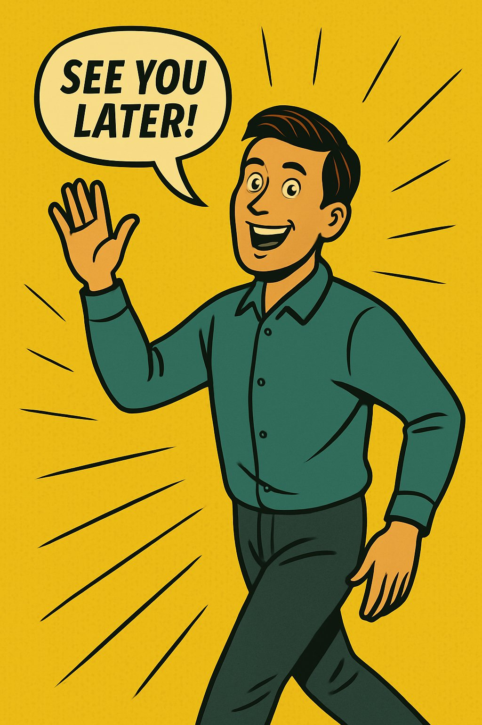

Notes:
🎙️ SCRIPT — read aloud:
Here's a phrase with melody. Listen as my voice rises and falls — I'll conduct it with my hand like a song. (voice goes up, then down) Hear the music? Say it with me, big and exaggerated. (pause) Don't be flat — let your voice dance. Good.
NOW YOUR TURN — 🎙️ SCRIPT — read aloud:
Last one — your turn. Say it with me three times, big mouth, big melody. Ready? (pause) Again. (pause) One more. (pause) Wonderful. You've got the music of English now. Next, we'll use your voice to FIX misunderstandings. See you there.

Slide 13
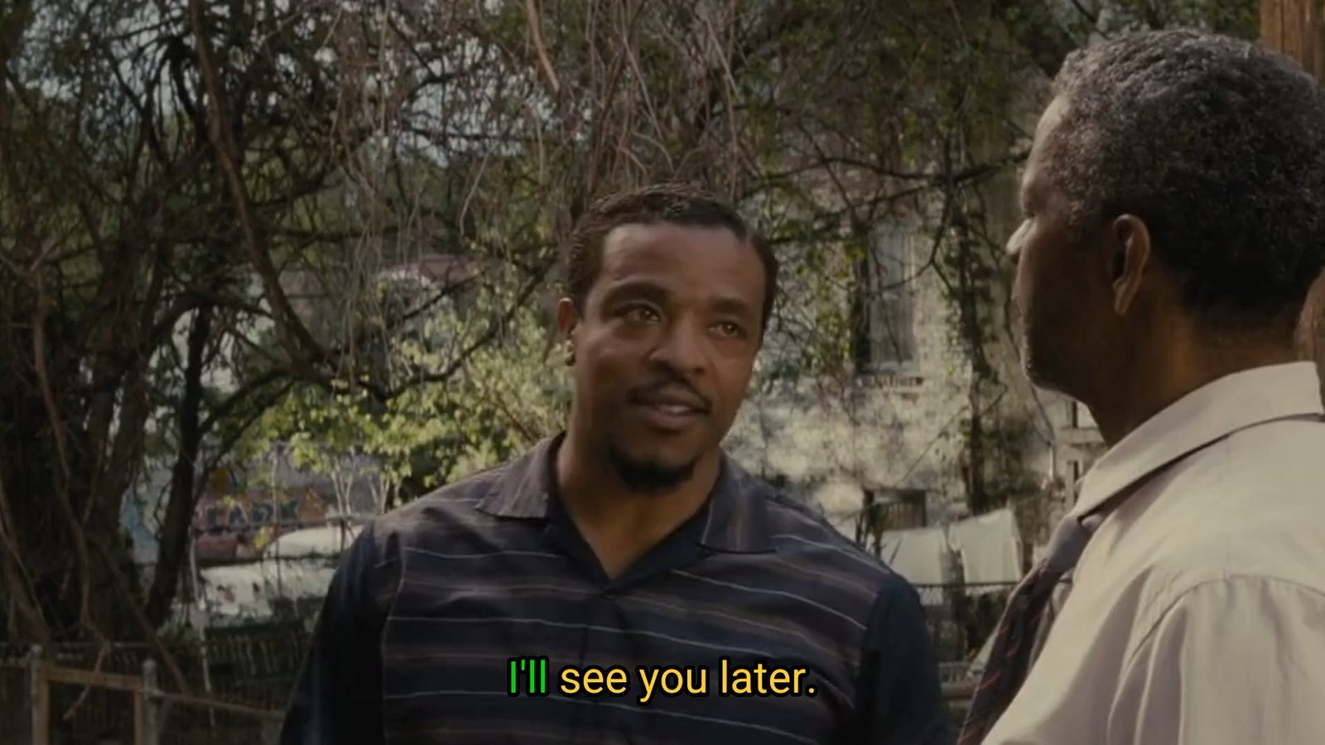
Notes:
🎙️ SCRIPT — read aloud:
Here's a phrase with melody. Listen as my voice rises and falls — I'll conduct it with my hand like a song. (voice goes up, then down) Hear the music? Say it with me, big and exaggerated. (pause) Don't be flat — let your voice dance. Good.

