Slide 1
DAY 11
yesterday's review: Day 10

Slide 2
👏 CLAP THE ALPHABET!
A B C D E F G
H I J K L M N O P

Slide 3
👏 CLAP THE ALPHABET!
Q R S · T U V
W X · Y & Z

Slide 4
M U R R A Y ' S E N G L I S H
reductions & linking
want to → wanna · formal → fast 🏃
DAY 10

Slide 5
🏃
PART 1 — Reductions
Some words melt together when we speak fast

Slide 6
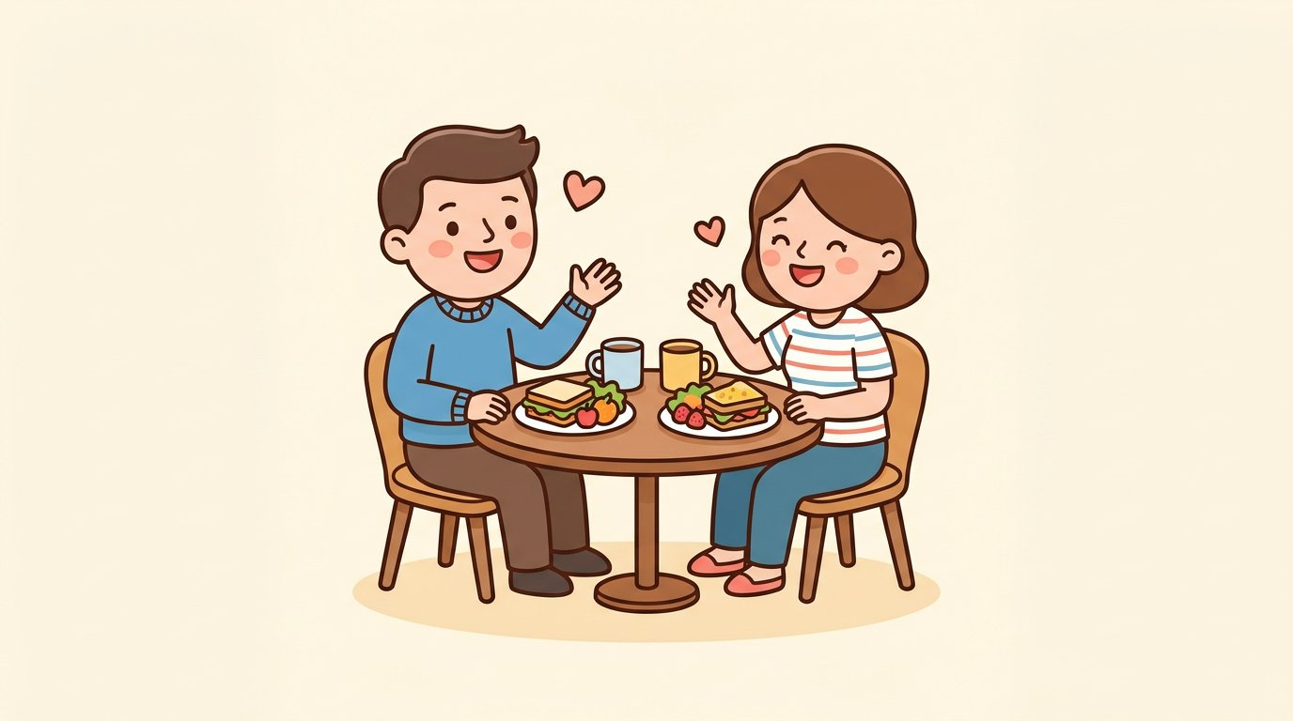
Do you want to eat? → Do you wanna eat?

Slide 7
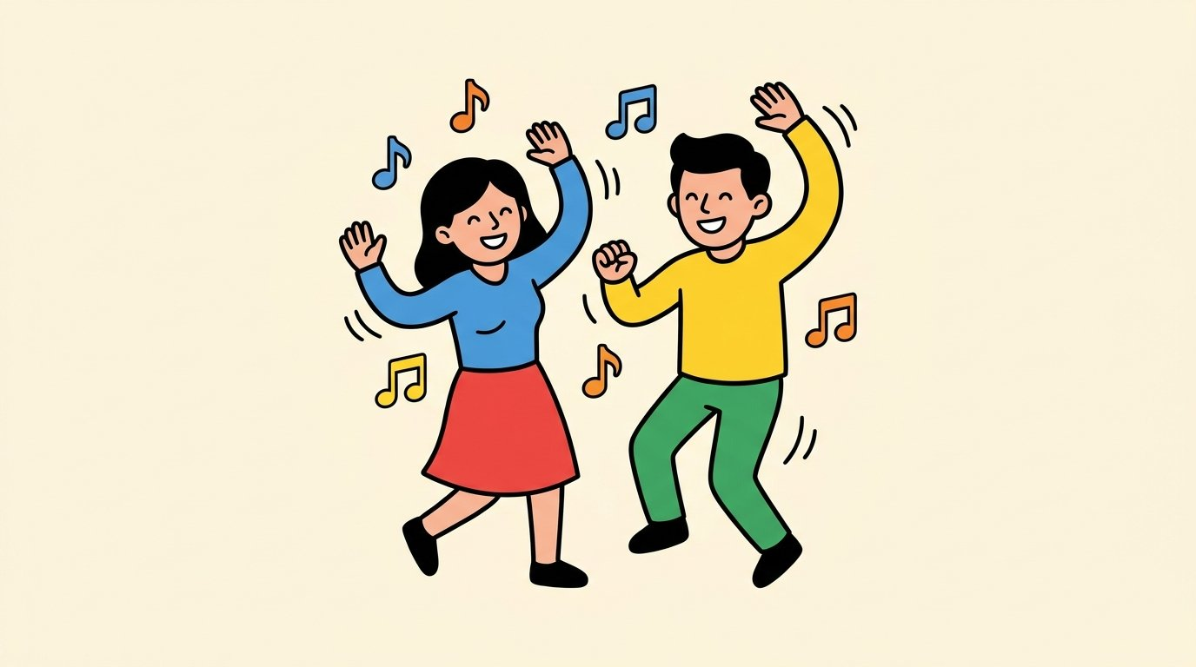
Do you want to dance? → Do you wanna dance?

Slide 8
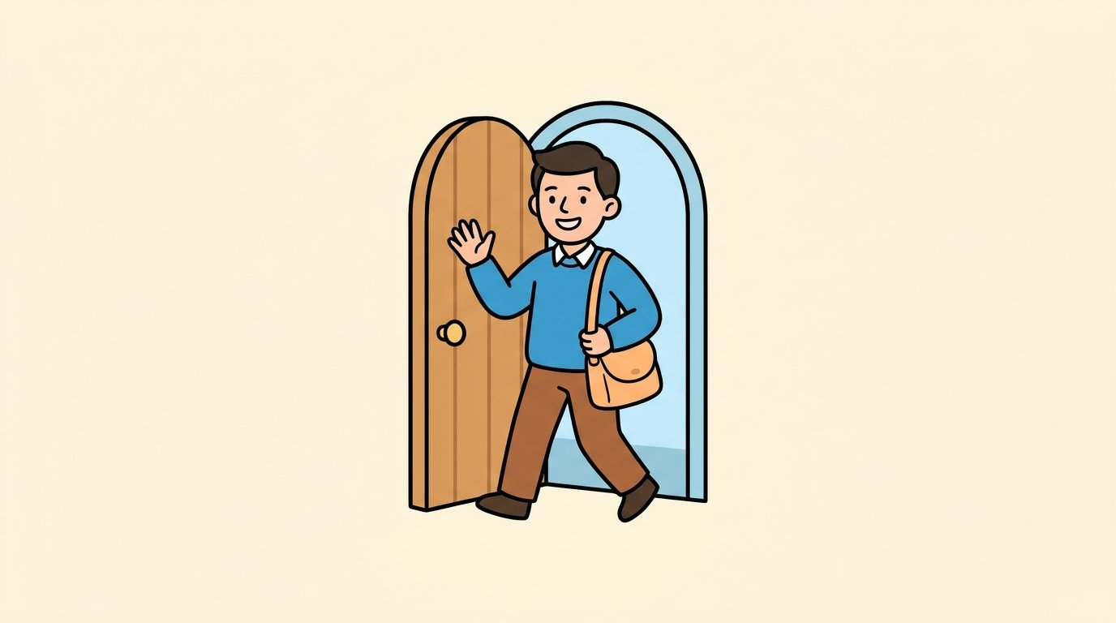
I am going to go now. → I’m gonna go now.

Slide 9
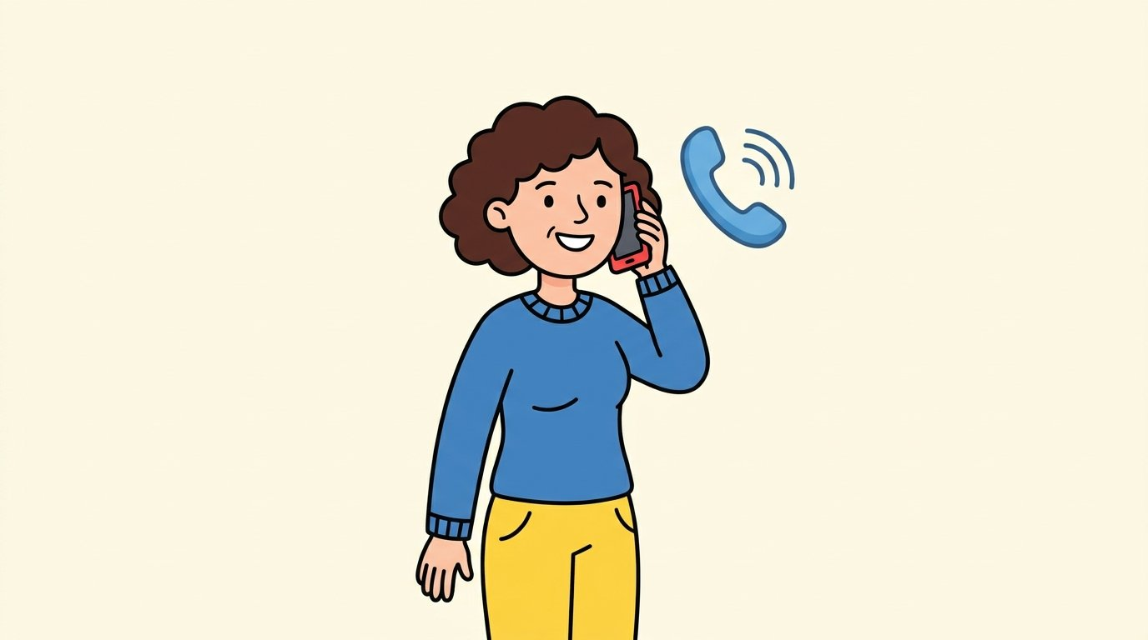
She is going to call me. → She’s gonna call me.

Slide 10
M U R R A Y ' S E N G L I S H
Intonation — the Music!
Your voice goes UP ↗ and DOWN ↘
DAY 10

Slide 11



Slide 12
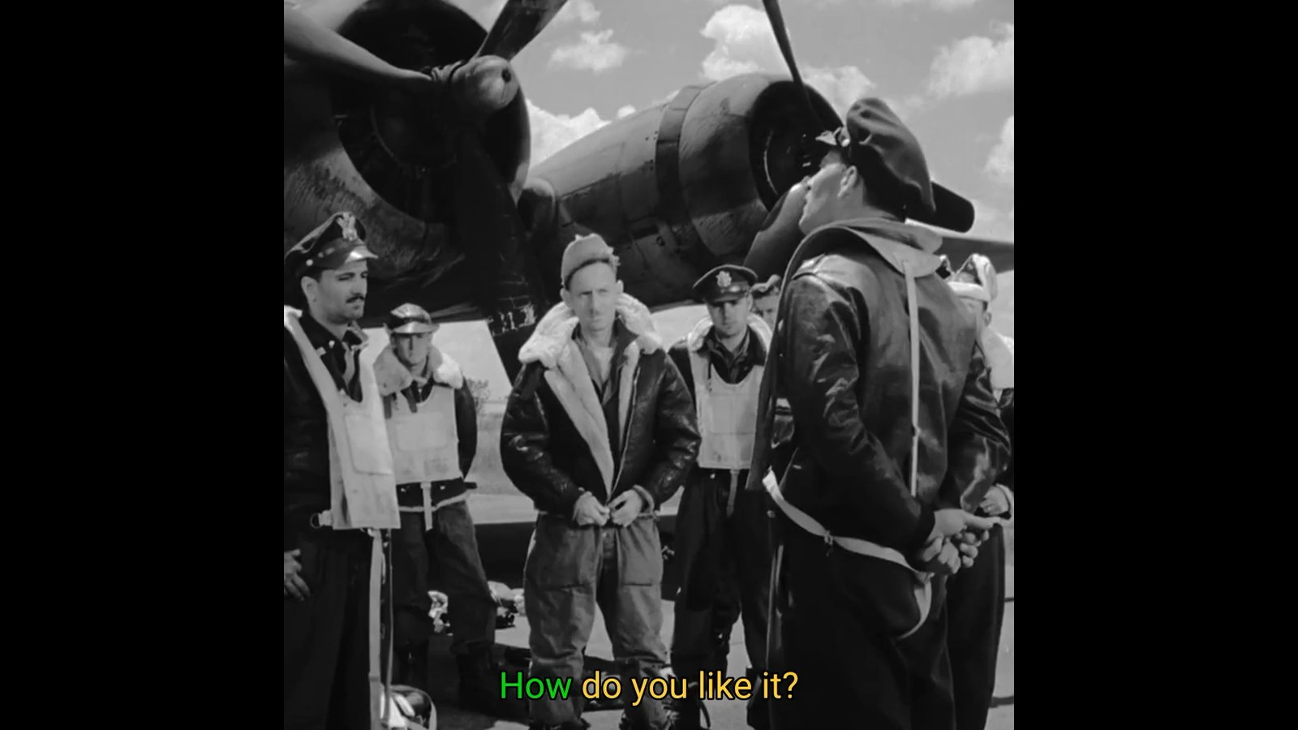

Slide 13
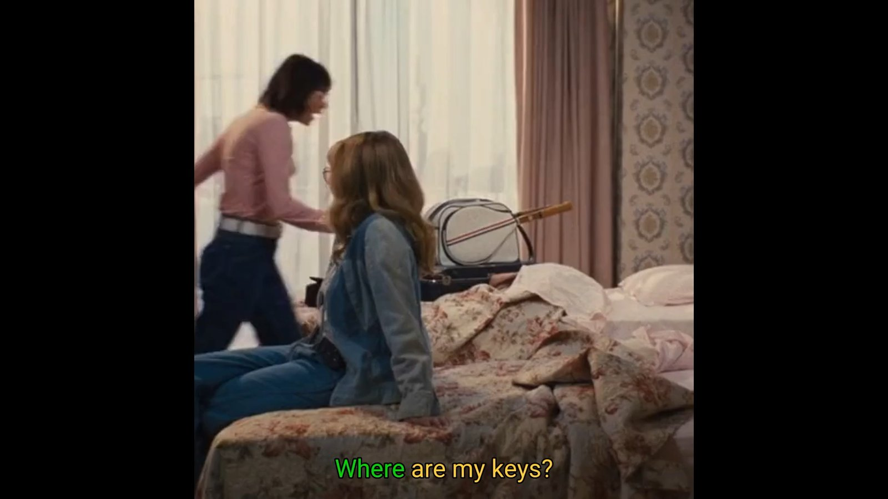

Slide 14
M U R R A Y ' S E N G L I S H
No, a PEN! 🖊️
Fix mistakes with your VOICE
DAY 10
murraycohen.com

Slide 15
DAY 10
TEACH
When they hear it wrong…
🗣️ You: I need a pen.
😕 Them: A pencil?
💪 You: No — a PEN!

Slide 16
DAY 10
PRACTICE
❌
✅
😕 “a pencil?”
💪 “No — a PEN!”
✏️
🖊️
what they heard
what you SAID — punch it! 👊

Slide 17
DAY 10
PRACTICE
❌
✅
😕 “thirty?”
💪 “No — thirTEEN!”
30
13
what they heard
what you SAID — punch it! 👊

Slide 18
M U R R A Y ' S E N G L I S H
at the Grocery Store
Eva & Noah shop — fast English in real life 🛒
DAY 10
murraycohen.com

Slide 19
DAY 10
WORDS
🗣️ today's fast words
wanna
dunno
whaddaya
= want to
= don’t know
= what do you
gimme
gotit
checkout
= give me
= got it
= pay and go 💳

Slide 20
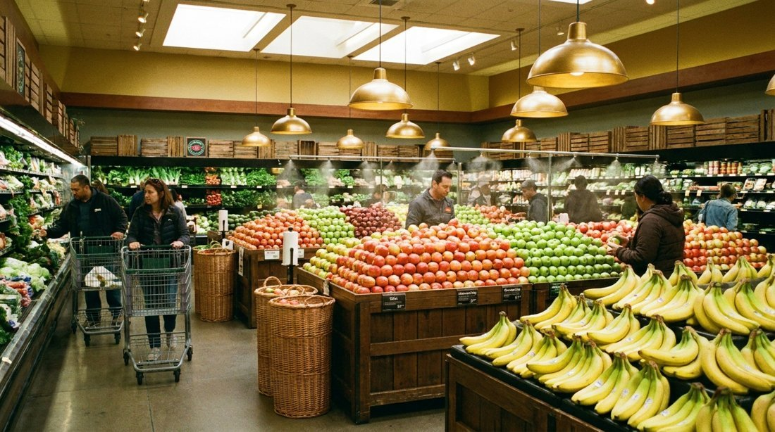
DAY 10
SCENE
Eva and Noah are at the grocery store.
What should they buy — apples 🍎 or bananas 🍌?

