Slide 1
M U R R A Y ' S E N G L I S H
THE BIG GAME SHOW! 🎪
One round for every day you conquered
DAY 11
murraycohen.com
Notes:
🎙️ SCRIPT — read aloud:
Welcome to THE BIG GAME SHOW! This is the big celebration — one round for every single day you conquered. I'll ask, you answer out loud, then we reveal it together. No pressure, all fun. You know more than you think. Let's play!

Slide 2
DAY 1
ROUND 1
🌙
Which letter says /mmm/
✅ m
Notes:
🎙️ SCRIPT — read aloud:
Round one — from Day One, where it all began. Letter sounds. Here's the sound: /mmm/. Which letter says /mmm/? Say it out loud. (pause)

Slide 3
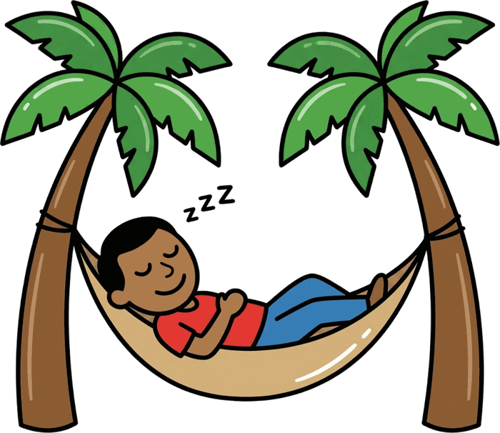
DAY 2
ROUND 2
I say /n/ /æ/ /p/ — what's the word?
✅ nap
Notes:
🎙️ SCRIPT — read aloud:
Round two — from Day Two. Blending! I'll say three sounds slowly, and you blend them into a word. Listen: /n/ … /æ/ … /p/. What's the word? Say it. (pause)

Slide 4

DAY 3
ROUND 3
can + magic e =
✅ cane
Notes:
🎙️ SCRIPT — read aloud:
Round three — Day Three. The magic e! Take the word 'can,' and add a magic e on the end. What does it become? Say it. (pause) And quick — what sound does the e itself make? (pause) Nothing! It's silent. It just does its magic.

Slide 5
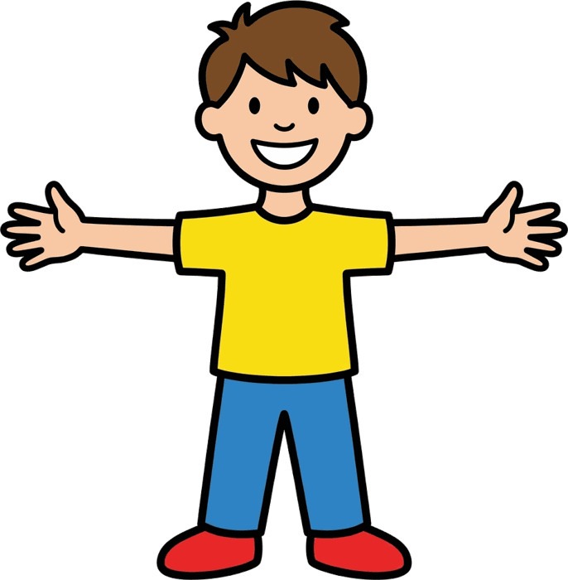
DAY 4
ROUND 4
Which is LONG — 1 or 2? cap … cape
✅ 2
Notes:
🎙️ SCRIPT — read aloud:
Round four — Day Four. Long versus short. Listen to both words: cap … cape. Which one is LONG — number one, or number two? (pause)

Slide 6
DAY 5
ROUND 5
🍉
Clap it — say the beats: watermelon
✅ 4
Notes:
🎙️ SCRIPT — read aloud:
Round five — Day Five. Clap it out! Here's the word: watermelon. Clap the beats and tell me how many. (pause)

Slide 7
DAY 6
ROUND 6
🍌
beats + strong? banana
✅ 3, 2
Notes:
🎙️ SCRIPT — read aloud:
Round six — Day Six. Beats AND strong. The word is: banana. How many beats — and which one is the strong syllable? (pause)

Slide 8
DAY 7
ROUND 7
🚕
I say a word — cap or cab? (listen to the END!)
✅ cab — the buzzy end! 🐝
Notes:
🎙️ SCRIPT — read aloud:
Round seven — Day Seven. The throat trick! Listen to the END of the word. cap … or … cab? I'll say one: cab. Hand on your throat — quiet or buzzy? (pause) Now this one: cap. (pause)

Slide 9
DAY 8
ROUND 8
🫐
Which do you hear — 1 berry or 2 very?
✅ It's VERY!
Notes:
🎙️ SCRIPT — read aloud:
Round eight — Day Eight. Listening close. Watch my lips. Do you hear — one, 'berry' … or two, 'very'? I'll say one. (pause) Now here's another pair — wet … or vet? (pause)

Slide 10
DAY 9
ROUND 9
💻
Decode the lazy spelling: kuhm-PYOO-ter
✅ computer
Notes:
🎙️ SCRIPT — read aloud:
Round nine — Day Nine. The schwa decoder! Here's a word written the lazy way: kuhm-PYOO-ter. What's the real word? Say it. (pause)

Slide 11
DAY 10
ROUND 10
🤷
'I dunno' — what are the REAL words?
✅ I do not know
Notes:
🎙️ SCRIPT — read aloud:
Round ten — Day Ten. Fast English! Here's how real speech sounds: 'I dunno.' What are the real, full words? Say them. (pause)

Slide 12
🏆 YOU WON THE WHOLE COURSE!
Eleven days ago: letters. Today: ENGLISH.
Notes:
🎙️ SCRIPT — read aloud:
And that's the game. Look what just happened — eleven days ago, you were learning letters. Today, you're speaking ENGLISH. You won the whole course. (pause) And… there's one more thing. Have you met… CATMAN? Come with me.

